Slide 1
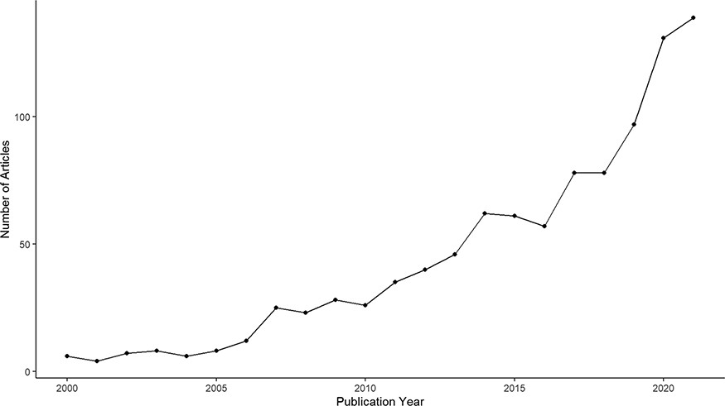
Figure 1. Annual publication of research articles containing the keyword ‘charismatic species’ between 2000 and 2021, ...
Notes:
Figure 1. Annual publication of research articles containing the keyword ‘charismatic species’ between 2000 and 2021, extracted from Clarivate Web of Science.
Unless provided in the caption above, the following copyright applies to the content of this slide: © The Author(s) 2023. Published by Oxford University Press.This is an Open Access article distributed under the terms of the Creative Commons Attribution License (https://creativecommons.org/licenses/by/4.0/), which permits unrestricted reuse, distribution, and reproduction in any medium, provided the original work is properly cited.

Slide 2
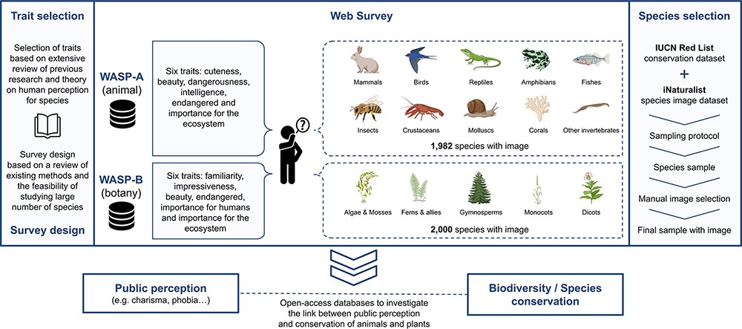
Figure 2. Schematic overview of the WASP surveys.
Notes:
Figure 2. Schematic overview of the WASP surveys.
Unless provided in the caption above, the following copyright applies to the content of this slide: © The Author(s) 2023. Published by Oxford University Press.This is an Open Access article distributed under the terms of the Creative Commons Attribution License (https://creativecommons.org/licenses/by/4.0/), which permits unrestricted reuse, distribution, and reproduction in any medium, provided the original work is properly cited.

Slide 3
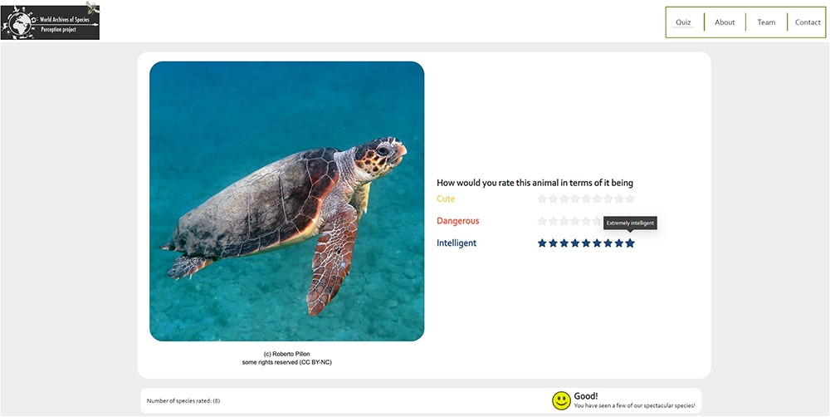
Figure 3. Snapshot of the WASP web survey.
Notes:
Figure 3. Snapshot of the WASP web survey.
Unless provided in the caption above, the following copyright applies to the content of this slide: © The Author(s) 2023. Published by Oxford University Press.This is an Open Access article distributed under the terms of the Creative Commons Attribution License (https://creativecommons.org/licenses/by/4.0/), which permits unrestricted reuse, distribution, and reproduction in any medium, provided the original work is properly cited.

Slide 4
Figure 5. Image selection criteria.
Notes:
Figure 5. Image selection criteria.
Unless provided in the caption above, the following copyright applies to the content of this slide: © The Author(s) 2023. Published by Oxford University Press.This is an Open Access article distributed under the terms of the Creative Commons Attribution License (https://creativecommons.org/licenses/by/4.0/), which permits unrestricted reuse, distribution, and reproduction in any medium, provided the original work is properly cited.

Slide 5
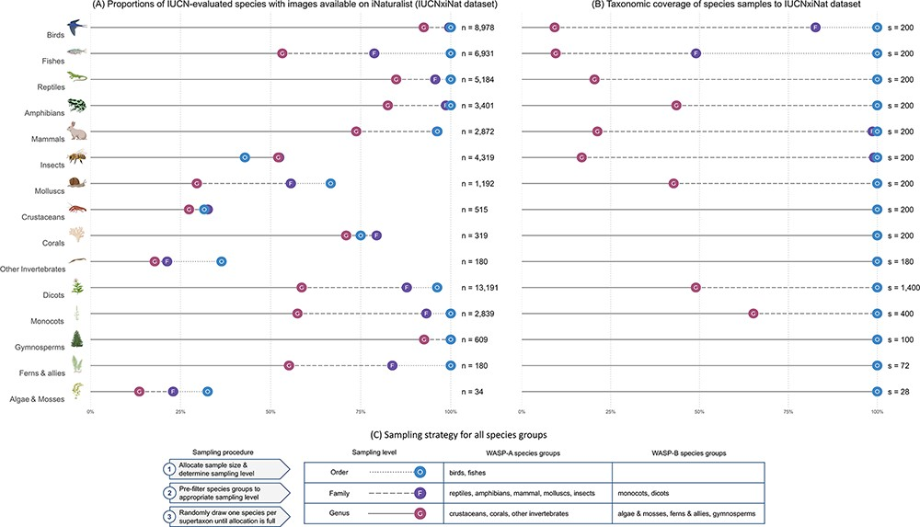
Figure 4. (A) Summary statistics of the IUCNxiNat species dataset presenting the proportions of species evaluated under ...
Notes:
Figure 4. (A) Summary statistics of the IUCNxiNat species dataset presenting the proportions of species evaluated under the IUCN Red List with images available on iNaturalist (left). (B) Taxonomic coverage of the species sample resulting from our sampling strategy to the IUCNxiNat dataset (right). (C) Sampling strategy chosen for all species groups in WASP-A and WASP-B surveys (bottom). The y-axis represents the species groups, each marked with an illustrative icon. The x-axis represents a measure of proportion, or coverage, in percentage. Values are expressed in terms of various taxonomic ranks, including genus (denoted as G with solid line), family (denoted as F with dashed line) and order (denoted as O with dotted line) levels.
Unless provided in the caption above, the following copyright applies to the content of this slide: © The Author(s) 2023. Published by Oxford University Press.This is an Open Access article distributed under the terms of the Creative Commons Attribution License (https://creativecommons.org/licenses/by/4.0/), which permits unrestricted reuse, distribution, and reproduction in any medium, provided the original work is properly cited.

Slide 6
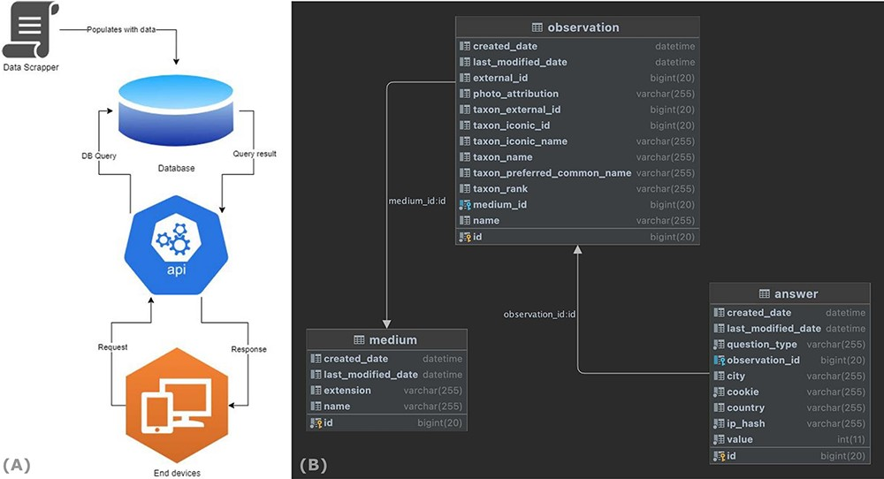
Figure 6. End-to-end data flow of the WASP web surveys.
Notes:
Figure 6. End-to-end data flow of the WASP web surveys.
Unless provided in the caption above, the following copyright applies to the content of this slide: © The Author(s) 2023. Published by Oxford University Press.This is an Open Access article distributed under the terms of the Creative Commons Attribution License (https://creativecommons.org/licenses/by/4.0/), which permits unrestricted reuse, distribution, and reproduction in any medium, provided the original work is properly cited.

Slide 7
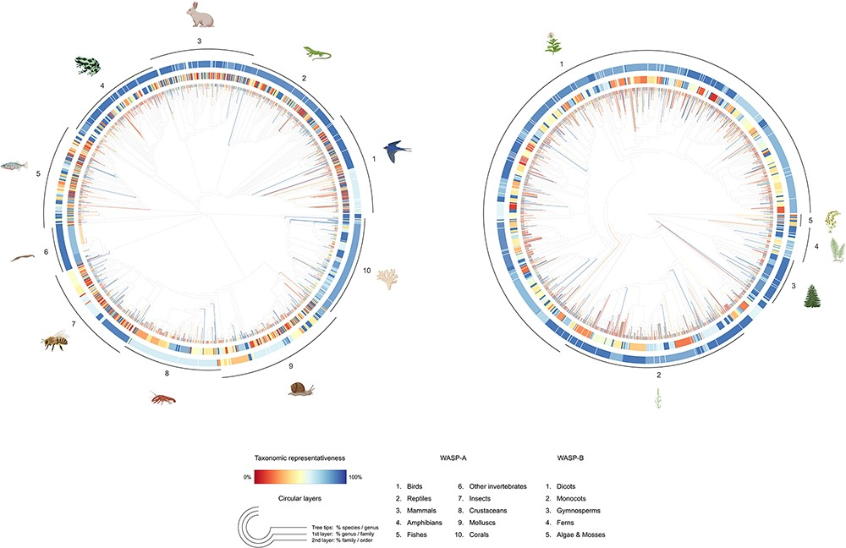
Figure 7. Tree-like structure illustrating the taxonomic representativeness of the WASP-A (left) and WASP-B (right) ...
Notes:
Figure 7. Tree-like structure illustrating the taxonomic representativeness of the WASP-A (left) and WASP-B (right) species samples. Color scale explains the taxonomic representativeness (in percentage covered) compared to the IUCN Red List species. Colored tree tips show the percentage of species covered in our species sample, by genus; the first (inner) and second (outer) circular layers represent the genus-coverage by family and family-coverage by order, respectively. The synthetic tree–like structure was generated from the Open Tree of Life, using the R package ‘rotl’.
Unless provided in the caption above, the following copyright applies to the content of this slide: © The Author(s) 2023. Published by Oxford University Press.This is an Open Access article distributed under the terms of the Creative Commons Attribution License (https://creativecommons.org/licenses/by/4.0/), which permits unrestricted reuse, distribution, and reproduction in any medium, provided the original work is properly cited.

Slide 8
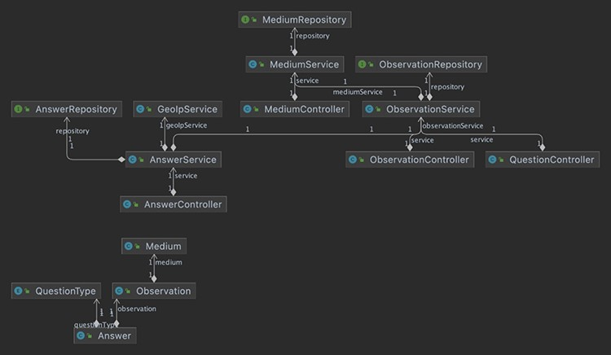
Figure A1. Business layer classes.
Notes:
Figure A1. Business layer classes.
Unless provided in the caption above, the following copyright applies to the content of this slide: © The Author(s) 2023. Published by Oxford University Press.This is an Open Access article distributed under the terms of the Creative Commons Attribution License (https://creativecommons.org/licenses/by/4.0/), which permits unrestricted reuse, distribution, and reproduction in any medium, provided the original work is properly cited.

