Slide 1
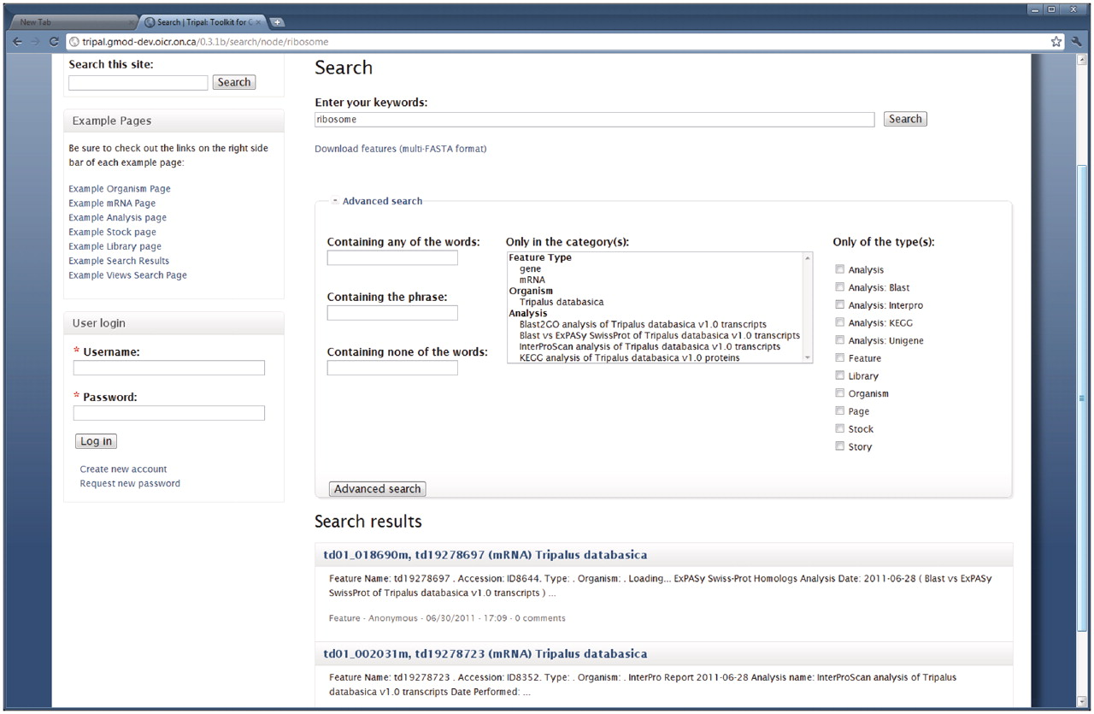
Figure 10. Full-text search page. Drupal provides a full-text searching mechanism which Tripal supports for searching ...
Notes:
Figure 10. Full-text search page. Drupal provides a full-text searching mechanism which Tripal supports for searching Chado content. The search page can be found by using the search box in the top right corner on the example website. In this example a search for the term ‘ribosome’ yielded two mRNA results. An advanced search field set is also available and shown expanded. This allows visitors to filter searches by a specific organism, feature type, analysis or Drupal content type (shown in the list along the right hand side). Users can download a FASTA file of search results by clicking the ‘Download features’ link near the top of the search page.
Unless provided in the caption above, the following copyright applies to the content of this slide: © The Author(s) 2011. Published by Oxford University Press.This is an Open Access article distributed under the terms of the Creative Commons Attribution Non-Commercial License (http://creativecommons.org/licenses/by-nc/3.0), which permits unrestricted non-commercial use, distribution, and reproduction in any medium, provided the original work is properly cited.

