Slide 1
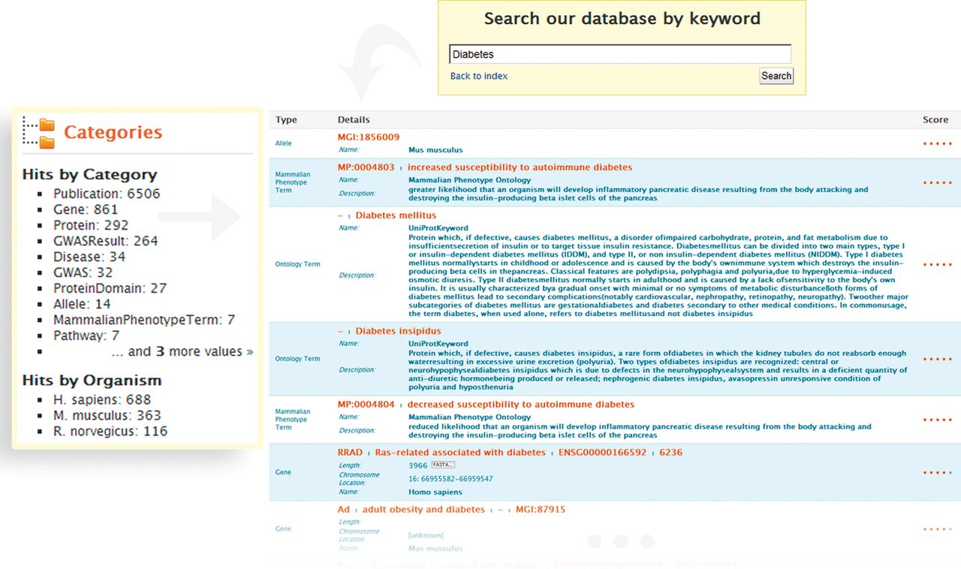
Figure 1. Keyword search and faceted results filtering in metabolicMine. A researcher conducts a broad keyword search ...
Notes:
Figure 1. Keyword search and faceted results filtering in metabolicMine. A researcher conducts a broad keyword search with the word ‘Diabetes’. The search engine operates across all data fields, and a category filter shows the different data types matching the search terms (e.g. Gene, Protein, GO Term or GWAS). The Lucene indexing library generates a score from 0 to 1 for the keyword search, based on how closely the search term matched what is in the search index. The results can then be refined by Category (by selecting, for example, ‘Gene’ or Publication) or by Organism (human, rat or mouse).
Unless provided in the caption above, the following copyright applies to the content of this slide: © Crown copyright 2013.

Slide 2
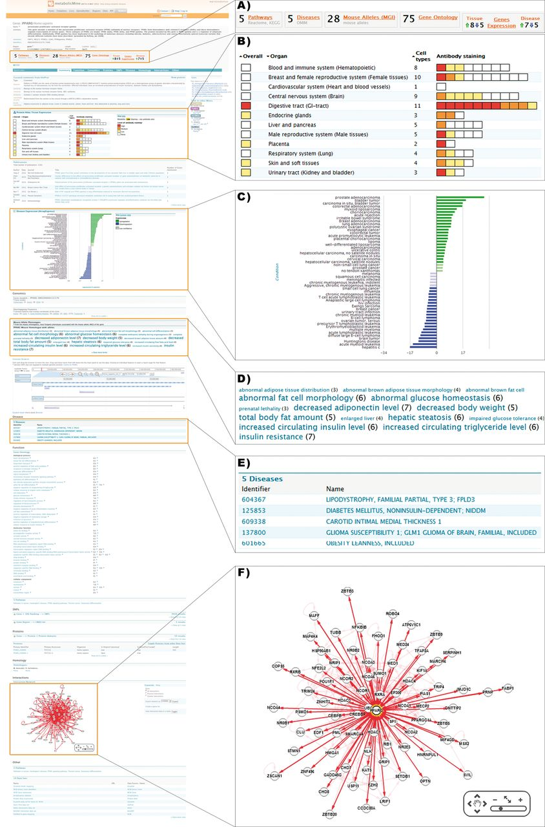
Figure 2. Detailed view of a metabolicMine gene report page, focusing on the gene PPARG. Report pages collate ...
Notes:
Figure 2. Detailed view of a metabolicMine gene report page, focusing on the gene PPARG. Report pages collate information from a range of data sets and include visualization tools and further links. (A) Previews provide summary counts for key data sets, helping the user identify relevant information. (B) Heatmaps are used to indicate PPARG protein levels in different tissues based on staining results in Protein Atlas. (C) Disease expression data from ArrayExpress is visualized, enabling exploration of links with different diseases. (D) The phenotype Tag Cloud is associated with the available alleles of the mouse PPARG homologue, enabling researchers to find interesting mouse strains for further experiments. Phenotypes with more alleles are displayed more prominently. (E) Human disease associations are summarized in tabular form and hyperlinked to the relevant report pages. (F) An interactive graphical tool enables exploration of PPARG's interactions with other genes, generated using data from IntAct and BioGRID.
Unless provided in the caption above, the following copyright applies to the content of this slide: © Crown copyright 2013.

Slide 3
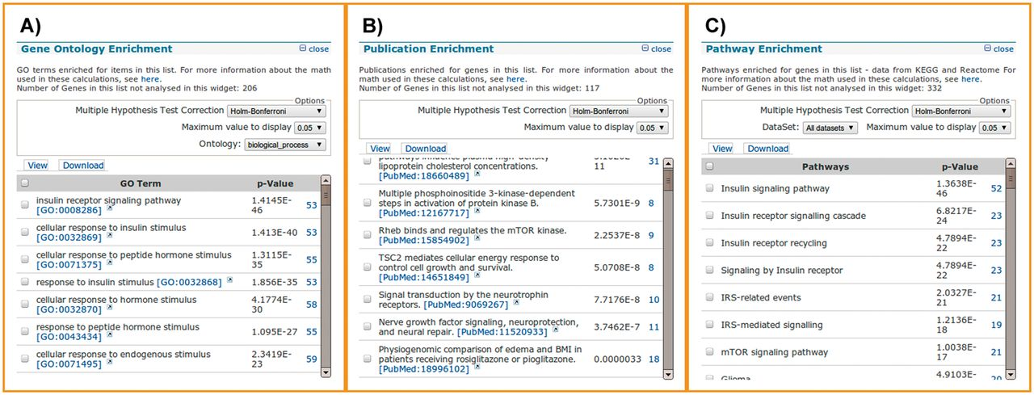
Figure 3. List analysis tools. List analysis pages contain a number of graphical and statistical analysis tools ...
Notes:
Figure 3. List analysis tools. List analysis pages contain a number of graphical and statistical analysis tools (‘widgets’). Here, we show examples of the tools available, using 450 randomly selected genes with 50 insulin receptor signalling pathway genes spiked in. (A) The GO enrichment analysis correctly identifies the 50 genes involved in the insulin receptor signalling pathway, along with 3 others that happened to be in the random gene list. (B) The publication enrichment widget identifies a number of articles describing members of the insulin signalling cascade, such as PI3 kinase and mTOR. (C) The pathway enrichment widget identifies the insulin signalling pathway from KEGG as the top result. This highlights how list analysis can be used to identify relevant target genes from a larger original gene set, for instance, one derived from a gene expression study.
Unless provided in the caption above, the following copyright applies to the content of this slide: © Crown copyright 2013.

Slide 4
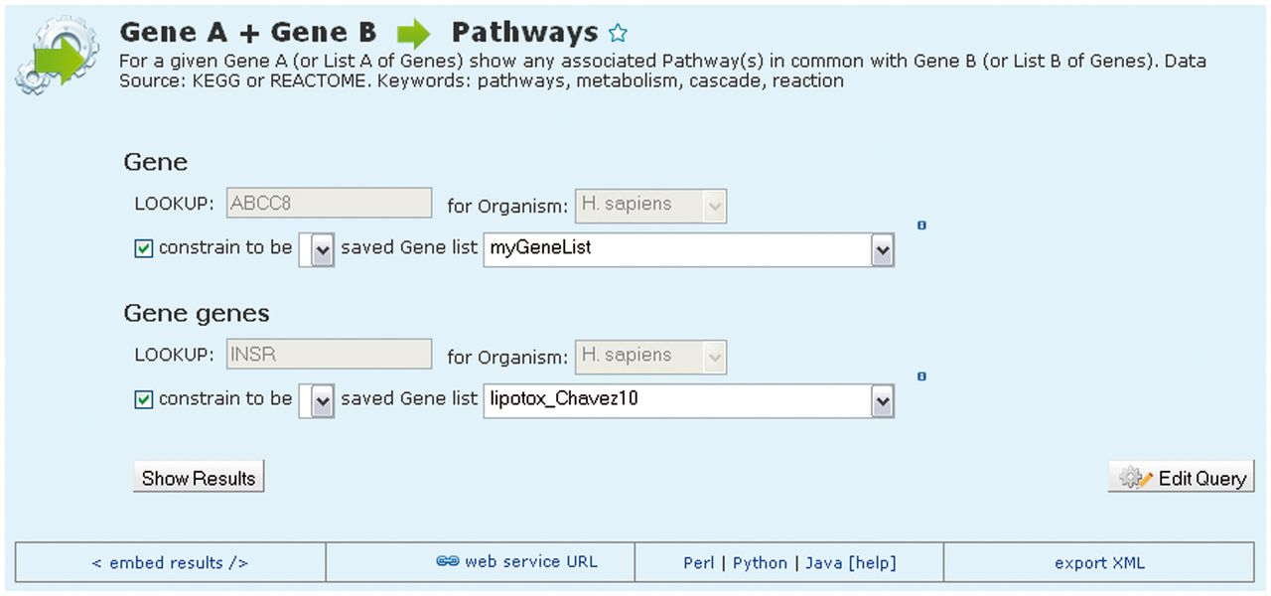
Figure 4. An example template search. MetabolicMine includes a library of template search forms—predefined searches ...
Notes:
Figure 4. An example template search. MetabolicMine includes a library of template search forms—predefined searches designed to perform a particular task. Each one contains a description and a form, with default values, to fill in. In this example, the template compares two lists of genes and shows which genes from the two lists are members of the same pathway(s). Users can also modify templates and create their own using the QueryBuilder.
Unless provided in the caption above, the following copyright applies to the content of this slide: © Crown copyright 2013.

Slide 5
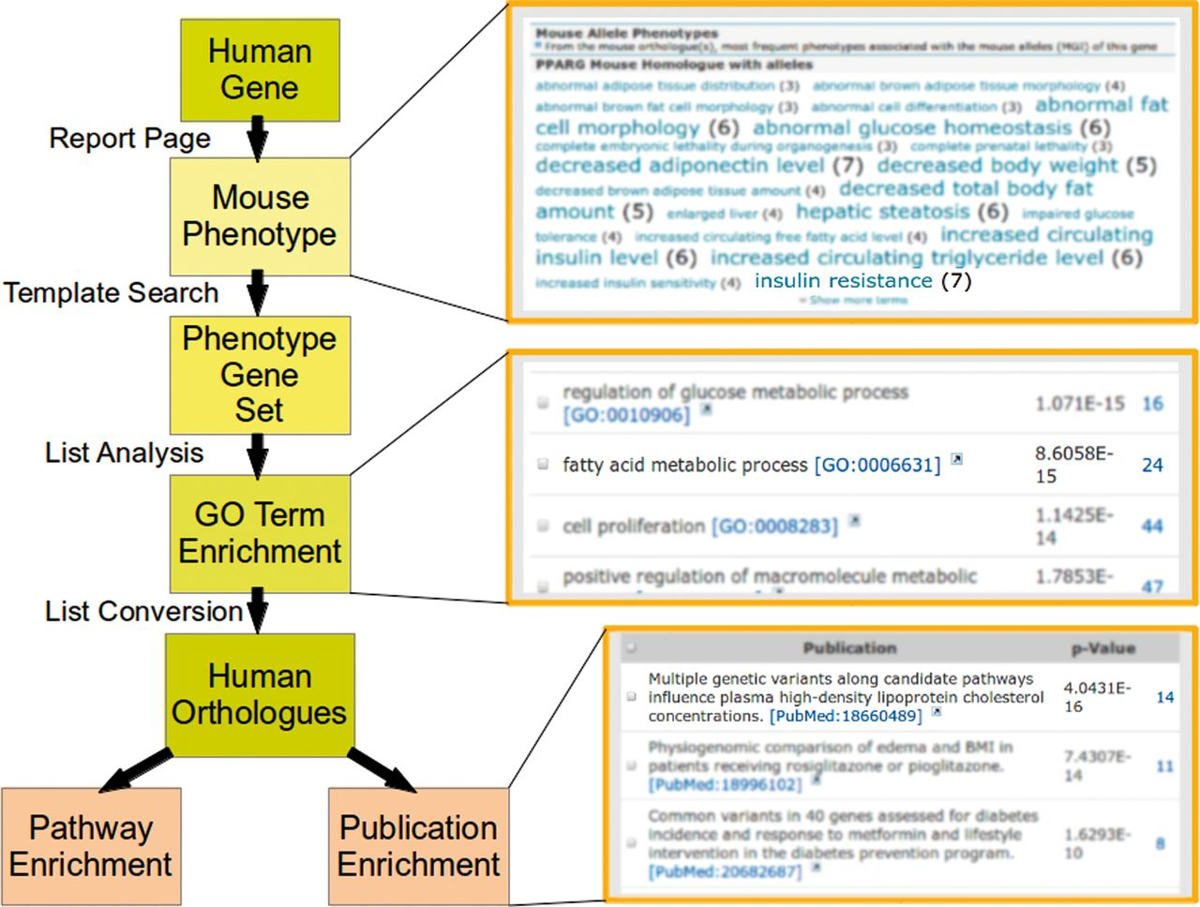
Figure 5. Using metabolicMine to uncover additional candidate genes. A researcher viewing the human PPARG gene report ...
Notes:
Figure 5. Using metabolicMine to uncover additional candidate genes. A researcher viewing the human PPARG gene report page finds mouse alleles with an insulin resistance phenotype. Conducting a template search (Phenotype → Alleles) using this phenotype term identifies 133 mouse genes sharing this phenotype, which can be saved as a list. The list is presented on a list analysis page that automatically runs a number of enrichment algorithms on the data. The GO enrichment widget identifies a subset of 26 genes involved in fatty acid metabolic process [GO:0006631] (P < 1.3E-15) that can be saved as a new list. Converting this list to their human orthologues shows enrichment for the adipocytokine signalling pathway. In addition, the top hit from the publications enrichment widget describes human genes associated with high-density lipoprotein cholesterol (HDL-C). Together, these provide the researcher with additional candidate targets for exploring interventions for insulin resistance and dyslipidaemia.
Unless provided in the caption above, the following copyright applies to the content of this slide: © Crown copyright 2013.

Slide 6
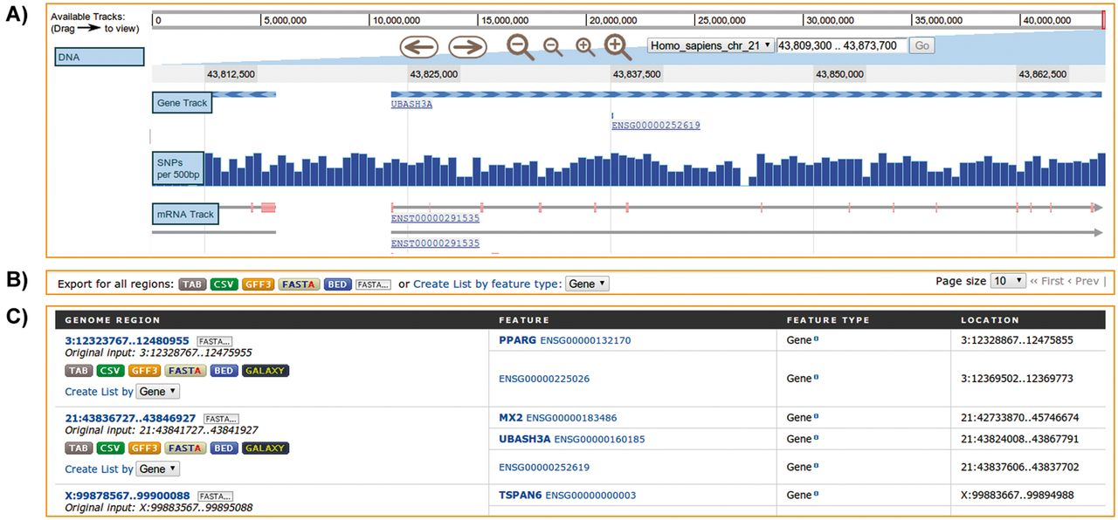
Figure 6. Regions Search. Analysis of genomic intervals using metabolicMine’s regions search, showing gene feature ...
Notes:
Figure 6. Regions Search. Analysis of genomic intervals using metabolicMine’s regions search, showing gene feature results from an uploaded list of genomic regions. (A) The embedded interactive genome browser allows a visual exploration of the results. (B) The results can be exported in a range of formats, including TAB, CSV, GFF, BED and FASTA. (C) The table displays results hyperlinked to individual report pages.
Unless provided in the caption above, the following copyright applies to the content of this slide: © Crown copyright 2013.

