Slide 1
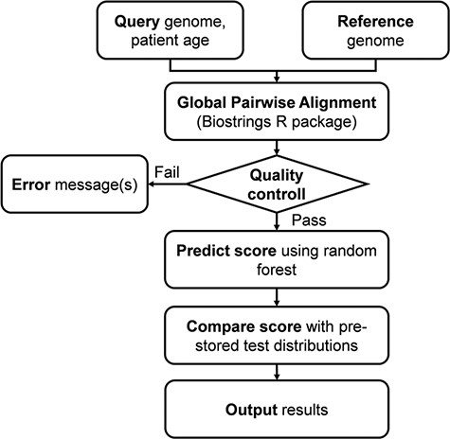
Figure 1. Flowchart of the online analysis platform. Quality control includes checking the number of identities with ...
Notes:
Figure 1. Flowchart of the online analysis platform. Quality control includes checking the number of identities with the Wuhan strain (min. 90%), genome length (29 000 < length < 40 000), GC contents (37% < GC < 39%) and number of uncertain (‘N’) characters (max 2%).
Unless provided in the caption above, the following copyright applies to the content of this slide: © The Author(s) 2021. Published by Oxford University Press.This is an Open Access article distributed under the terms of the Creative Commons Attribution License (http://creativecommons.org/licenses/by/4.0/), which permits unrestricted reuse, distribution, and reproduction in any medium, provided the original work is properly cited.

