Slide 1
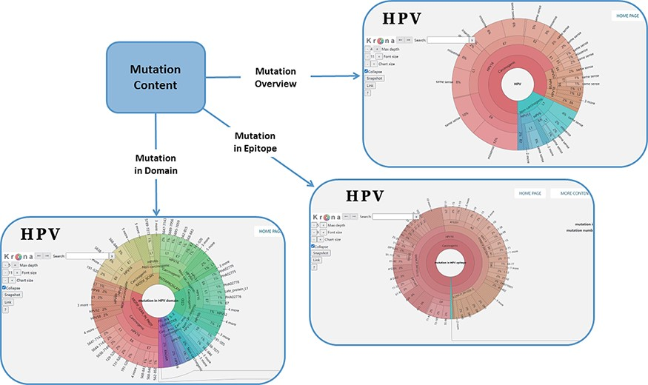
Figure 2. Distribution of mutation content among the whole sequences, the domains and the epitopes; the parameters on ...
Notes:
Figure 2. Distribution of mutation content among the whole sequences, the domains and the epitopes; the parameters on the left can adjust the display of the pie chart.
Unless provided in the caption above, the following copyright applies to the content of this slide: © The Author(s) 2022. Published by Oxford University Press.This is an Open Access article distributed under the terms of the Creative Commons Attribution License (https://creativecommons.org/licenses/by/4.0/), which permits unrestricted reuse, distribution, and reproduction in any medium, provided the original work is properly cited.

