Slide 1
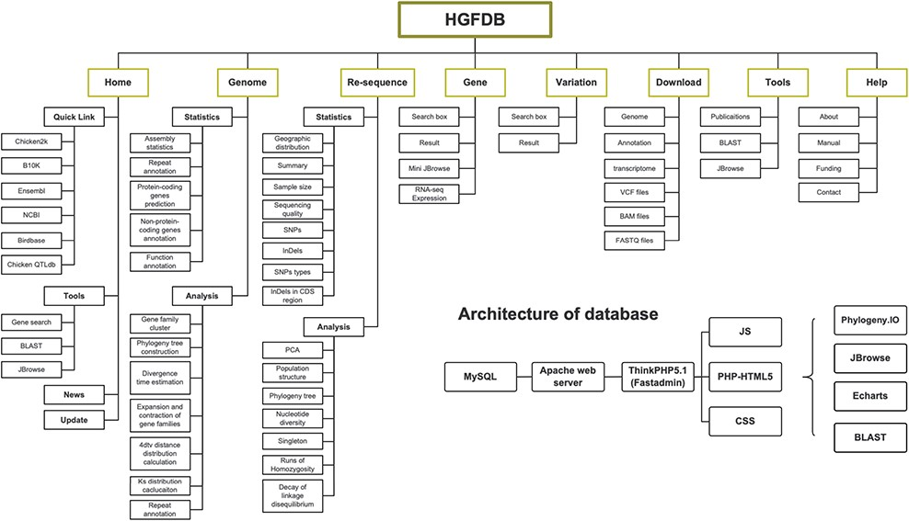
Figure 1. Framework of HGFDB. Eight main modules are highlighted in the dark yellow boxes. The corresponding contents ...
Notes:
Figure 1. Framework of HGFDB. Eight main modules are highlighted in the dark yellow boxes. The corresponding contents of each module are listed below. The bottom right shows the architecture of HGFDB.
Unless provided in the caption above, the following copyright applies to the content of this slide: © The Author(s) 2021. Published by Oxford University Press.This is an Open Access article distributed under the terms of the Creative Commons Attribution License (http://creativecommons.org/licenses/by/4.0/), which permits unrestricted reuse, distribution, and reproduction in any medium, provided the original work is properly cited.

