Slide 1
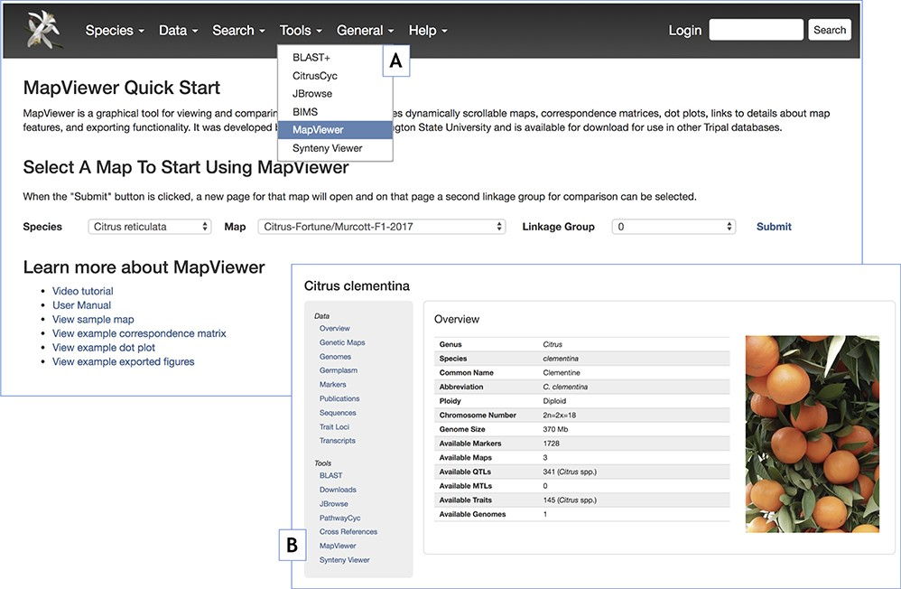
Figure 9 MapViewer Quick Start landing page introducing MapViewer functionality and providing usage instructions and ...
Notes:
Figure 9 MapViewer Quick Start landing page introducing MapViewer functionality and providing usage instructions and examples. A. Tools menu reference to the MapViewer landing page. B. Reference to the MapViewer landing page through the table of contents side panel in the Tripal Organism or Species pages.
Unless provided in the caption above, the following copyright applies to the content of this slide: © The Author(s) 2019. Published by Oxford University Press.This work is written by US Government employees and is in the public domain in the US.

