Slide 1
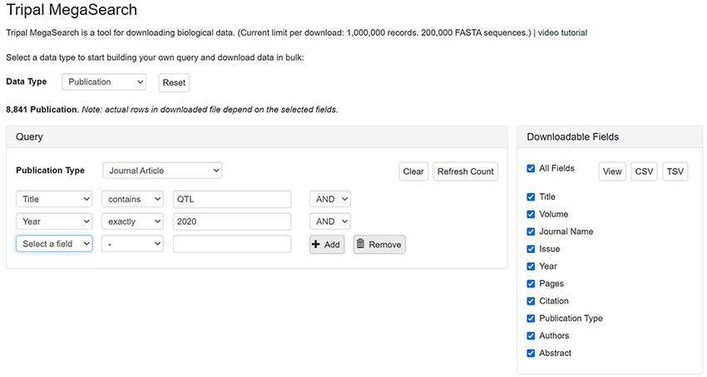
Figure 3. An example interface of flexible dynamic query forms of Tripal MegaSearch. The filters, pre-populated with ...
Notes:
Figure 3. An example interface of flexible dynamic query forms of Tripal MegaSearch. The filters, pre-populated with values mapped to the underlying data source columns, can be added dynamically in this type of interface.
Unless provided in the caption above, the following copyright applies to the content of this slide: © The Author(s) 2021. Published by Oxford University Press.This is an Open Access article distributed under the terms of the Creative Commons Attribution License (http://creativecommons.org/licenses/by/4.0/), which permits unrestricted reuse, distribution, and reproduction in any medium, provided the original work is properly cited.

