Slide 1
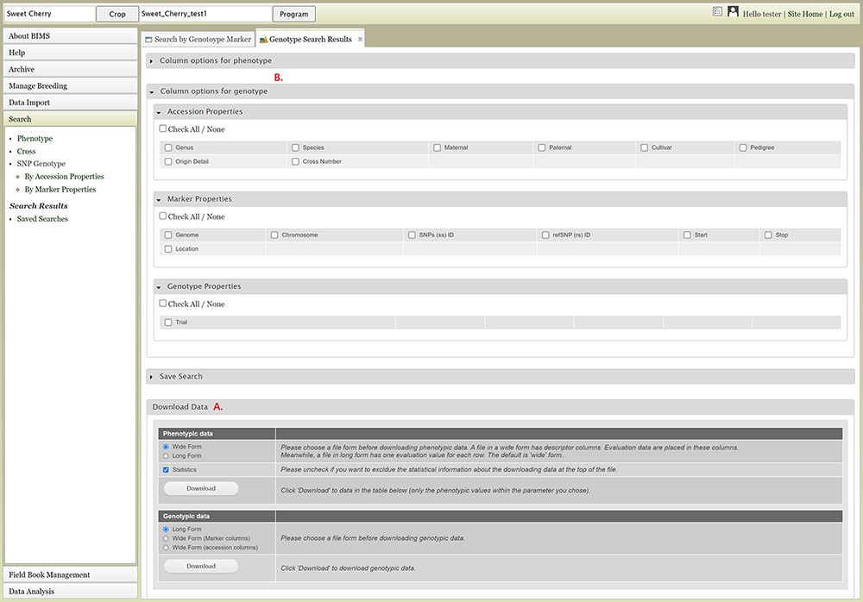
Figure 14. Genotype Search Results tab. A. Download Data section where users can download phenotype data as well as ...
Notes:
Figure 14. Genotype Search Results tab. A. Download Data section where users can download phenotype data as well as genotype data when the data is available. B. Column options section where users can add columns either for phenotype or genotype data. C. Link to the account page where users can access the downloaded data files.
Unless provided in the caption above, the following copyright applies to the content of this slide: © The Author(s) 2021. Published by Oxford University Press.This is an Open Access article distributed under the terms of the Creative Commons Attribution License (http://creativecommons.org/licenses/by/4.0/), which permits unrestricted reuse, distribution, and reproduction in any medium, provided the original work is properly cited.

