Slide 1
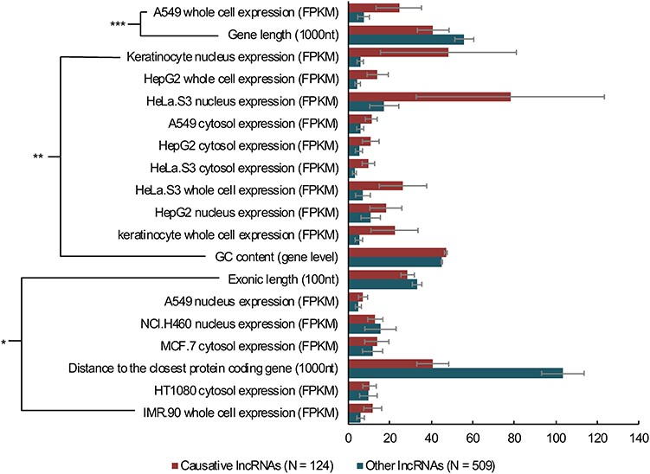
Figure 3 The comparisons between causative and other human lncRNAs. Wilcoxon rank-sum tests were performed on the ...
Notes:
Figure 3 The comparisons between causative and other human lncRNAs. Wilcoxon rank-sum tests were performed on the webserver of LnCompare for comparison analyses of 124 causative human lncRNAs and 509 other (manually annotated as non-causative) human lncRNAs using 109 features. The analysis only performed on lncRNAs with Ensembl IDs. *P < 0.05, **P < 0.01, ***P < 0.001, error bars show the SEM.
Unless provided in the caption above, the following copyright applies to the content of this slide: © The Author(s) 2020. Published by Oxford University Press. All rights reserved. For Permissions, please email: journals.permissions@oup.comThis is an Open Access article distributed under the terms of the Creative Commons Attribution License (http://creativecommons.org/licenses/by/4.0/), which permits unrestricted reuse, distribution, and reproduction in any medium, provided the original work is properly cited.

