Slide 1
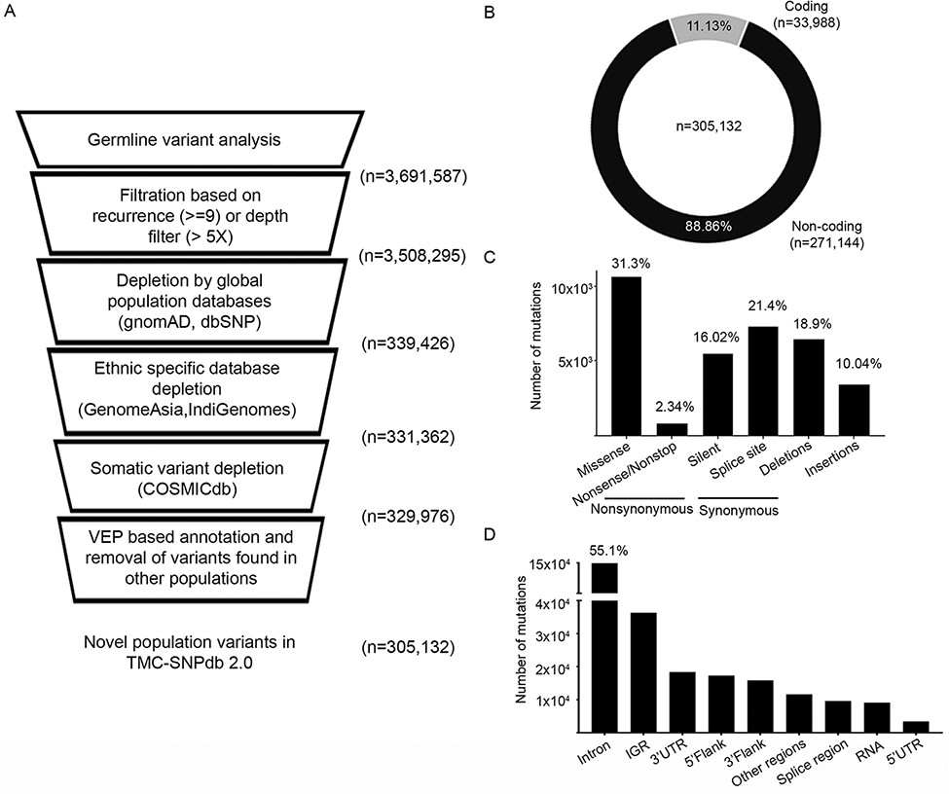
Figure 1. Development of TMC-SNPdb 2.0 and characteristic features of the variants in the database; A) schematic ...
Notes:
Figure 1. Development of TMC-SNPdb 2.0 and characteristic features of the variants in the database; A) schematic workflow of the steps in the development of the database; the raw variants obtained from the analysis of 173 normal samples were subject to quality/recurrence filter, followed by the depletion of variants found in germline and somatic databases to obtain novel germline variants; B) distribution of coding and non-coding variants; C) distribution of different types of synonymous variants, non-synonymous variants and INDELs; D) proportion of types of non-coding variants, identified in the TMC-SNPdb 2.0. IGR and RNA (in panel D) correspond to the intergenic and non-coding RNA variants in the database, respectively.
Unless provided in the caption above, the following copyright applies to the content of this slide: © The Author(s) 2022. Published by Oxford University Press.This is an Open Access article distributed under the terms of the Creative Commons Attribution-NonCommercial License (https://creativecommons.org/licenses/by-nc/4.0/), which permits non-commercial re-use, distribution, and reproduction in any medium, provided the original work is properly cited. For commercial re-use, please contact journals.permissions@oup.com

