Slide 1
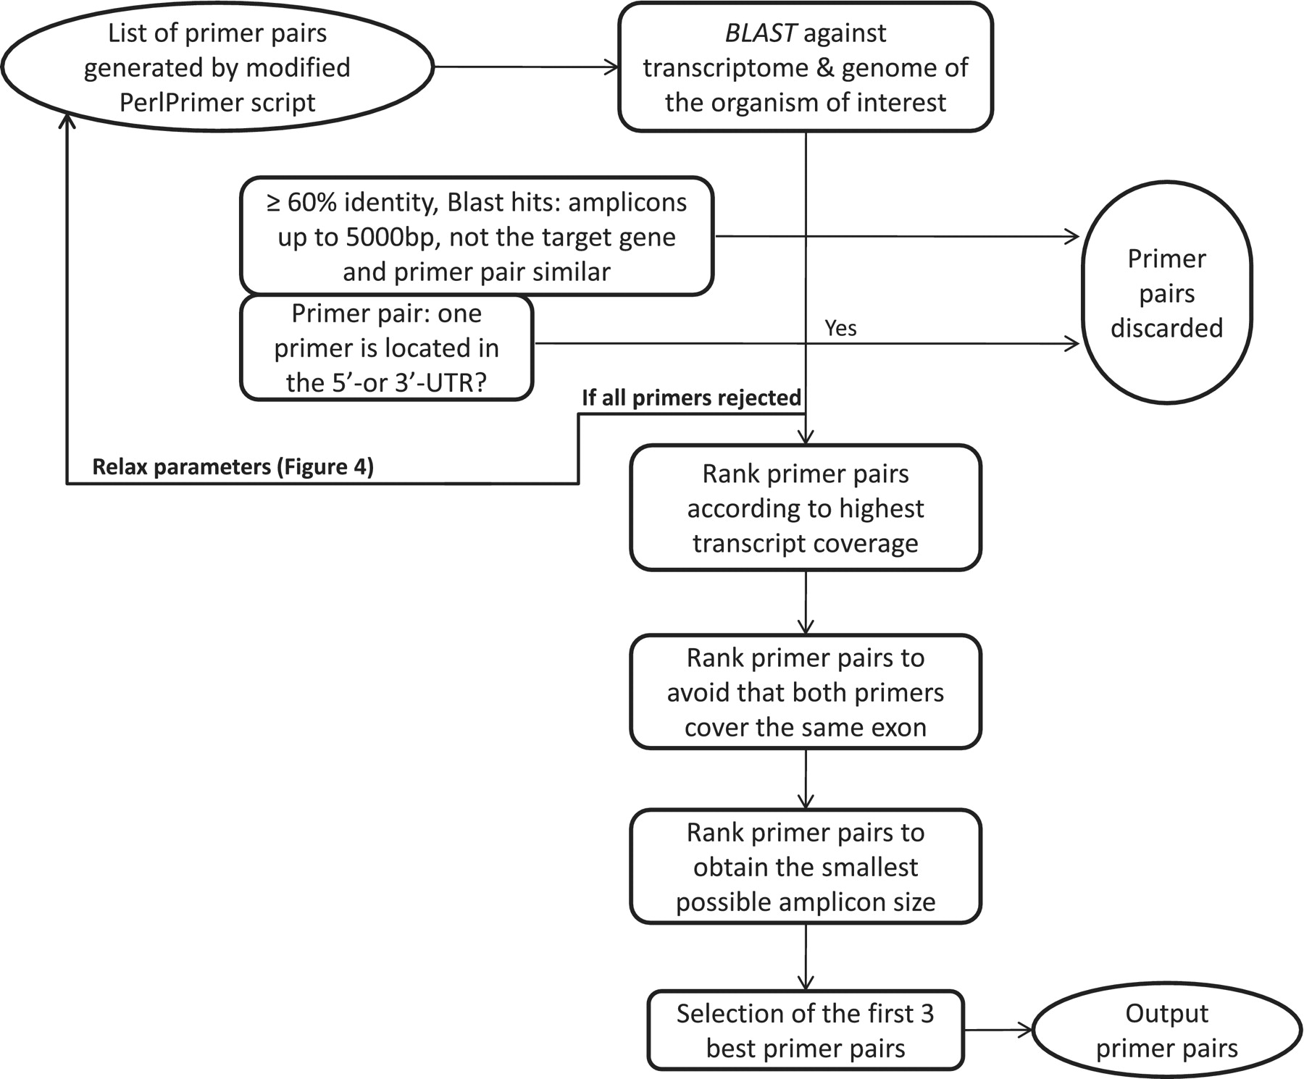
Figure 3. Workflow to select the best primer pairs. The selection of the best primer pairs is automated according to ...
Notes:
Figure 3. Workflow to select the best primer pairs. The selection of the best primer pairs is automated according to these hierarchical criteria. First, each primer pair is blasted and potentially discarded as described in the Figure and in the main text. Then, with the remaining primer pairs, pairs are discarded if at least one primer spans the 5′- or 3′-UTR. After these two stringent filtering steps, the remaining primers are ranked according to (i) highest transcript coverage, (ii) whether the primers are located within the same exon (not desirable) or not (desirable) and (iii) smallest amplicon size which has shown to be more optimal for qPCR efficiency and experimental variation (35).
Unless provided in the caption above, the following copyright applies to the content of this slide: © The Author(s) 2011. Published by Oxford University Press.This is Open Access article distributed under the terms of the Creative Commons Attribution Non-Commercial License (http://creativecommons.org/licenses/by-nc/2.5), which permits unrestricted non-commercial use, distribution, and reproduction in any medium, provided the original work is properly cited.

