Slide 1
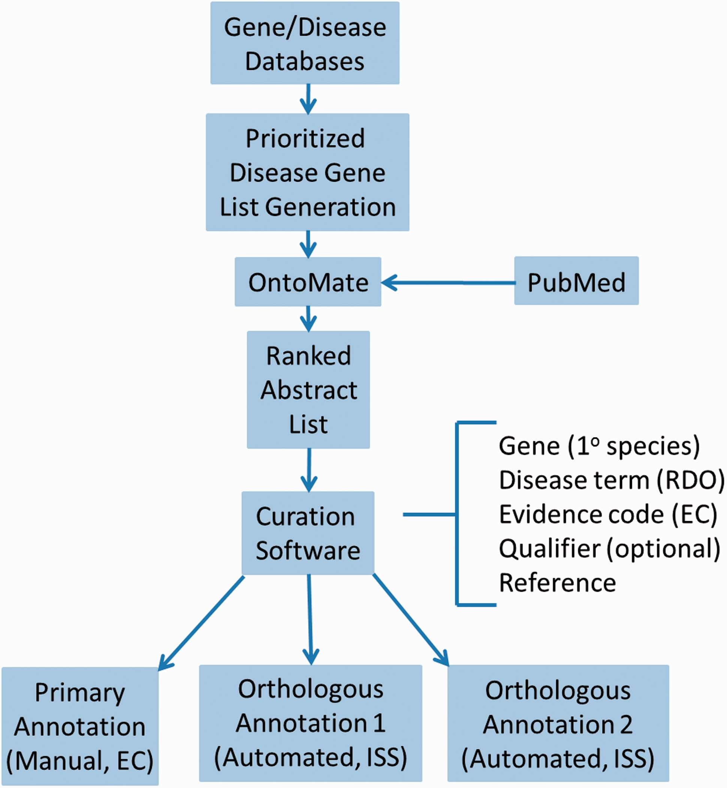
Figure 1. Disease curation flow diagram. Prioritized gene lists derived from disease databases are used to search ...
Notes:
Figure 1. Disease curation flow diagram. Prioritized gene lists derived from disease databases are used to search PubMed using the text mining tool OntoMate. The ranked abstract list obtained is manually curated to generate primary and orthologous annotations.
Unless provided in the caption above, the following copyright applies to the content of this slide: © The Author(s) 2016. Published by Oxford University Press. This is an Open Access article distributed under the terms of the Creative Commons Attribution License ( http://creativecommons.org/licenses/by/4.0/ ), which permits unrestricted reuse, distribution, and reproduction in any medium, provided the original work is properly cited.

Slide 2
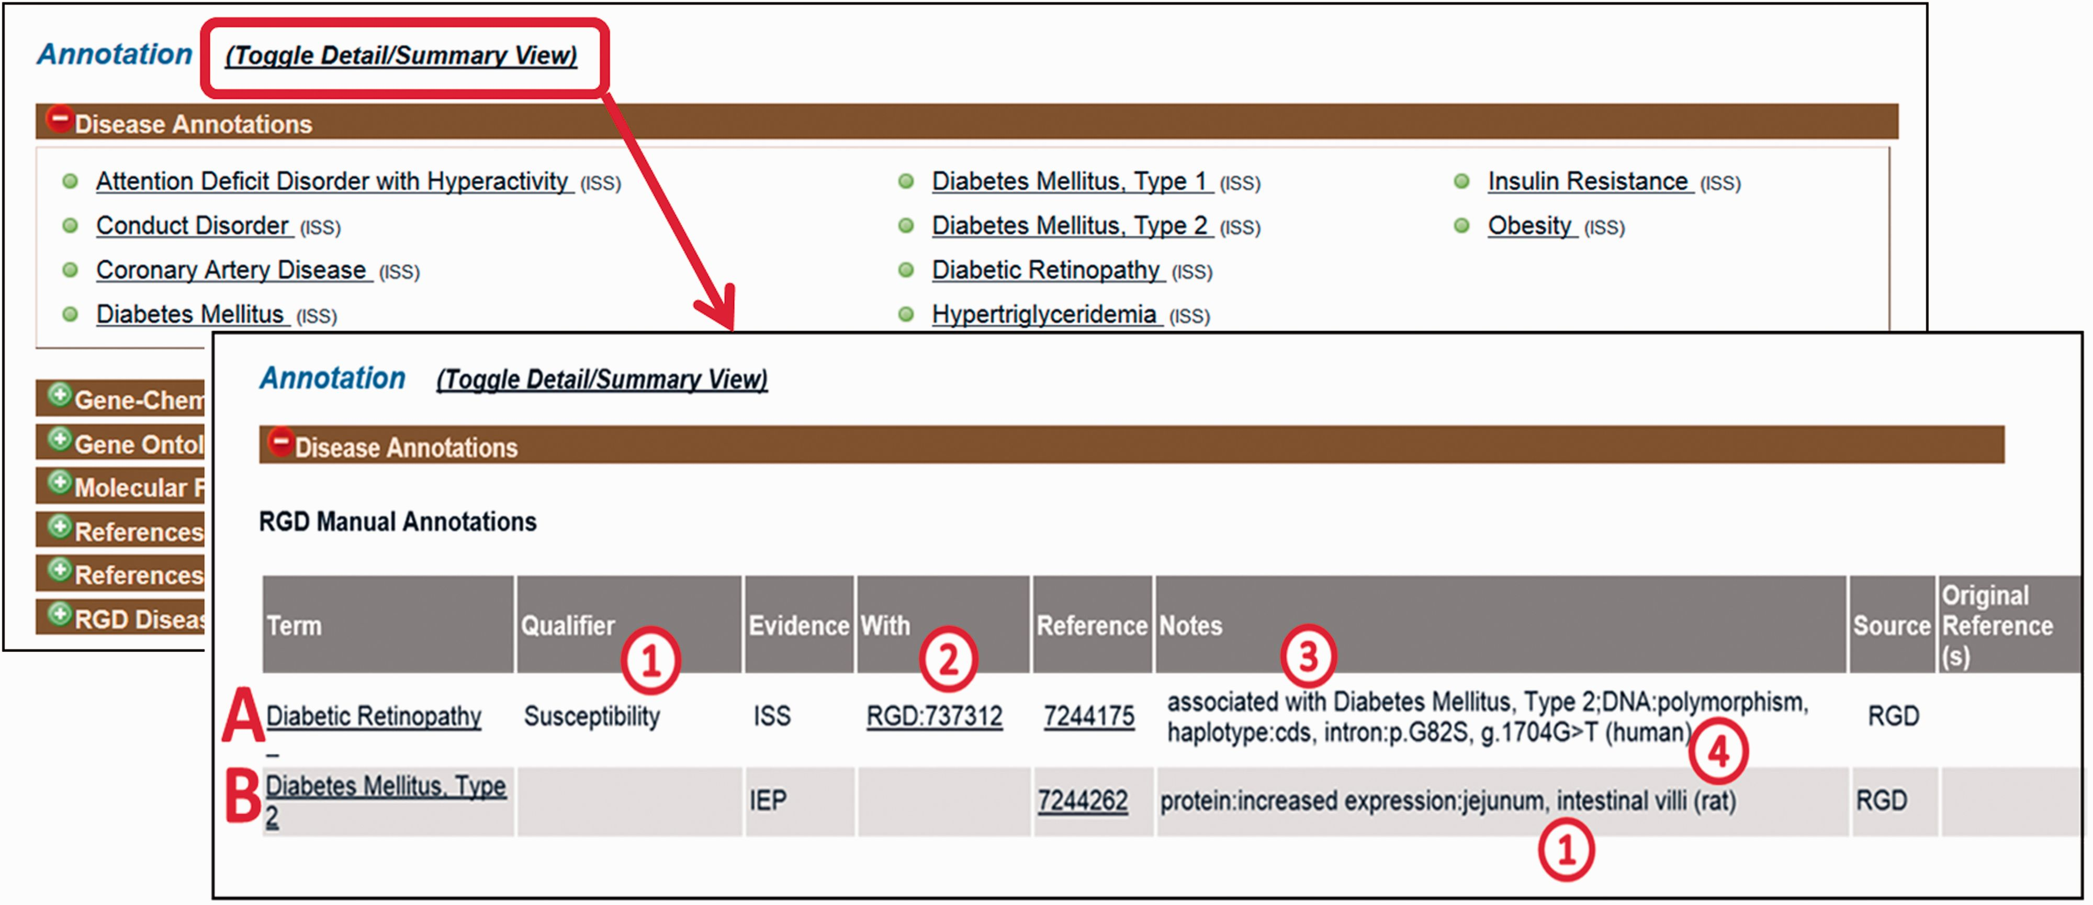
Figure 2. Disease annotation display examples. Shown fields are term, qualifier (A1), evidence code, “With” field (A2), ...
Notes:
Figure 2. Disease annotation display examples. Shown fields are term, qualifier (A1), evidence code, “With” field (A2), reference, “Notes” field composed of background disease field (A3), alteration level field, modifier field, location field (two entries, B1), free text field (A4).
Unless provided in the caption above, the following copyright applies to the content of this slide: © The Author(s) 2016. Published by Oxford University Press. This is an Open Access article distributed under the terms of the Creative Commons Attribution License ( http://creativecommons.org/licenses/by/4.0/ ), which permits unrestricted reuse, distribution, and reproduction in any medium, provided the original work is properly cited.

Slide 3
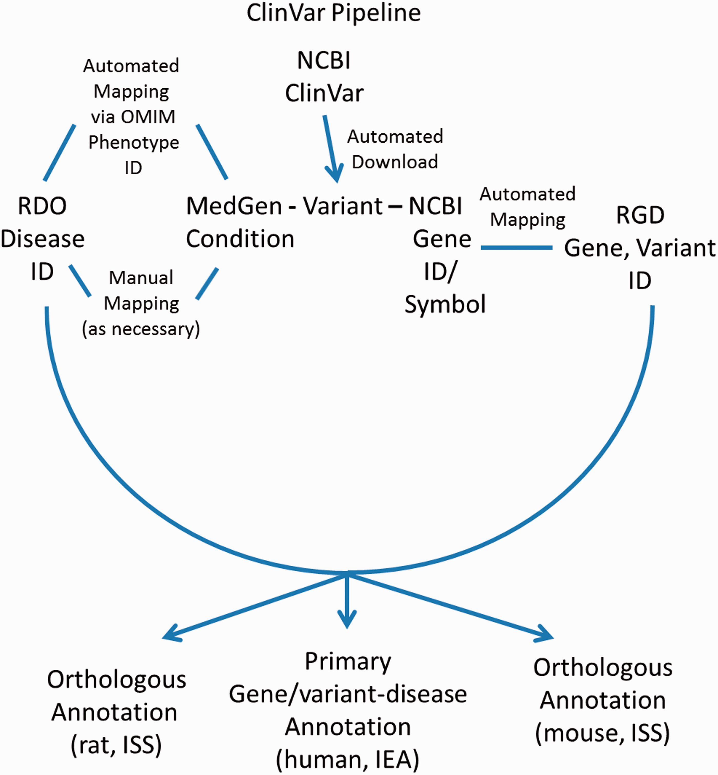
Figure 3. ClinVar Automated Import and Annotation Pipeline flow chart.
Notes:
Figure 3. ClinVar Automated Import and Annotation Pipeline flow chart.
Unless provided in the caption above, the following copyright applies to the content of this slide: © The Author(s) 2016. Published by Oxford University Press. This is an Open Access article distributed under the terms of the Creative Commons Attribution License ( http://creativecommons.org/licenses/by/4.0/ ), which permits unrestricted reuse, distribution, and reproduction in any medium, provided the original work is properly cited.

Slide 4
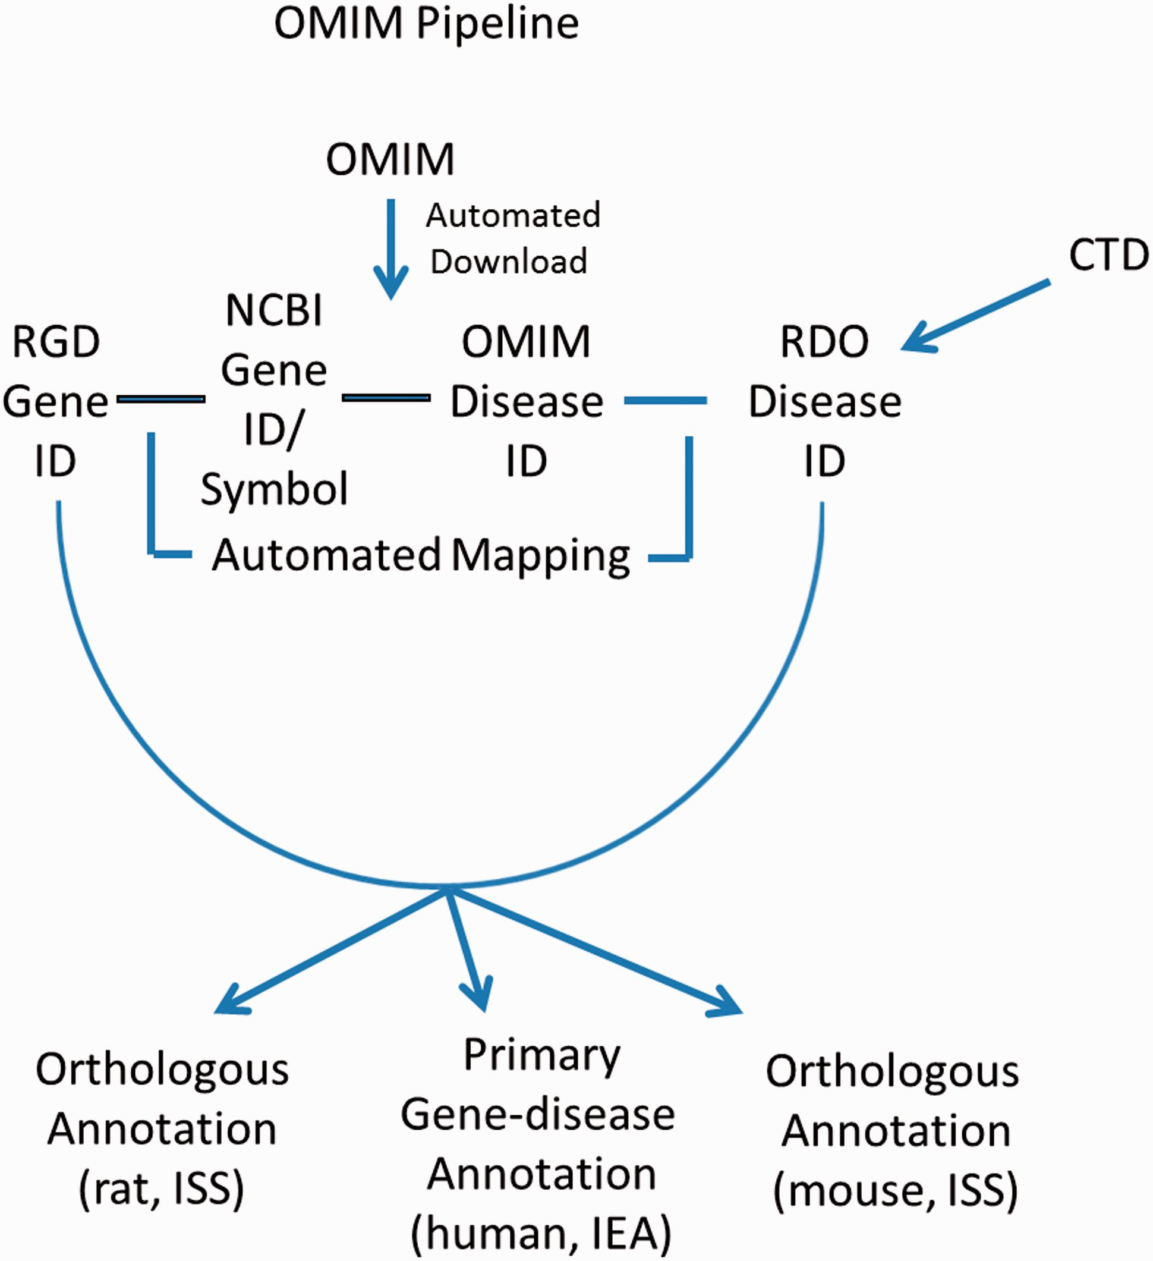
Figure 4. OMIM Disease Annotation Pipeline flow chart.
Notes:
Figure 4. OMIM Disease Annotation Pipeline flow chart.
Unless provided in the caption above, the following copyright applies to the content of this slide: © The Author(s) 2016. Published by Oxford University Press. This is an Open Access article distributed under the terms of the Creative Commons Attribution License ( http://creativecommons.org/licenses/by/4.0/ ), which permits unrestricted reuse, distribution, and reproduction in any medium, provided the original work is properly cited.

Slide 5
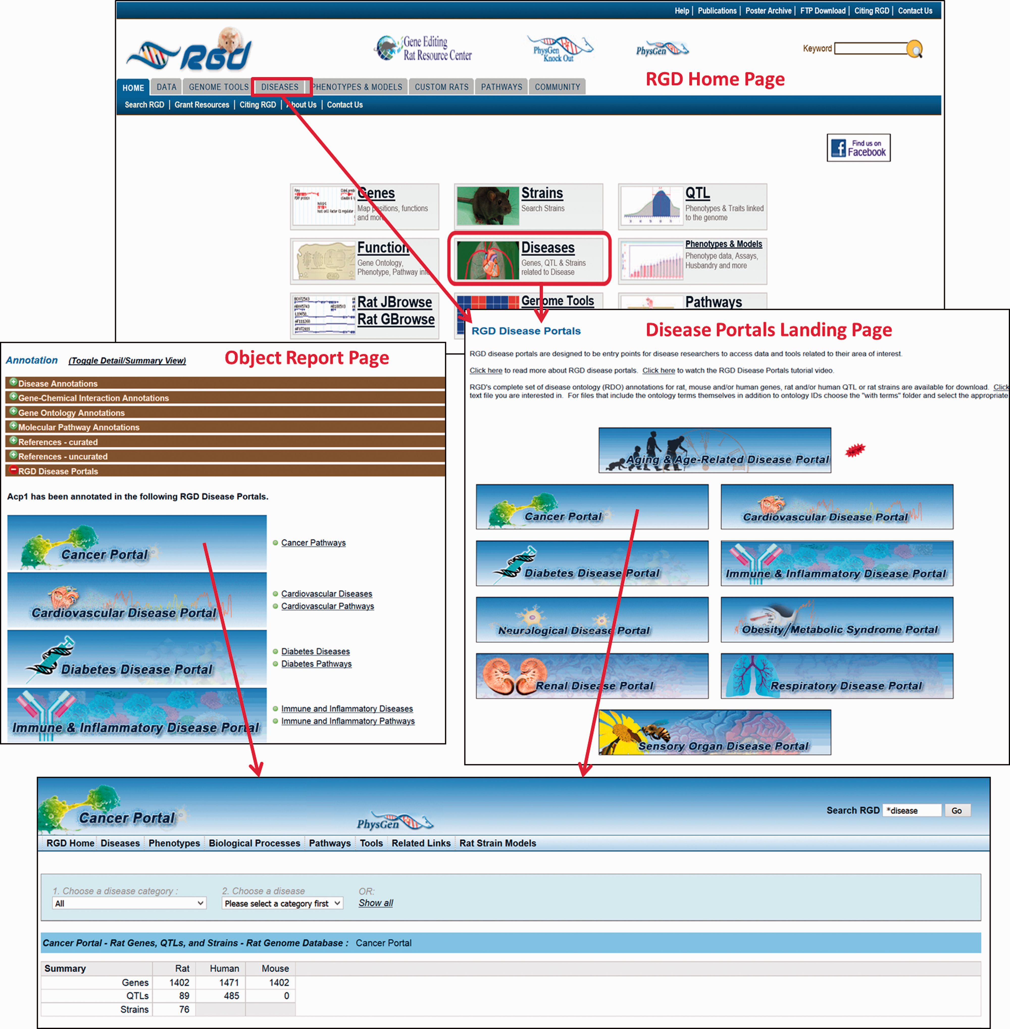
Figure 5. The RGD home page showing Disease Portal entry points. Disease Portals can be accessed via the landing page ...
Notes:
Figure 5. The RGD home page showing Disease Portal entry points. Disease Portals can be accessed via the landing page or object report pages.
Unless provided in the caption above, the following copyright applies to the content of this slide: © The Author(s) 2016. Published by Oxford University Press. This is an Open Access article distributed under the terms of the Creative Commons Attribution License ( http://creativecommons.org/licenses/by/4.0/ ), which permits unrestricted reuse, distribution, and reproduction in any medium, provided the original work is properly cited.

Slide 6
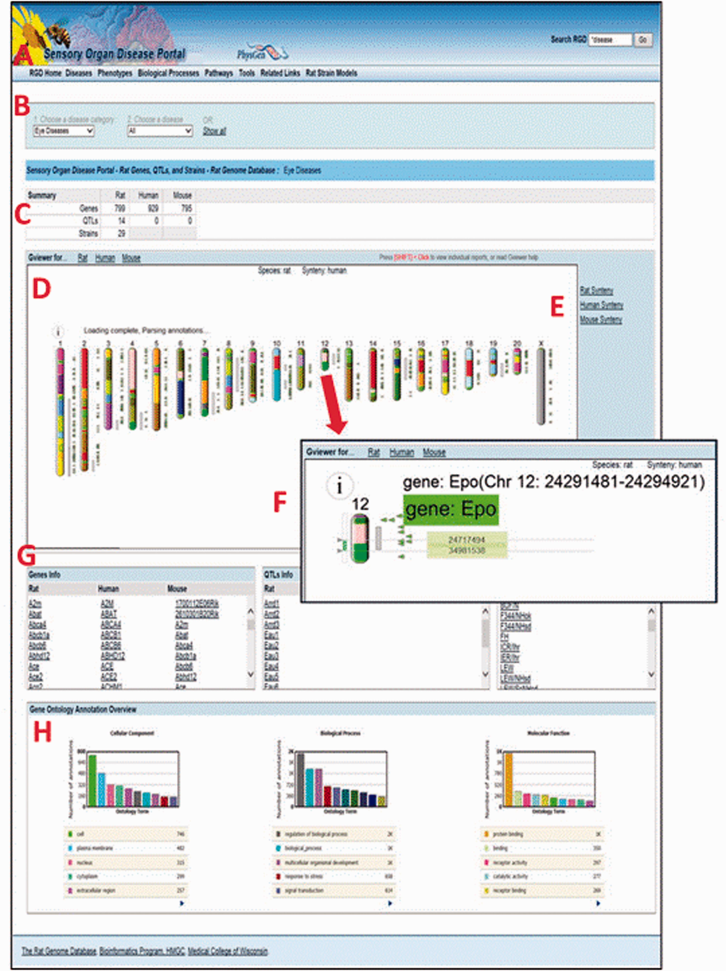
Figure 6. The Sensory Organ Disease Portal main page. A , category tabs; B , term drop-down menus; C , summary table; ...
Notes:
Figure 6. The Sensory Organ Disease Portal main page. A , category tabs; B , term drop-down menus; C , summary table; D , Genome Viewer; E , synteny function; F , single chromosome view and functionality; G , gene, QTL, strain lists; H , portal GO term annotation frequencies.
Unless provided in the caption above, the following copyright applies to the content of this slide: © The Author(s) 2016. Published by Oxford University Press. This is an Open Access article distributed under the terms of the Creative Commons Attribution License ( http://creativecommons.org/licenses/by/4.0/ ), which permits unrestricted reuse, distribution, and reproduction in any medium, provided the original work is properly cited.

Slide 7
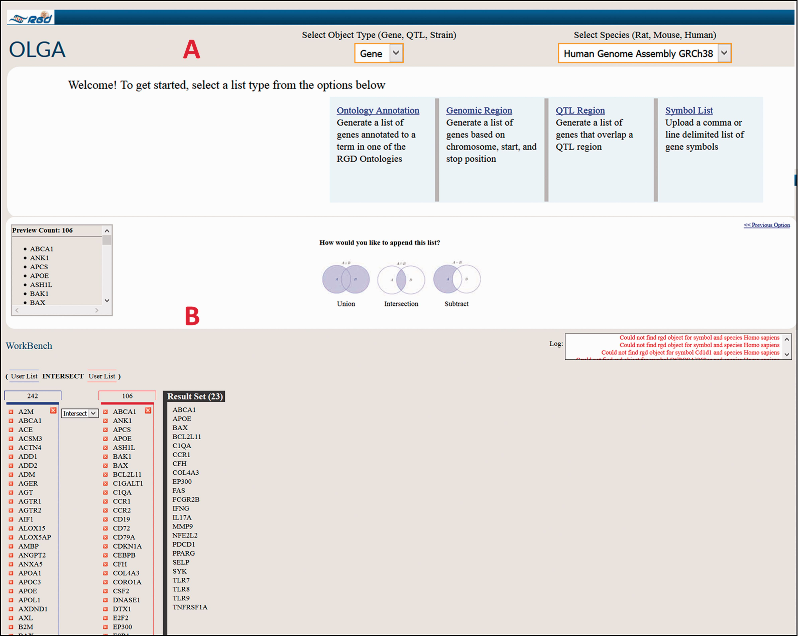
Figure 7. Cross-species use case for identifying genes associated with glomerulonephritis using the Renal Disease ...
Notes:
Figure 7. Cross-species use case for identifying genes associated with glomerulonephritis using the Renal Disease Portal and the OLGA tool.
Unless provided in the caption above, the following copyright applies to the content of this slide: © The Author(s) 2016. Published by Oxford University Press. This is an Open Access article distributed under the terms of the Creative Commons Attribution License ( http://creativecommons.org/licenses/by/4.0/ ), which permits unrestricted reuse, distribution, and reproduction in any medium, provided the original work is properly cited.

