Slide 1
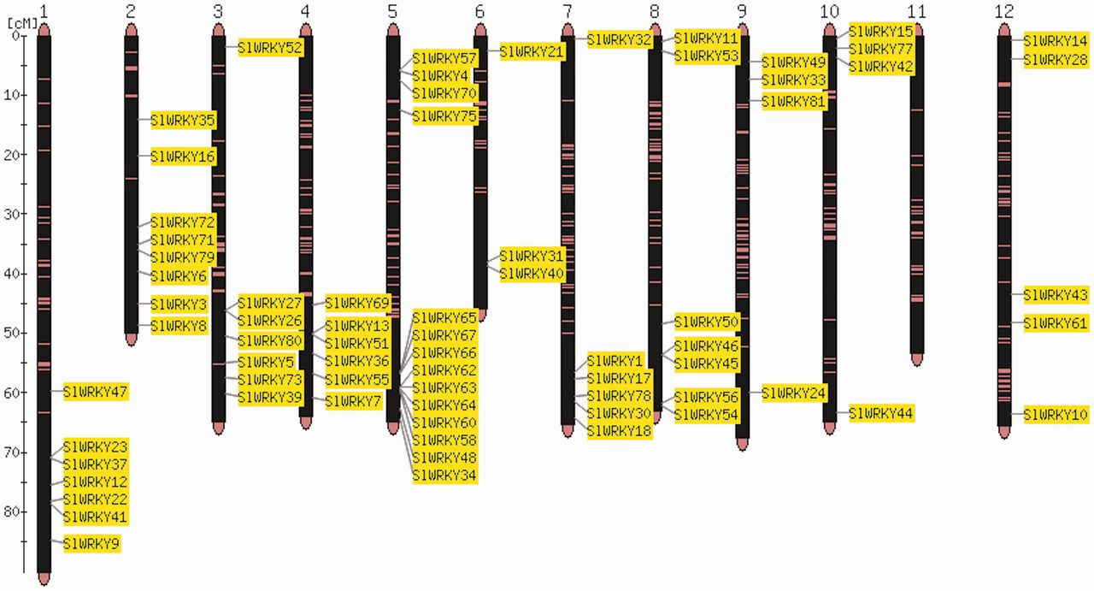
Figure 1. Map viewer. Chromosome distribution of the 82 members of the tomato WRKY gene family. The shown locations are ...
Notes:
Figure 1. Map viewer. Chromosome distribution of the 82 members of the tomato WRKY gene family. The shown locations are based on the physical position of each corresponding genome gene model, based on the ITAG2.3 annotation of the tomato genome.
Unless provided in the caption above, the following copyright applies to the content of this slide: © The Author(s) 2013. Published by Oxford University Press.This is an Open Access article distributed under the terms of the Creative Commons Attribution Non-Commercial License (http://creativecommons.org/licenses/by-nc/3.0/), which permits unrestricted non-commercial use, distribution, and reproduction in any medium, provided the original work is properly cited.

Slide 2
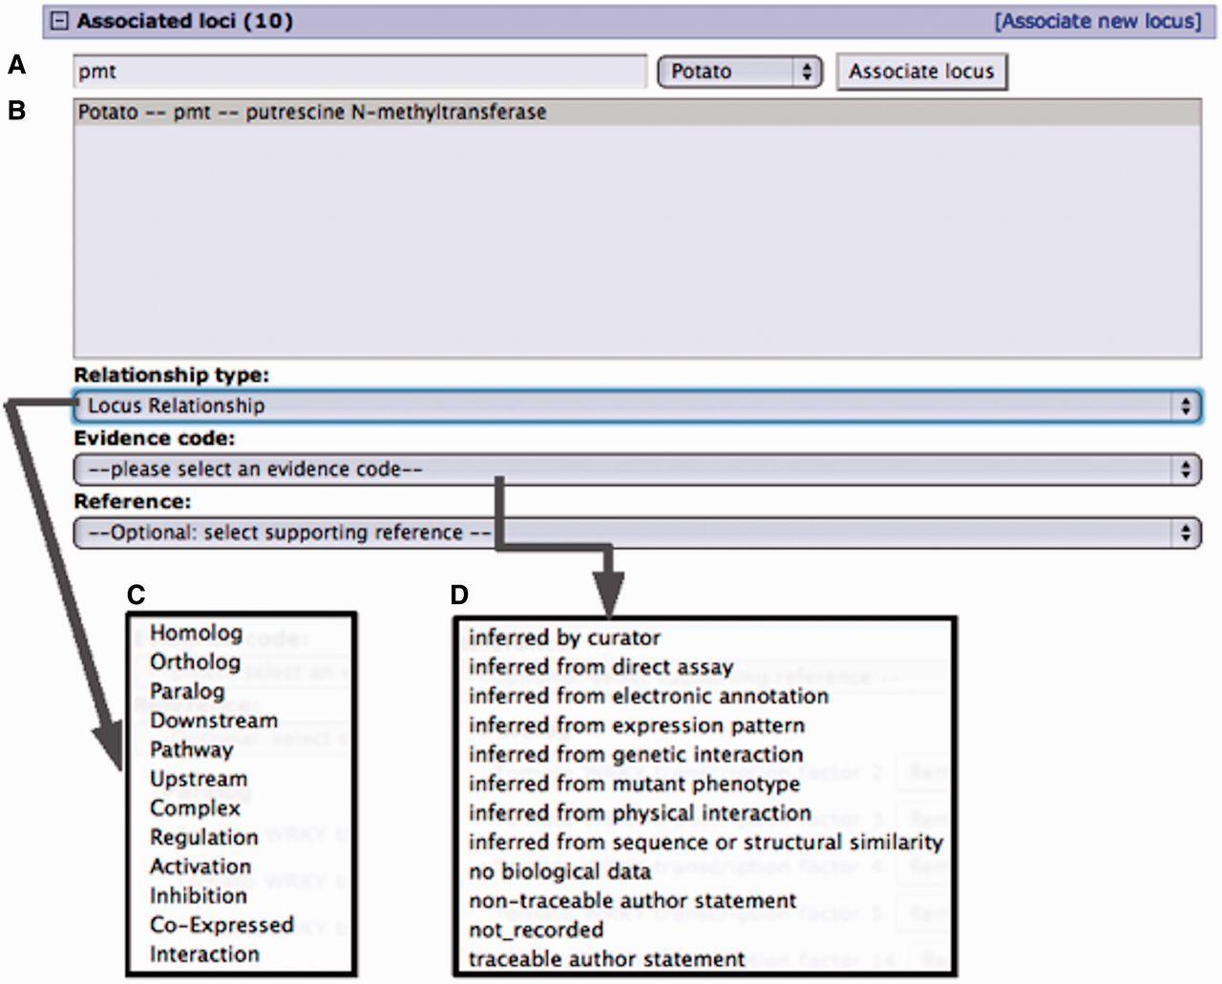
Figure 2. Curation interface for associating a locus from an existing locus page. (A) A search for a locus name by the ...
Notes:
Figure 2. Curation interface for associating a locus from an existing locus page. (A) A search for a locus name by the organism common name. (B) Select locus from the result list pop-up menu. (C) Select the relationship type from the pop-up menu. (D) Select evidence code for the described locus relationship. Adding a reference is optional. Only references associated with the loci involved are presented in the pop-up menu.
Unless provided in the caption above, the following copyright applies to the content of this slide: © The Author(s) 2013. Published by Oxford University Press.This is an Open Access article distributed under the terms of the Creative Commons Attribution Non-Commercial License (http://creativecommons.org/licenses/by-nc/3.0/), which permits unrestricted non-commercial use, distribution, and reproduction in any medium, provided the original work is properly cited.

Slide 3
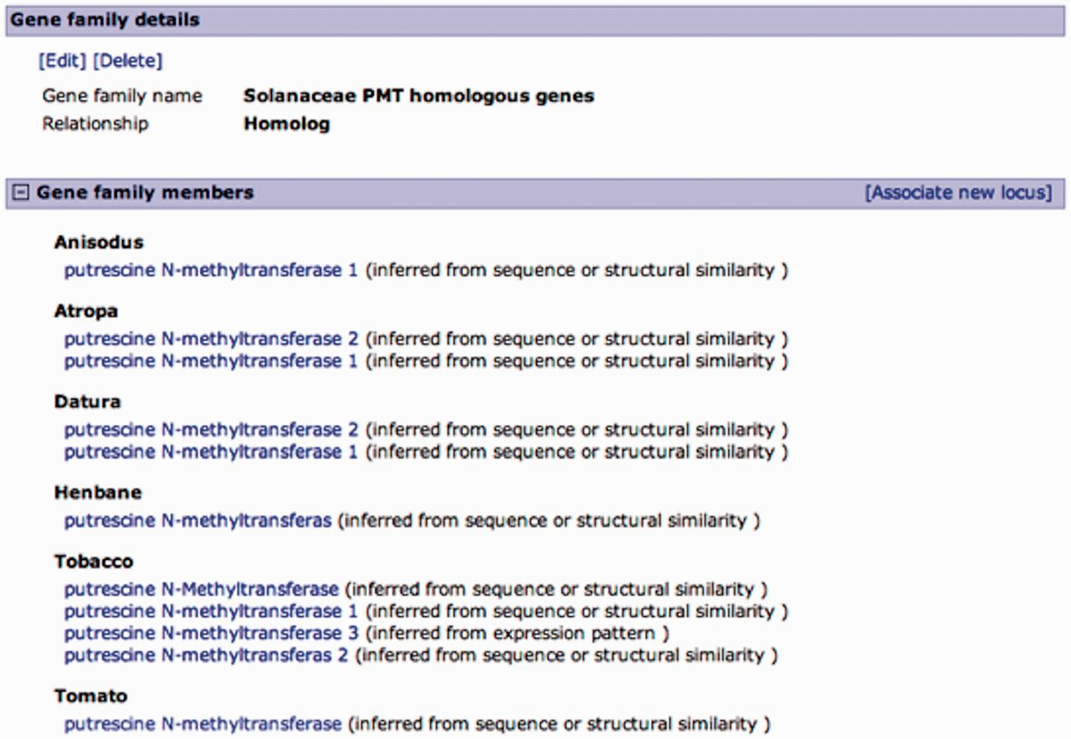
Figure 3. Curated gene family page. A family of putrescine N-methyltransferase (PMT) homologous genes from multiple ...
Notes:
Figure 3. Curated gene family page. A family of putrescine N-methyltransferase (PMT) homologous genes from multiple Solanaceae organisms. Gene family details are editable, and curators can add members to the family in a similar manner as associating loci from the locus page, except for the relationship type, which is predefined. Gene family members are listed by organism with an evidence code.
Unless provided in the caption above, the following copyright applies to the content of this slide: © The Author(s) 2013. Published by Oxford University Press.This is an Open Access article distributed under the terms of the Creative Commons Attribution Non-Commercial License (http://creativecommons.org/licenses/by-nc/3.0/), which permits unrestricted non-commercial use, distribution, and reproduction in any medium, provided the original work is properly cited.

Slide 4
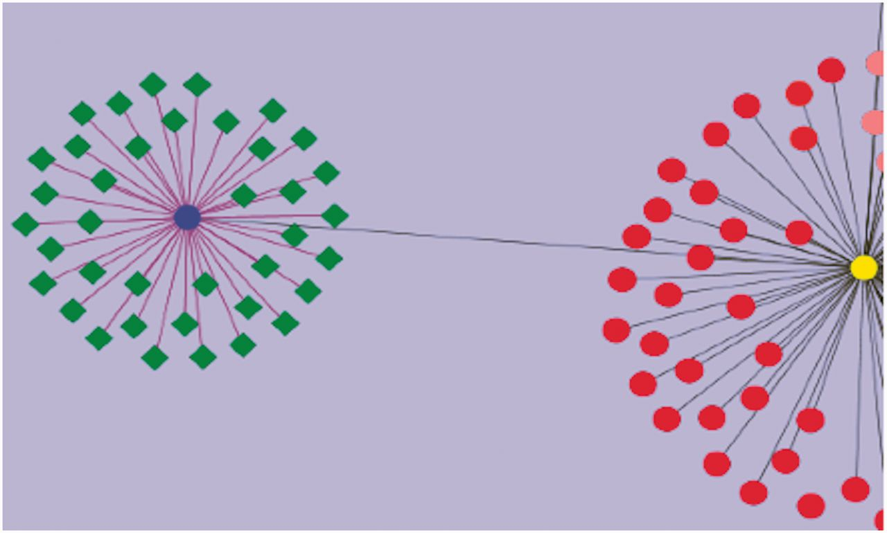
Figure 4. Visualization of genes associated with drought tolerance in Solanaceae. A simple example network is shown. ...
Notes:
Figure 4. Visualization of genes associated with drought tolerance in Solanaceae. A simple example network is shown. The nodes represent genes, and the edges represent relationships between the genes. The blue circular node is WRKY 39 and the green nodes having diamond shapes are genes associated with drought, annotated in the SGN database. The purple edges connecting WRKY 39 to the other genes represent the relationship based on the evidence code ‘Co-expressed’. These genes have been curated from an article reporting a transcriptomic study of drought response genes in tomato species. The deep gray colored edge connects WRKY 39 transcription factor to WRKY 1 (yellow circular node) in a paralogous relationship. Similarly all red colored nodes are the WRKY gene family members curated in SGN. This network diagram shows the genes in the SGN database that have been currently annotated to the GO term, ‘GO: response to water deprivation’.
Unless provided in the caption above, the following copyright applies to the content of this slide: © The Author(s) 2013. Published by Oxford University Press.This is an Open Access article distributed under the terms of the Creative Commons Attribution Non-Commercial License (http://creativecommons.org/licenses/by-nc/3.0/), which permits unrestricted non-commercial use, distribution, and reproduction in any medium, provided the original work is properly cited.

