Slide 1
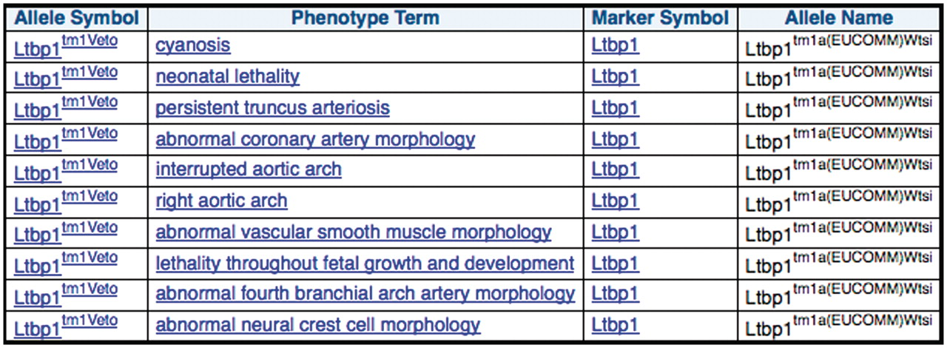
Figure 5. MGI curated phenotype data for other mutant alleles of the same gene for each of the mouse lines produced ...
Notes:
Figure 5. MGI curated phenotype data for other mutant alleles of the same gene for each of the mouse lines produced from EUCOMM ES cell resources.
Unless provided in the caption above, the following copyright applies to the content of this slide: © The Author(s) 2011. Published by Oxford University Press.This is Open Access article distributed under the terms of the Creative Commons Attribution Non-Commercial License (http://creativecommons.org/licenses/by-nc/2.5), which permits unrestricted non-commercial use, distribution, and reproduction in any medium, provided the original work is properly cited.

