Slide 1
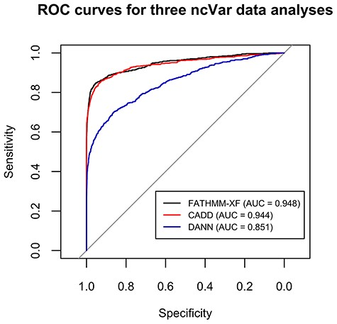
Figure 2. ROC curves for the classification analyses of the ncVar dataset by three different software tools: FATHMM-XF, ...
Notes:
Figure 2. ROC curves for the classification analyses of the ncVar dataset by three different software tools: FATHMM-XF, CADD v1.4 and DANN. FATHMM-XF and CADD predict the pathogenicity of the ncVarDB variants with noticeably higher specificity and sensitivity than DANN. Overall good performance of all three tools additionally validates the ncVar dataset.
Unless provided in the caption above, the following copyright applies to the content of this slide: © The Author(s) 2020. Published by Oxford University Press.This is an Open Access article distributed under the terms of the Creative Commons Attribution License (http://creativecommons.org/licenses/by/4.0/), which permits unrestricted reuse, distribution, and reproduction in any medium, provided the original work is properly cited.

