Slide 1
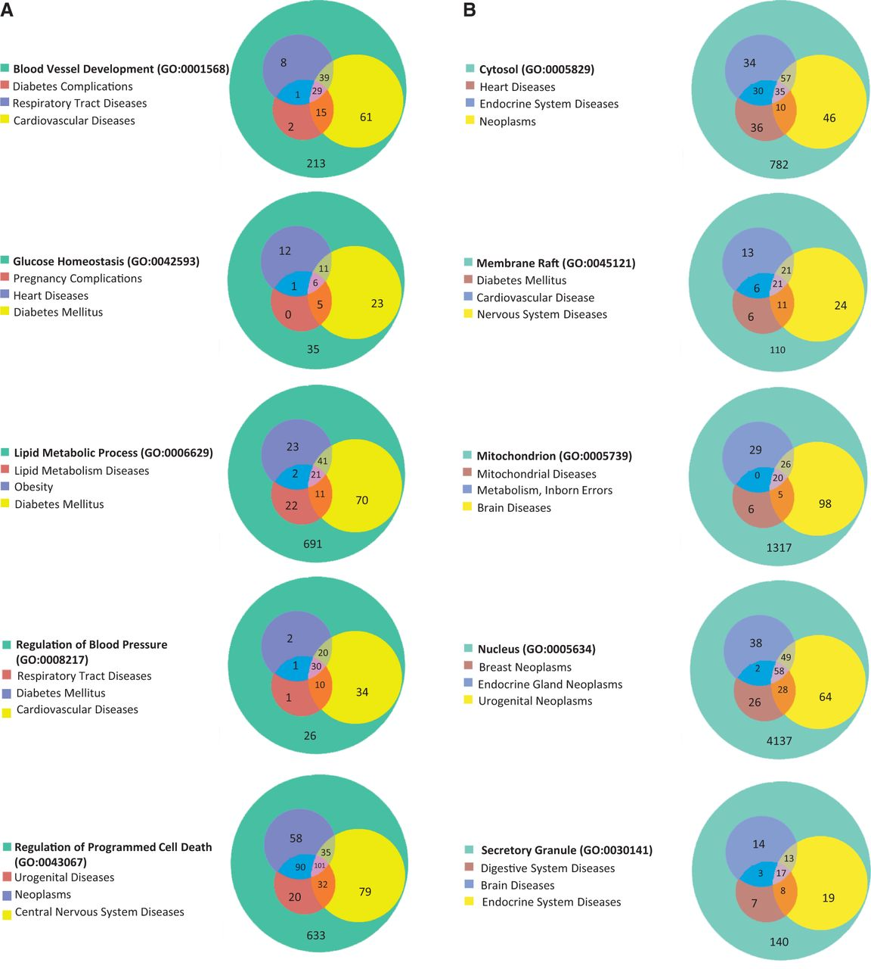
Figure 5. (A) The disease enrichment analysis of five BP-annotated gene lists. The three most enriched diseases from ...
Notes:
Figure 5. (A) The disease enrichment analysis of five BP-annotated gene lists. The three most enriched diseases from each gene list are presented in Venn diagrams. The numbers in each area represent the gene count of the section. (B) The disease enrichment analysis of five CC-annotated gene lists. The three most enriched diseases from each gene list are presented in Venn diagrams. The numbers in each area represent the gene count of that section. (C) The disease enrichment analysis of five MF annotated gene lists. The three most enriched diseases from each gene list are presented in Venn diagrams. The numbers in each area represent the gene count of that section.
Unless provided in the caption above, the following copyright applies to the content of this slide: © The Author(s) 2013. Published by Oxford University Press.This is an Open Access article distributed under the terms of the Creative Commons Attribution License (http://creativecommons.org/licenses/by/3.0/), which permits unrestricted reuse, distribution, and reproduction in any medium, provided the original work is properly cited.

Slide 2
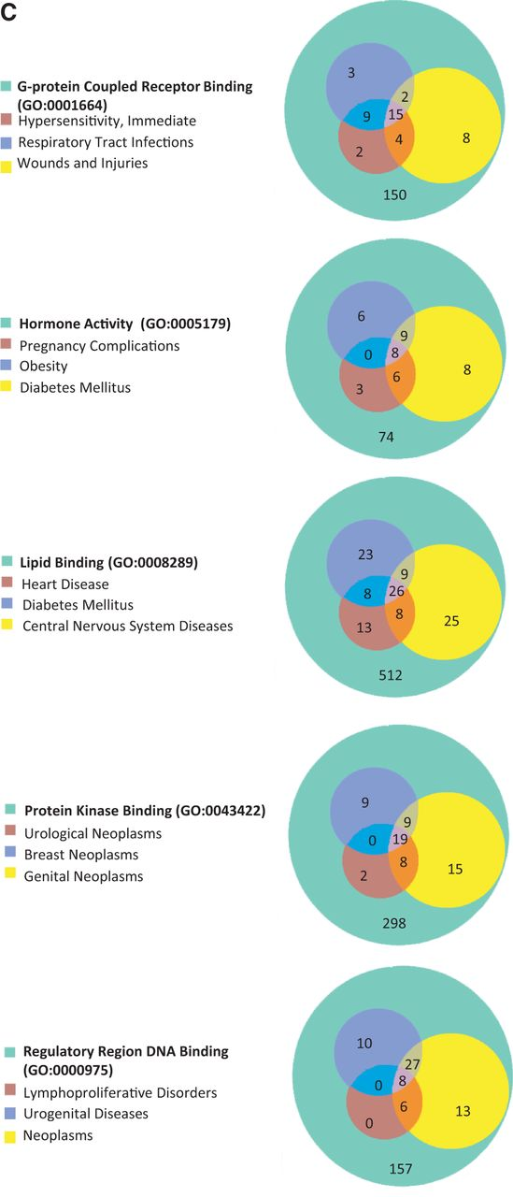
Figure 5. (A) The disease enrichment analysis of five BP-annotated gene lists. The three most enriched diseases from ...
Notes:
Figure 5. (A) The disease enrichment analysis of five BP-annotated gene lists. The three most enriched diseases from each gene list are presented in Venn diagrams. The numbers in each area represent the gene count of the section. (B) The disease enrichment analysis of five CC-annotated gene lists. The three most enriched diseases from each gene list are presented in Venn diagrams. The numbers in each area represent the gene count of that section. (C) The disease enrichment analysis of five MF annotated gene lists. The three most enriched diseases from each gene list are presented in Venn diagrams. The numbers in each area represent the gene count of that section.
Unless provided in the caption above, the following copyright applies to the content of this slide: © The Author(s) 2013. Published by Oxford University Press.This is an Open Access article distributed under the terms of the Creative Commons Attribution License (http://creativecommons.org/licenses/by/3.0/), which permits unrestricted reuse, distribution, and reproduction in any medium, provided the original work is properly cited.

Slide 3
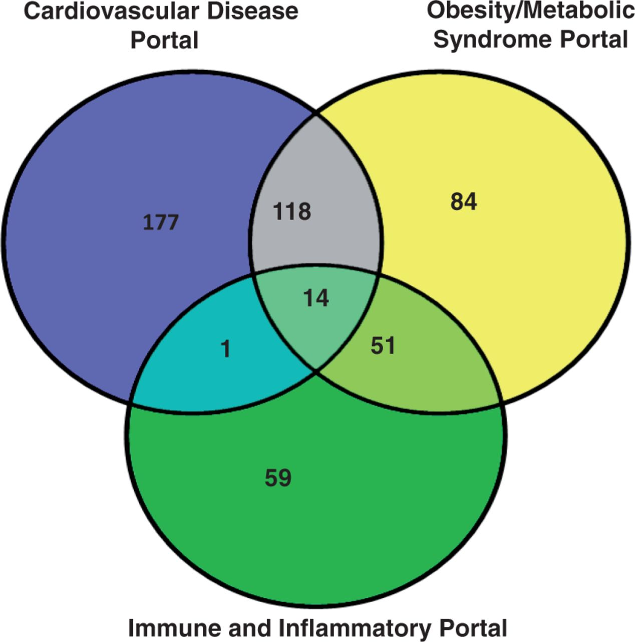
Figure 1. The rat strain distribution among three RGD disease portals. The numbers in each area represent the strain ...
Notes:
Figure 1. The rat strain distribution among three RGD disease portals. The numbers in each area represent the strain count of that section. Strain names are available from the RGD disease portals (http://rgd.mcw.edu/wg/portals).
Unless provided in the caption above, the following copyright applies to the content of this slide: © The Author(s) 2013. Published by Oxford University Press.This is an Open Access article distributed under the terms of the Creative Commons Attribution License (http://creativecommons.org/licenses/by/3.0/), which permits unrestricted reuse, distribution, and reproduction in any medium, provided the original work is properly cited.

Slide 4
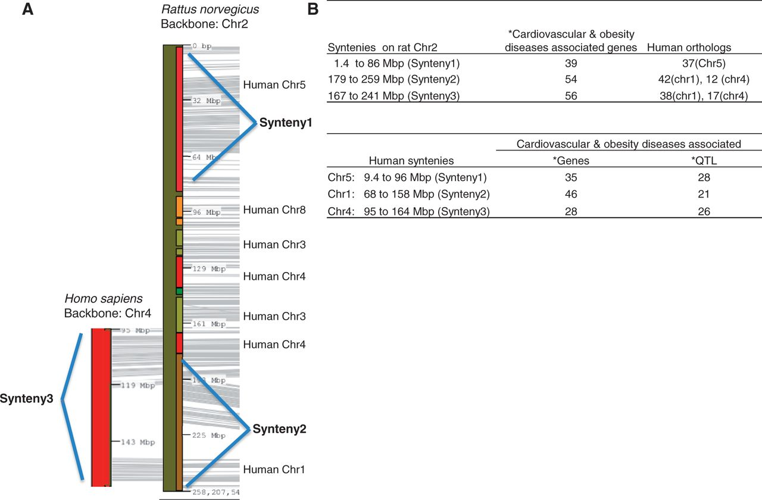
Figure 2. Cardiovascular and obesity diseases association of rat chromosome 2 and the human syntenies. Syntenic mapping ...
Notes:
Figure 2. Cardiovascular and obesity diseases association of rat chromosome 2 and the human syntenies. Syntenic mapping of rat chromosome 2 to the human genome was performed using VCMap (http://animalgenome.org/VCmap/). (A) The two backbone chromosomes are labelled in Mbp. The chromosomal origins of syntenies are labelled to the right. (B) Rat and human syntenies are listed, with corresponding human orthologs for the rat syntenies, and disease-associated genes and QTL. (Asterisk) The cardiovascular and obesity diseases–associated genes (human and rat) and QTL (human) in the synteny were downloaded from ‘Disease Related Tracks’ (cardiovascular diseases and nutritional and metabolic diseases) from genome browsers at RGD. (rat: http://rgd.mcw.edu/fgb2/gbrowse/rgd_904/ and human: http://rgd.mcw.edu/fgb2/gbrowse/human_36_3/).
Unless provided in the caption above, the following copyright applies to the content of this slide: © The Author(s) 2013. Published by Oxford University Press.This is an Open Access article distributed under the terms of the Creative Commons Attribution License (http://creativecommons.org/licenses/by/3.0/), which permits unrestricted reuse, distribution, and reproduction in any medium, provided the original work is properly cited.

Slide 5
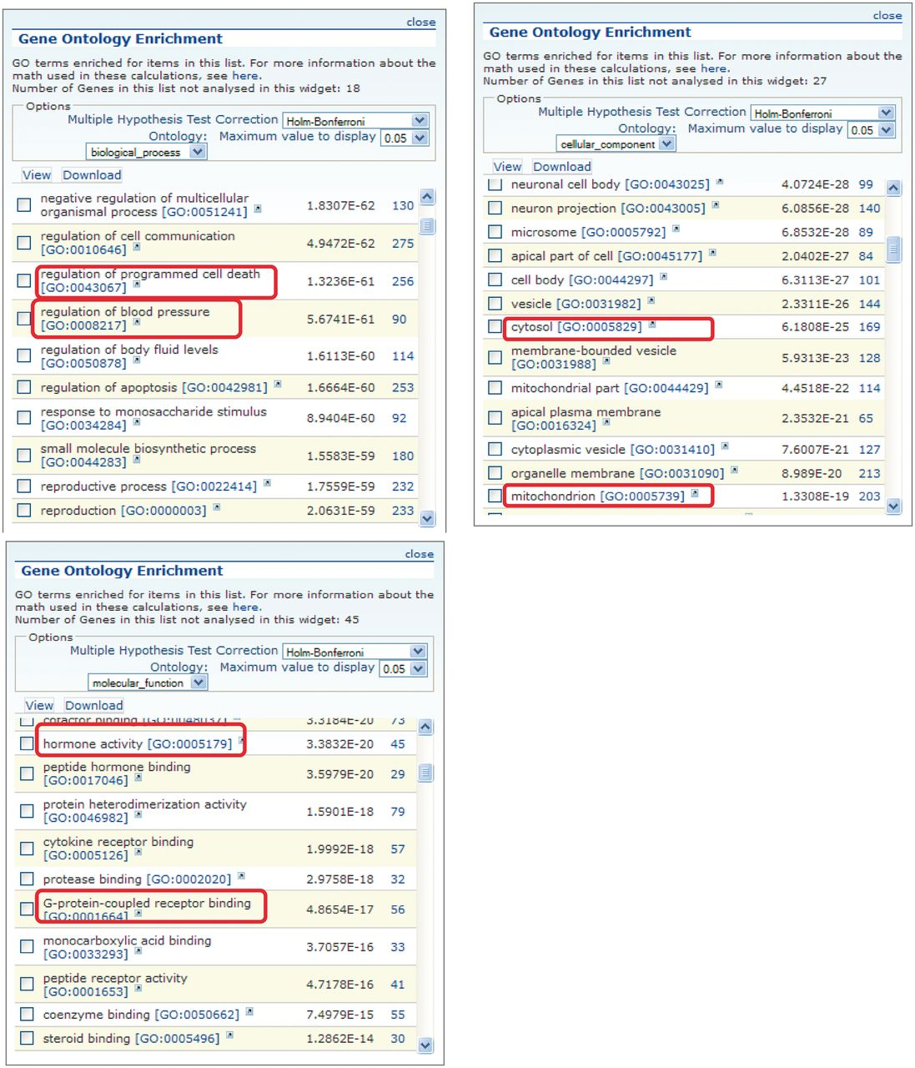
Figure 3. GO enrichment tables for the three GO aspects of genes associated with the obesity/metabolic syndrome portal. ...
Notes:
Figure 3. GO enrichment tables for the three GO aspects of genes associated with the obesity/metabolic syndrome portal. A total of 1049 rat genes associated with this disease portal were subjected to GO enrichment analysis in RatMine. Only the top portions of the enrichment tables are shown. Two GO terms selected from each GO aspect for comparison are highlighted.
Unless provided in the caption above, the following copyright applies to the content of this slide: © The Author(s) 2013. Published by Oxford University Press.This is an Open Access article distributed under the terms of the Creative Commons Attribution License (http://creativecommons.org/licenses/by/3.0/), which permits unrestricted reuse, distribution, and reproduction in any medium, provided the original work is properly cited.

Slide 6
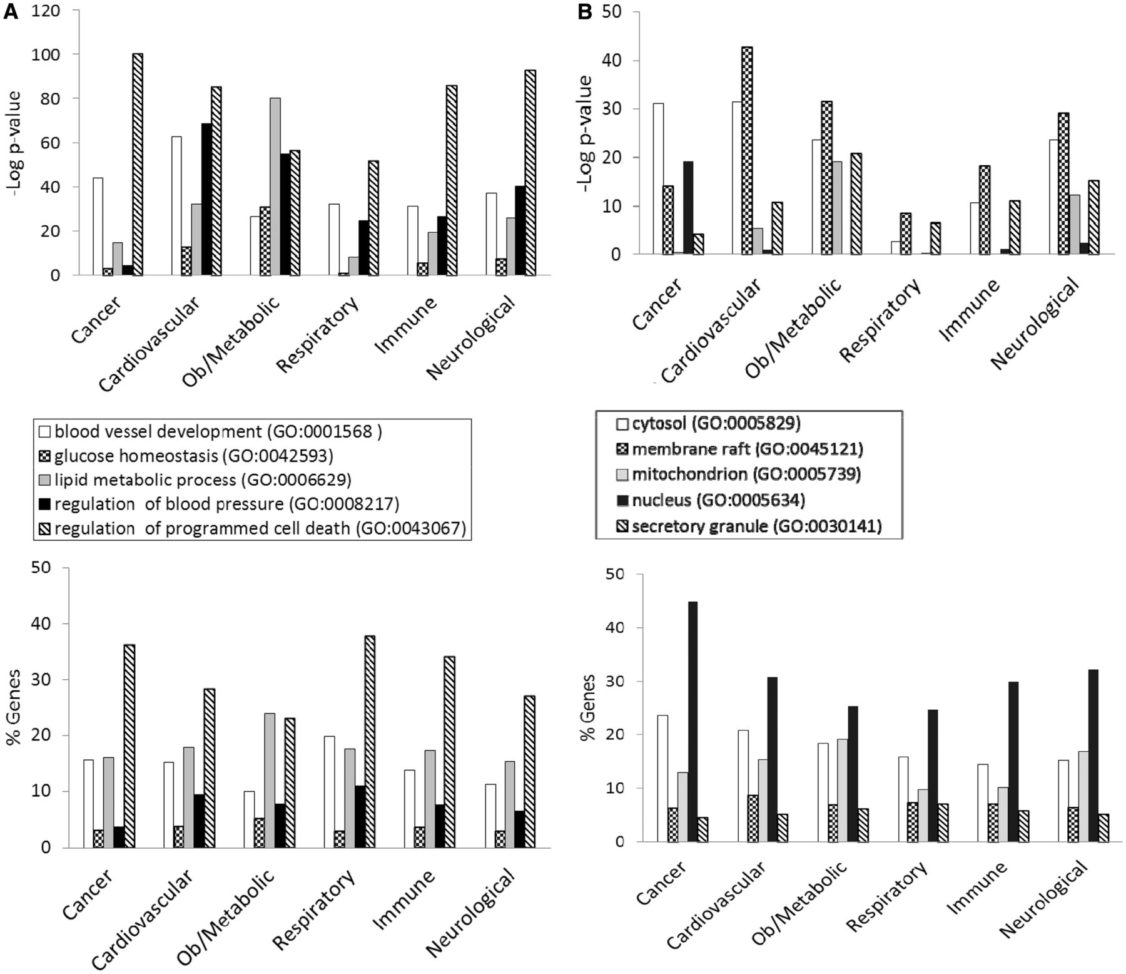
Figure 4. (A) The BP annotations of the disease-associated genes at RGD were subjected to enrichment analysis using ...
Notes:
Figure 4. (A) The BP annotations of the disease-associated genes at RGD were subjected to enrichment analysis using RatMine. The enrichment P-values, presented as ‘–Log P-value’ are shown in the top panel, and the percentages of genes annotated with the relevant GO term and its children are shown in the bottom panel. The six RGD disease portals—cancer portal (cancer), cardiovascular disease portal (cardiovascular), obesity/metabolic syndrome portal (ob/metabolic), respiratory disease portal (respiratory), immune and inflammatory disease portal (immune) and neurological disease portal (neurological)—are listed across the x axis. (B) The CC annotations of the disease-associated genes at RGD were subjected to enrichment analysis using RatMine. The enrichment P-values, presented as ‘–Log P-value’ are shown in the top panel, and the percentages of genes annotated with the relevant GO term and its children are shown in the bottom panel. The six RGD disease portals—cancer portal (cancer), cardiovascular disease portal (cardiovascular), obesity/metabolic syndrome portal (ob/metabolic), respiratory disease portal (respiratory), immune and inflammatory disease portal (immune) and neurological disease portal (neurological)—are listed across the x axis. (C) The MF annotations of the disease-associated genes at RGD were subjected to enrichment analysis using RatMine. The enrichment P-values, presented as ‘–Log P-value’ are shown in the top panel, and the percentages of genes annotated with the relevant GO term and its children are shown in the bottom panel. The six RGD disease portals—cancer portal (cancer), cardiovascular disease portal (cardiovascular), obesity/metabolic syndrome portal (ob/metabolic), respiratory disease portal (respiratory), immune and inflammatory disease portal (immune) and neurological disease portal (neurological)—are listed across the x axis.
Unless provided in the caption above, the following copyright applies to the content of this slide: © The Author(s) 2013. Published by Oxford University Press.This is an Open Access article distributed under the terms of the Creative Commons Attribution License (http://creativecommons.org/licenses/by/3.0/), which permits unrestricted reuse, distribution, and reproduction in any medium, provided the original work is properly cited.

Slide 7
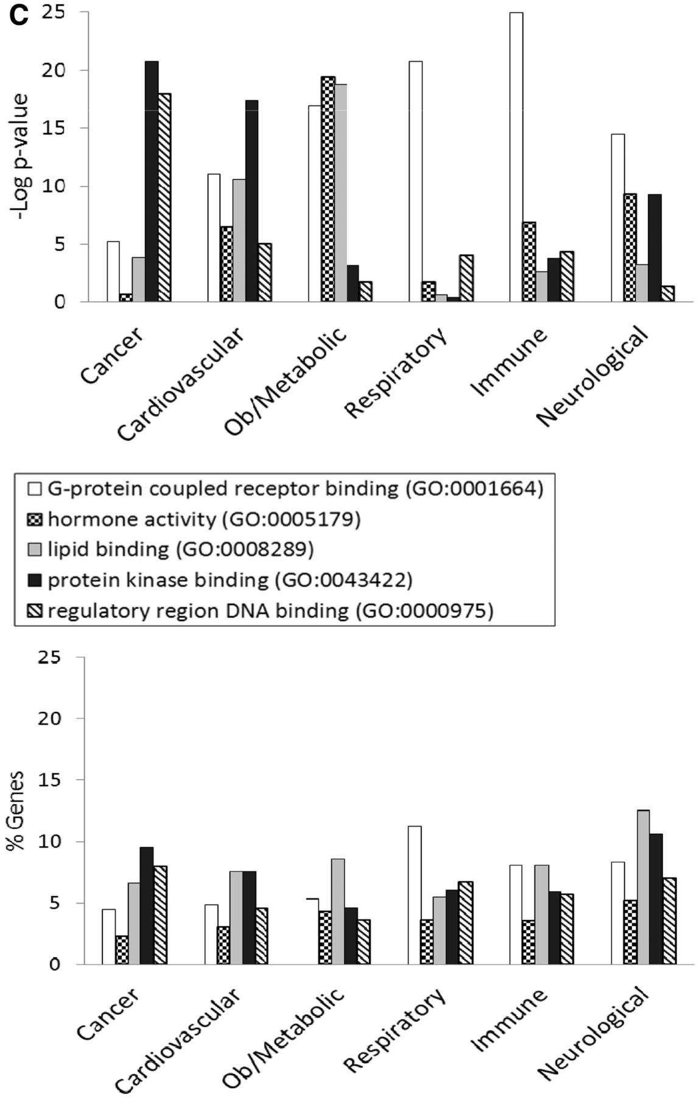
Figure 4. (A) The BP annotations of the disease-associated genes at RGD were subjected to enrichment analysis using ...
Notes:
Figure 4. (A) The BP annotations of the disease-associated genes at RGD were subjected to enrichment analysis using RatMine. The enrichment P-values, presented as ‘–Log P-value’ are shown in the top panel, and the percentages of genes annotated with the relevant GO term and its children are shown in the bottom panel. The six RGD disease portals—cancer portal (cancer), cardiovascular disease portal (cardiovascular), obesity/metabolic syndrome portal (ob/metabolic), respiratory disease portal (respiratory), immune and inflammatory disease portal (immune) and neurological disease portal (neurological)—are listed across the x axis. (B) The CC annotations of the disease-associated genes at RGD were subjected to enrichment analysis using RatMine. The enrichment P-values, presented as ‘–Log P-value’ are shown in the top panel, and the percentages of genes annotated with the relevant GO term and its children are shown in the bottom panel. The six RGD disease portals—cancer portal (cancer), cardiovascular disease portal (cardiovascular), obesity/metabolic syndrome portal (ob/metabolic), respiratory disease portal (respiratory), immune and inflammatory disease portal (immune) and neurological disease portal (neurological)—are listed across the x axis. (C) The MF annotations of the disease-associated genes at RGD were subjected to enrichment analysis using RatMine. The enrichment P-values, presented as ‘–Log P-value’ are shown in the top panel, and the percentages of genes annotated with the relevant GO term and its children are shown in the bottom panel. The six RGD disease portals—cancer portal (cancer), cardiovascular disease portal (cardiovascular), obesity/metabolic syndrome portal (ob/metabolic), respiratory disease portal (respiratory), immune and inflammatory disease portal (immune) and neurological disease portal (neurological)—are listed across the x axis.
Unless provided in the caption above, the following copyright applies to the content of this slide: © The Author(s) 2013. Published by Oxford University Press.This is an Open Access article distributed under the terms of the Creative Commons Attribution License (http://creativecommons.org/licenses/by/3.0/), which permits unrestricted reuse, distribution, and reproduction in any medium, provided the original work is properly cited.

Slide 8
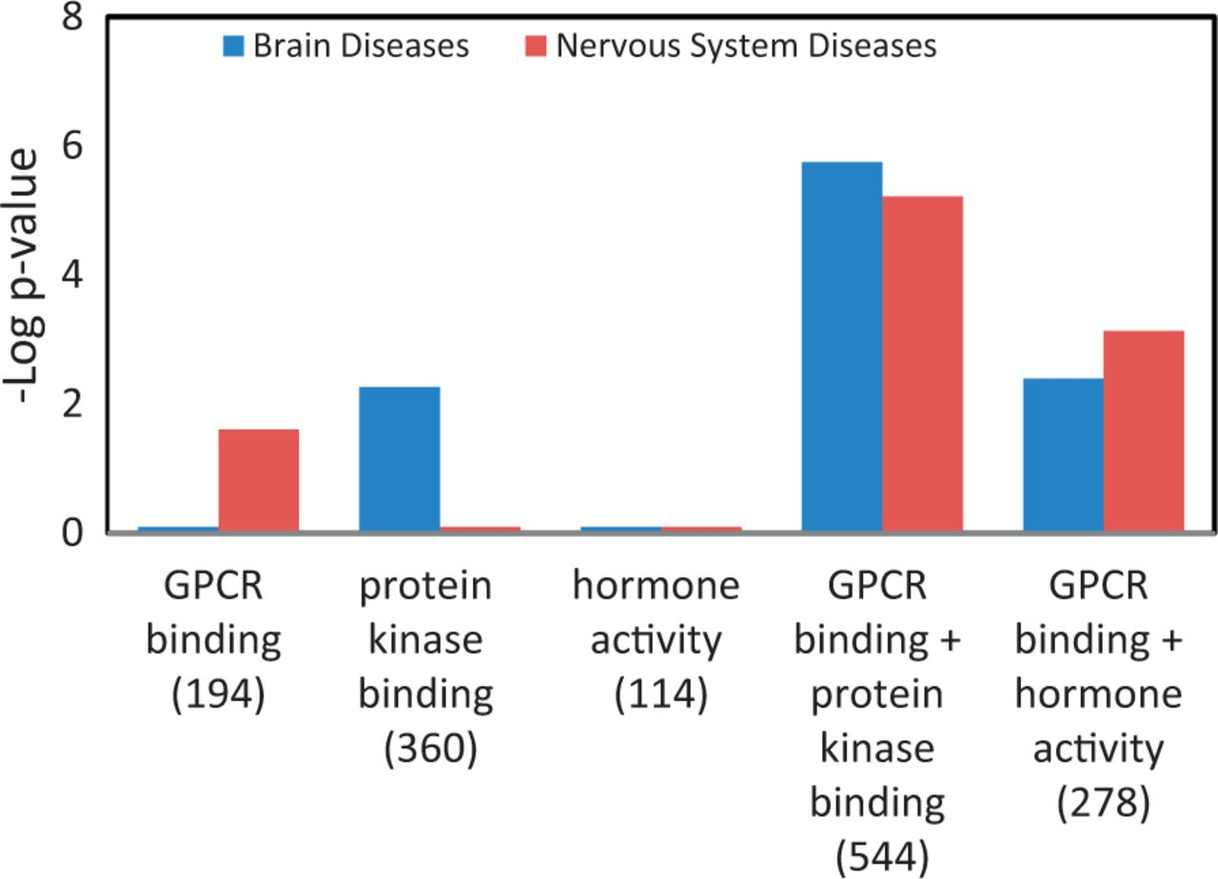
Figure 6. Enhanced enrichment of neurological diseases by combining MF term–annotated gene lists. The ‘GPCR binding’ ...
Notes:
Figure 6. Enhanced enrichment of neurological diseases by combining MF term–annotated gene lists. The ‘GPCR binding’ gene list was combined with the ‘protein kinase binding’ gene list or the ‘hormone activity’ gene list. The enrichment P-values for these two diseases, shown as ‘–Log P-value’ were compared before and after combination. The gene count of each list is shown in parenthesis.
Unless provided in the caption above, the following copyright applies to the content of this slide: © The Author(s) 2013. Published by Oxford University Press.This is an Open Access article distributed under the terms of the Creative Commons Attribution License (http://creativecommons.org/licenses/by/3.0/), which permits unrestricted reuse, distribution, and reproduction in any medium, provided the original work is properly cited.

