Slide 1
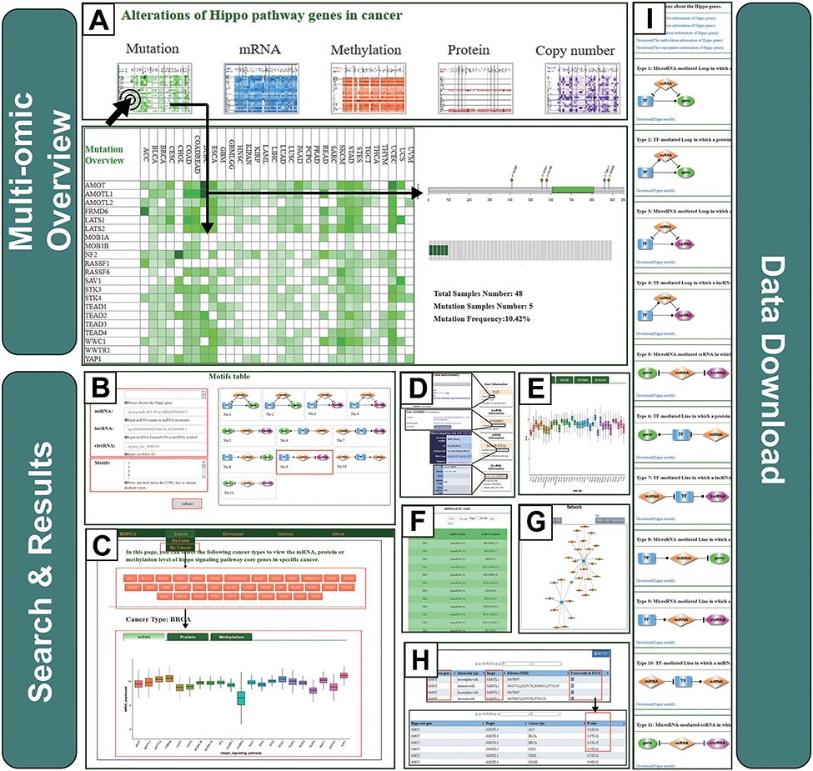
Figure 3 Operating instructions of the RHPCG database. (A) Overview of the multi-omics interface of RHPCG. (B) Search ...
Notes:
Figure 3 Operating instructions of the RHPCG database. (A) Overview of the multi-omics interface of RHPCG. (B) Search by gene section. (C) Search by cancer section. (D) Information box. (E) Multi-omics visualization section. (F) Table of motif results. (G) Network of motifs. (H) Potential targets of the Hippo signaling pathway. (I) Download page of RHPCG.
Unless provided in the caption above, the following copyright applies to the content of this slide: © The Author(s) 2019. Published by Oxford University Press.This is an Open Access article distributed under the terms of the Creative Commons Attribution License (http://creativecommons.org/licenses/by/4.0/), which permits unrestricted reuse, distribution, and reproduction in any medium, provided the original work is properly cited.

