Slide 1
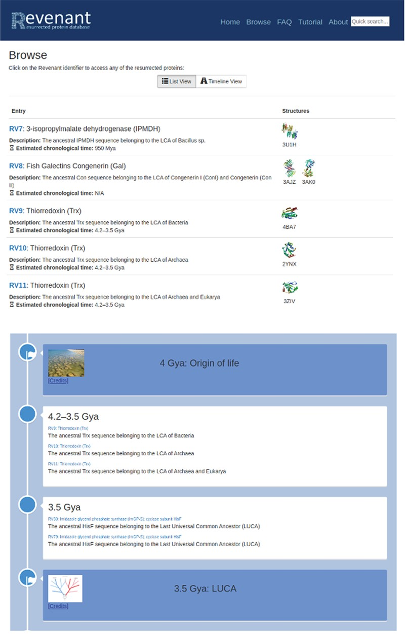
Figure 2 Two different browsing capabilities are available in Revenant. In the first one (top panel) proteins are ...
Notes:
Figure 2 Two different browsing capabilities are available in Revenant. In the first one (top panel) proteins are listed sequentially using their RV codes. In the second browser (bottom panel) we display the Revenant proteins in an Earth’s timeline showing important biological events since the origin of life.
Unless provided in the caption above, the following copyright applies to the content of this slide: © The Author(s) 2020. Published by Oxford University Press.This is an Open Access article distributed under the terms of the Creative Commons Attribution License (http://creativecommons.org/licenses/by/4.0/), which permits unrestricted reuse, distribution, and reproduction in any medium, provided the original work is properly cited.

