Slide 1
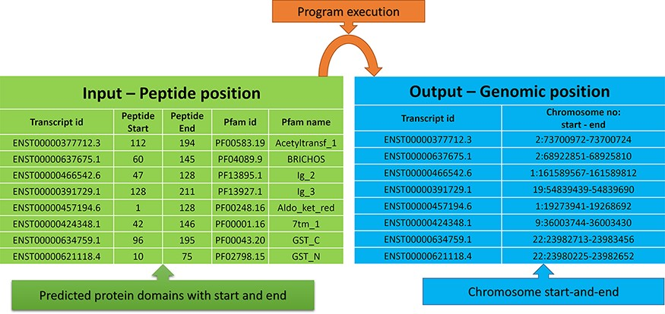
Figure 5. Input and output features for the peptide to genome program execution. The green table indicates the peptide ...
Notes:
Figure 5. Input and output features for the peptide to genome program execution. The green table indicates the peptide positions for each transcript id, and the program’s output provides the genomic locations as depicted in the blue table.
Unless provided in the caption above, the following copyright applies to the content of this slide: © The Author(s) 2021. Published by Oxford University Press.This is an Open Access article distributed under the terms of the Creative Commons Attribution License (https://creativecommons.org/licenses/by/4.0/), which permits unrestricted reuse, distribution, and reproduction in any medium, provided the original work is properly cited.

