Slide 1
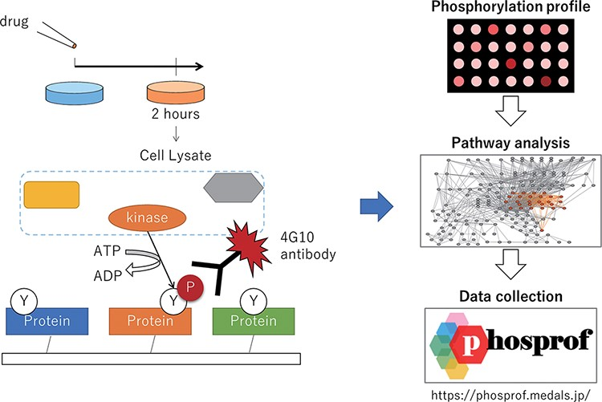
Figure 1. Scheme of the data collection and analysis for Phosprof. (Left) A drug from the Selleck L2400 Library was ...
Notes:
Figure 1. Scheme of the data collection and analysis for Phosprof. (Left) A drug from the Selleck L2400 Library was added to the cell culture media 2 h prior to the harvest of the cell lysate, which was then applied to a protein array with ATP. The tyrosine residues of the proteins on the array are phosphorylated by the cell lysate and detected using 4G10 antibody. (Right) The resultant ‘phosphorylation profiles’ were then analyzed to identify the significant pathways. The collected data can be browsed using various pathway analysis tools.
Unless provided in the caption above, the following copyright applies to the content of this slide: © The Author(s) 2022. Published by Oxford University Press.This is an Open Access article distributed under the terms of the Creative Commons Attribution-NonCommercial License (https://creativecommons.org/licenses/by-nc/4.0/), which permits non-commercial re-use, distribution, and reproduction in any medium, provided the original work is properly cited. For commercial re-use, please contact journals.permissions@oup.com

Slide 2
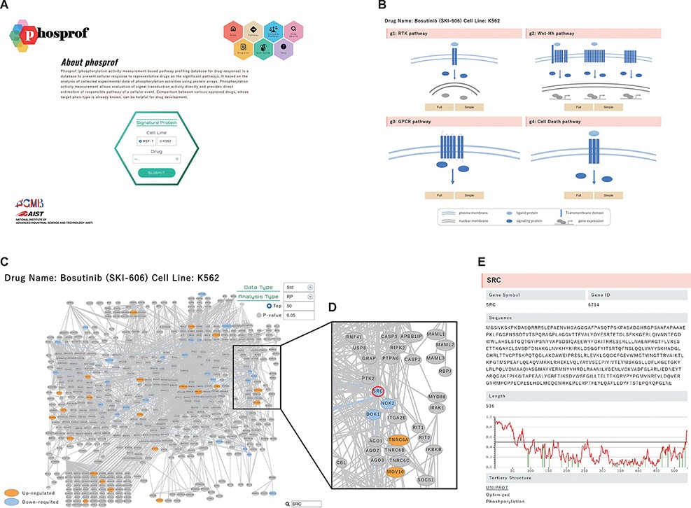
Figure 2. ‘Signature Protein’ section. (A) Phosprof top page. Proteins with significant change in phosphorylation level ...
Notes:
Figure 2. ‘Signature Protein’ section. (A) Phosprof top page. Proteins with significant change in phosphorylation level can be browsed by choosing the tested cell type (MCF7 or K562) and treated drug. (B) Signature proteins are highlighted on a pathway map. The 376 analyzed pathways were divided into four functional groups (g1: RTK pathway; g2: Wnt–Hh pathway; g3: GPCR pathway and g4: Cell Death pathway), according to the Reactome classification. (C) Signature proteins of K562 cells under treatment with the SRC inhibitor bosutinib. Data type (Std: standardized data or Raw: raw data), analysis type (RP: rank products or Pearson) and thresholds (Top 50/100/150/200 or P-value) can be selected. (D) Enlarged view after searching for SRC on the pathway map. (E) The nodes of the pathway map are linked to the ‘details of the protein’ page. Detailed information includes the gene symbols, amino acid sequences and the disorder scores. This page is also connected to the PDB web site and the protein tertiary structures.
Unless provided in the caption above, the following copyright applies to the content of this slide: © The Author(s) 2022. Published by Oxford University Press.This is an Open Access article distributed under the terms of the Creative Commons Attribution-NonCommercial License (https://creativecommons.org/licenses/by-nc/4.0/), which permits non-commercial re-use, distribution, and reproduction in any medium, provided the original work is properly cited. For commercial re-use, please contact journals.permissions@oup.com

Slide 3
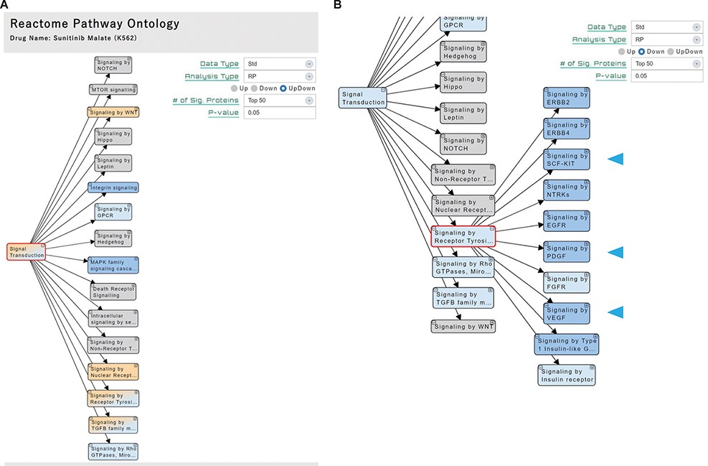
Figure 3. ‘Pathway’ section. (A) Significant pathways with Up, Down or both (UpDown) signatures are displayed in the ...
Notes:
Figure 3. ‘Pathway’ section. (A) Significant pathways with Up, Down or both (UpDown) signatures are displayed in the tree form, according to the pathway ontology classification of Reactome. The number of signature proteins for pathway analysis can be selected (top 50/100/150/200 or P-value < 0.05). (B) The multi-targeted RTK inhibitor sunitinib malate downregulates the ‘Signaling by Receptor Tyrosine Kinases’ pathways, including the drug target-related pathways (arrowhead).
Unless provided in the caption above, the following copyright applies to the content of this slide: © The Author(s) 2022. Published by Oxford University Press.This is an Open Access article distributed under the terms of the Creative Commons Attribution-NonCommercial License (https://creativecommons.org/licenses/by-nc/4.0/), which permits non-commercial re-use, distribution, and reproduction in any medium, provided the original work is properly cited. For commercial re-use, please contact journals.permissions@oup.com

Slide 4
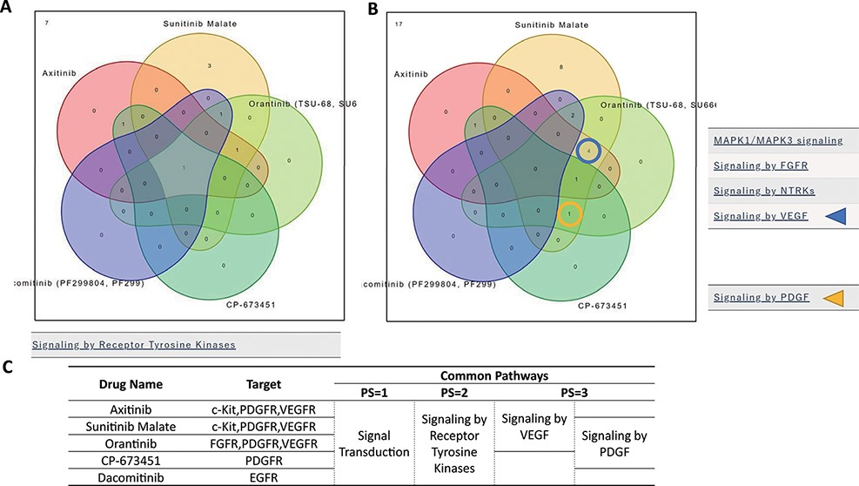
Figure 4. ‘Compare Pathway’ section. Five inhibitory drugs of the protein tyrosine kinase pathway were selected. (A) In ...
Notes:
Figure 4. ‘Compare Pathway’ section. Five inhibitory drugs of the protein tyrosine kinase pathway were selected. (A) In the higher pathway hierarchy (pathway stratum = 2), five drugs commonly downregulated the ‘Signaling by Receptor Tyrosine Kinases’. (B) At lower pathway hierarchy, five drugs showed various specificities for pathway activities. (C) The drug information and common pathway results are summarized.
Unless provided in the caption above, the following copyright applies to the content of this slide: © The Author(s) 2022. Published by Oxford University Press.This is an Open Access article distributed under the terms of the Creative Commons Attribution-NonCommercial License (https://creativecommons.org/licenses/by-nc/4.0/), which permits non-commercial re-use, distribution, and reproduction in any medium, provided the original work is properly cited. For commercial re-use, please contact journals.permissions@oup.com

Slide 5
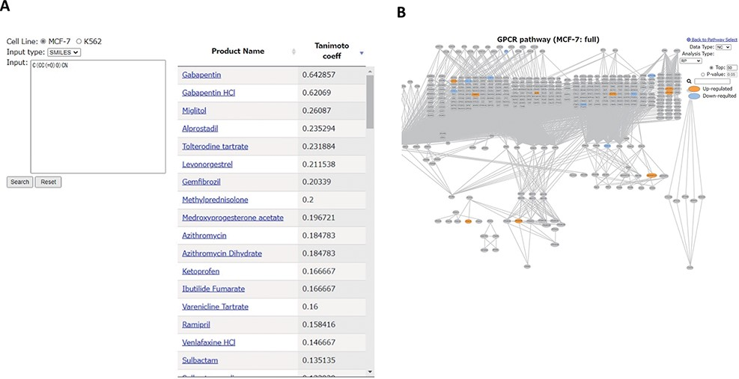
Figure 5. ‘Drug Search’ tool. (A) Similarity search for GABA (SMILES: C(CC(=O)O)CN). Product names of similar drugs in ...
Notes:
Figure 5. ‘Drug Search’ tool. (A) Similarity search for GABA (SMILES: C(CC(=O)O)CN). Product names of similar drugs in Phosprof are listed with the Tanimoto coefficient score. (B) Product Name in the list (A) is linked to the Signature Protein section.
Unless provided in the caption above, the following copyright applies to the content of this slide: © The Author(s) 2022. Published by Oxford University Press.This is an Open Access article distributed under the terms of the Creative Commons Attribution-NonCommercial License (https://creativecommons.org/licenses/by-nc/4.0/), which permits non-commercial re-use, distribution, and reproduction in any medium, provided the original work is properly cited. For commercial re-use, please contact journals.permissions@oup.com

