Slide 1
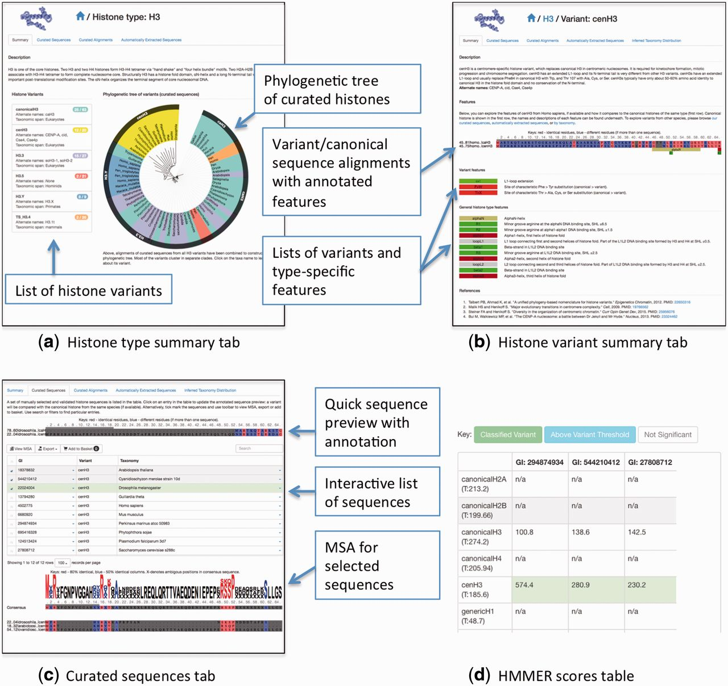
Figure 3 A summary of HistoneDB 2.0 web site. (a) information page for a given histone type, (b) a summary page for a ...
Notes:
Figure 3 A summary of HistoneDB 2.0 web site. (a) information page for a given histone type, (b) a summary page for a typical histone variant, (c) ‘Curated sequences’ tab of the histone variant page, (d) a table view of HMMER scores used to classify the selected sequences from the automatically extracted set (access via ‘Advanced’ menu, ‘Score against all HMMs’ button).
Unless provided in the caption above, the following copyright applies to the content of this slide: Published by Oxford University Press 2015. This work is written by US Government employees and is in the public domain in the United States.

