Slide 1
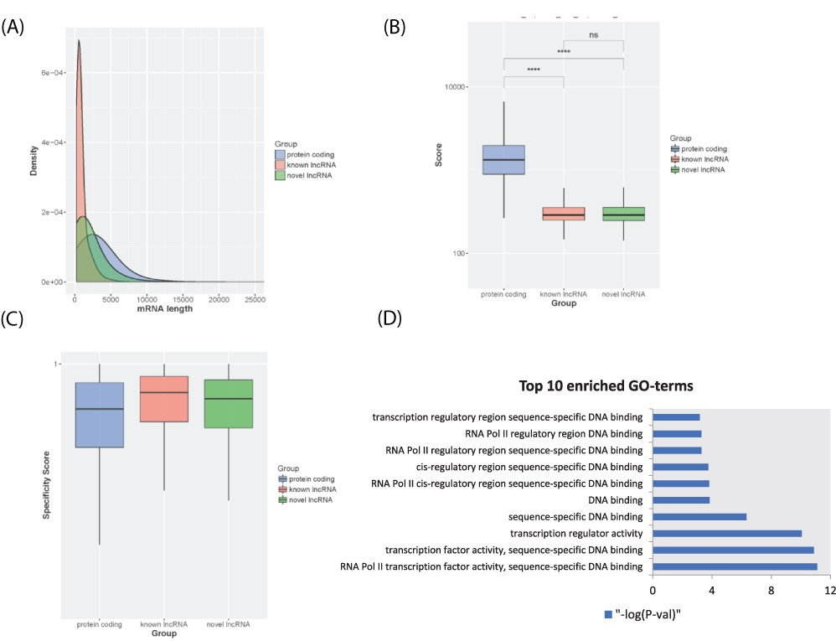
Figure 2. LncRNA transcript characterization. (A) Distribution of transcript lengths for known lncRNAs (red), novel ...
Notes:
Figure 2. LncRNA transcript characterization. (A) Distribution of transcript lengths for known lncRNAs (red), novel lncRNAs (green) and protein-coding genes (blue). (B) Boxplot of coding potential of transcripts by txCDS tool computed in three sets: known lncRNAs (red), novel lncRNAs (green) and protein-coding genes (blue). The statistical significance difference was calculated using Wilcoxon rank sum test. ‘ns’: non-significant, ‘****’: P-value < 0.001. (C) Boxplot of disease specificity score in three sets: known lncRNAs (red), novel lncRNAs (green) and protein-coding genes (blue). (D) Top 10 statistically significant enriched GO terms (molecular function category) for lncRNA HOTTIP 12 adjacent genes.
Unless provided in the caption above, the following copyright applies to the content of this slide: © The Author(s) 2021. Published by Oxford University Press.This is an Open Access article distributed under the terms of the Creative Commons Attribution License (https://creativecommons.org/licenses/by/4.0/), which permits unrestricted reuse, distribution, and reproduction in any medium, provided the original work is properly cited.

