Slide 1
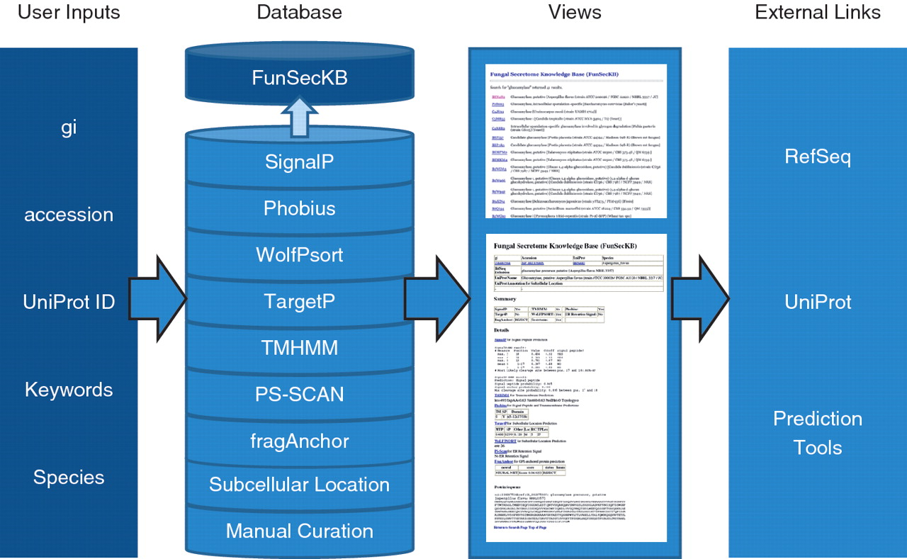
Figure 1. Overview of FunSecKB. To search the database users can enter NCBI RefSeq gi or accession number, UniProt ...
Notes:
Figure 1. Overview of FunSecKB. To search the database users can enter NCBI RefSeq gi or accession number, UniProt accession number, keywords or species. The database consists of information generated using seven prediction tools and subcellular location annotated in UniProtKB and our own manual curation. Users can browse through the results using the web user-interface. Links to external databases and resources are also provided for further exploration. Whole secretome sequences can be downloaded and BLAST utility can be accessed from the database interface.
Unless provided in the caption above, the following copyright applies to the content of this slide: © The Author(s) 2011. Published by Oxford University Press.This is Open Access article distributed under the terms of the Creative Commons Attribution Non-Commercial License (http://creativecommons.org/licenses/by-nc/2.5), which permits unrestricted non-commercial use, distribution, and reproduction in any medium, provided the original work is properly cited.

