Slide 1
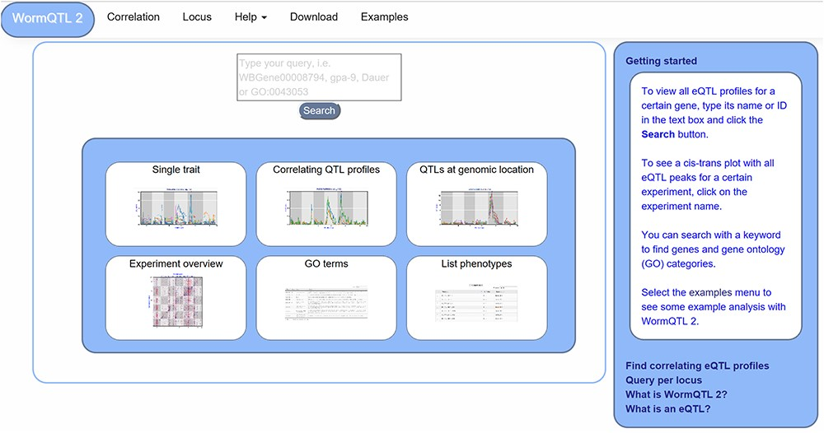
Figure 1 WormQTL2 Homepage. On the top of the page, the navigation bar can be found. This includes the WormQTL2 logo, ...
Notes:
Figure 1 WormQTL2 Homepage. On the top of the page, the navigation bar can be found. This includes the WormQTL2 logo, which functions as a home button. It also includes a fast link to the Correlation and Locus overviews as well as links for help, data download and visual examples. The search box is located in the center, in which genes, phenotypes and GO terms can be entered. Shown in the blue middle square are the buttons for the investigations of single traits, correlating QTL profiles, QTLs at a specific locus, all eQTLs of an experiment, eQTLs per GO term and a list of all phenotypes for which QTLs can be shown. On the right side, a bar with information about WormQTL2 and QTLs in general can be found.
Unless provided in the caption above, the following copyright applies to the content of this slide: © The Author(s) 2020. Published by Oxford University Press.This is an Open Access article distributed under the terms of the Creative Commons Attribution License (http://creativecommons.org/licenses/by/4.0/), which permits unrestricted reuse, distribution, and reproduction in any medium, provided the original work is properly cited.

Slide 2
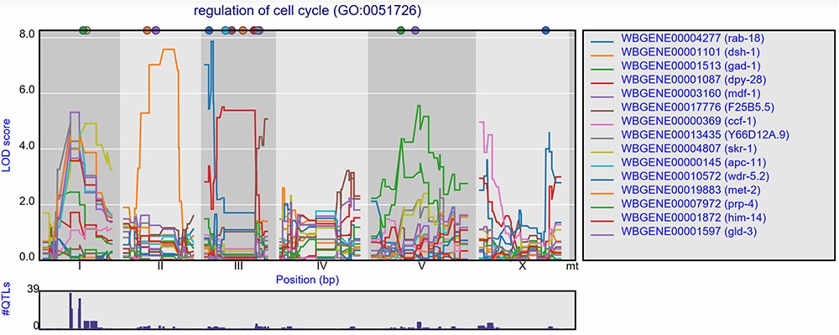
Figure 5 eQTL transband on chromosome X in Rockman et al. (67). The eQTL profiles of the top-15 highest eQTLs at ...
Notes:
Figure 5 eQTL transband on chromosome X in Rockman et al. (67). The eQTL profiles of the top-15 highest eQTLs at marker rmm1258 in Rockman et al. are shown as profiles. Colors indicate different genes. The legend is shown on the right. Chromosomes are indicated by different gray backgrounds and below the x-axis. The web-based plot is interactive; a mouse over provides the exact base pair position of each QTL or other point on the profile. Moreover, more than the top-15 can be added to the plot creating a custom overview.
Unless provided in the caption above, the following copyright applies to the content of this slide: © The Author(s) 2020. Published by Oxford University Press.This is an Open Access article distributed under the terms of the Creative Commons Attribution License (http://creativecommons.org/licenses/by/4.0/), which permits unrestricted reuse, distribution, and reproduction in any medium, provided the original work is properly cited.

Slide 3
Figure 2 eQTL profiles of gmd-2 from all experiments hosted in WormQTL2. The significance profile (−log10(p)) per ...
Notes:
Figure 2 eQTL profiles of gmd-2 from all experiments hosted in WormQTL2. The significance profile (−log10(p)) per experiment for gmd-2 is shown in different colors per experiment. The legend is shown on the right and shows the colors for the different experiments. Chromosomes are indicated by different gray backgrounds and below the x-axis. The web-based plot is interactive; a mouse over provides the exact base pair position of each QTL or other point on the profile.
Unless provided in the caption above, the following copyright applies to the content of this slide: © The Author(s) 2020. Published by Oxford University Press.This is an Open Access article distributed under the terms of the Creative Commons Attribution License (http://creativecommons.org/licenses/by/4.0/), which permits unrestricted reuse, distribution, and reproduction in any medium, provided the original work is properly cited.

Slide 4
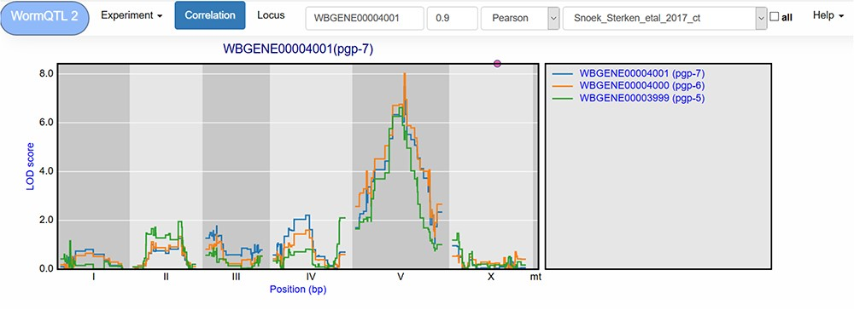
Figure 3 Correlation between eQTL profiles of pgp-7, pgp-6 and pgp-5. Correlation between the eQTL profile of pgp-7 ...
Notes:
Figure 3 Correlation between eQTL profiles of pgp-7, pgp-6 and pgp-5. Correlation between the eQTL profile of pgp-7 and the other genes was set to report those profiles with a Pearson correlation >0.9, see navigation bar at the top. Genes are shown in different colors. The legend is shown on the right. Chromosomes are indicated by different gray backgrounds and below the x-axis. The web-based plot is interactive; a mouse over provides the exact base pair position of each QTL or other point on the profile.
Unless provided in the caption above, the following copyright applies to the content of this slide: © The Author(s) 2020. Published by Oxford University Press.This is an Open Access article distributed under the terms of the Creative Commons Attribution License (http://creativecommons.org/licenses/by/4.0/), which permits unrestricted reuse, distribution, and reproduction in any medium, provided the original work is properly cited.

Slide 5
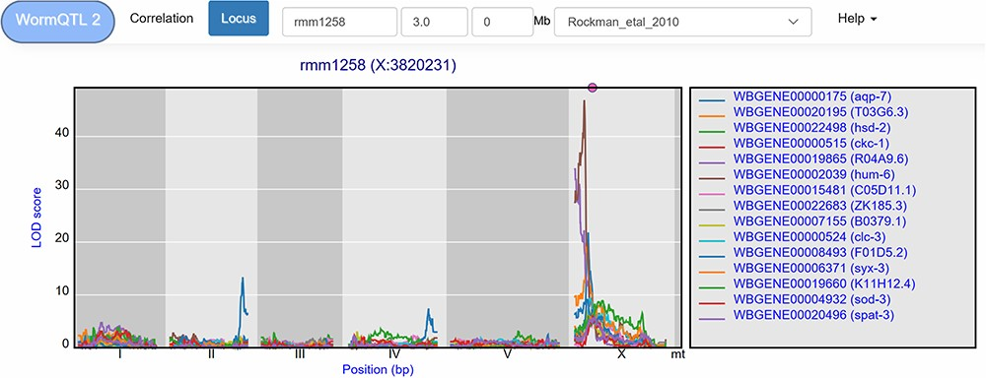
Figure 4 Co-locating eQTL profiles of genes annotated with GO term ‘regulation of cell cycle’. The eQTL profiles of ...
Notes:
Figure 4 Co-locating eQTL profiles of genes annotated with GO term ‘regulation of cell cycle’. The eQTL profiles of the top-15 highest eQTLs are shown as profiles. A histogram of all peaks −log10(p) > 3.5 is shown below the profile plot to detect possible regulatory hotspots, as can be observed here on chromosome I. Genes are shown in different colors. The legend is shown on the right. Chromosomes are indicated by different gray backgrounds and below the x-axis. The web-based plot is interactive; a mouse over provides the exact base pair position of each QTL or other point on the profile.
Unless provided in the caption above, the following copyright applies to the content of this slide: © The Author(s) 2020. Published by Oxford University Press.This is an Open Access article distributed under the terms of the Creative Commons Attribution License (http://creativecommons.org/licenses/by/4.0/), which permits unrestricted reuse, distribution, and reproduction in any medium, provided the original work is properly cited.

