Slide 1
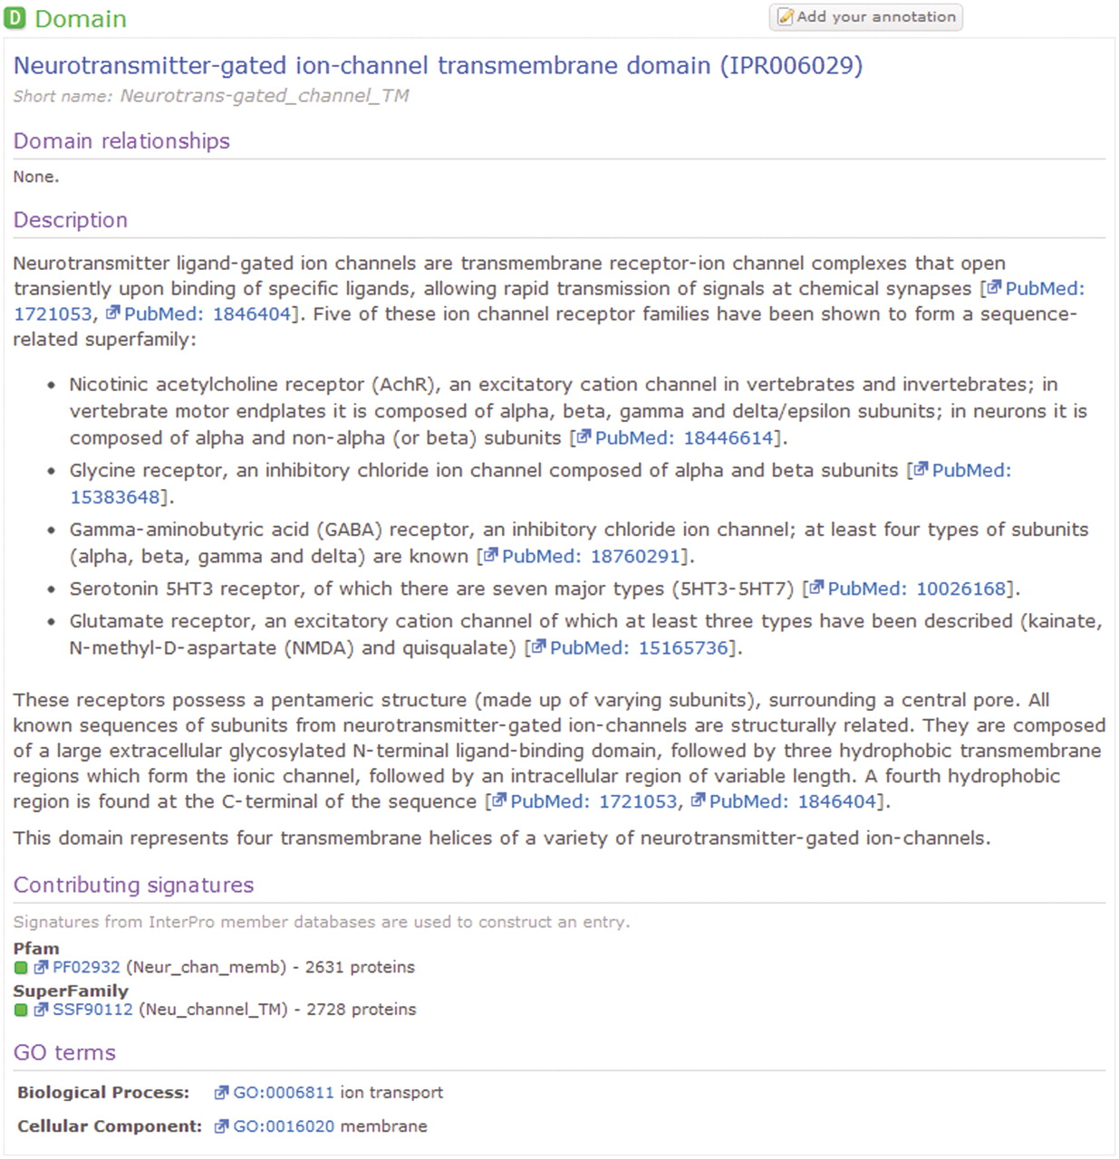
Figure 1. An example human-curated InterPro entry, illustrating the detailed description provided for the entry and ...
Notes:
Figure 1. An example human-curated InterPro entry, illustrating the detailed description provided for the entry and cross references to the GO and the member database signatures from which the entry is composed.
Unless provided in the caption above, the following copyright applies to the content of this slide: © The Author(s) 2011. Published by Oxford University Press.This is Open Access article distributed under the terms of the Creative Commons Attribution Non-Commercial License (http://creativecommons.org/licenses/by-nc/2.5), which permits unrestricted non-commercial use, distribution, and reproduction in any medium, provided the original work is properly cited.

