Slide 1
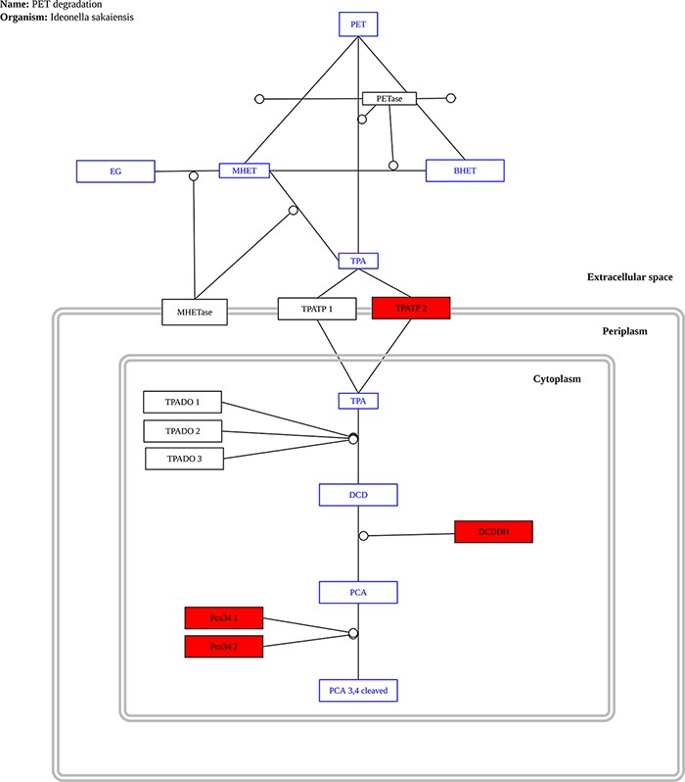
Figure 8. Example graph output from the ‘Pathway Analysis’ tool. Black rectangles represent proteins, blue rectangles ...
Notes:
Figure 8. Example graph output from the ‘Pathway Analysis’ tool. Black rectangles represent proteins, blue rectangles represent substrates and red rectangles represent proteins present in the genome or metagenome being investigated, in this case, the genome of the bacterium P. aeruginosa.
Unless provided in the caption above, the following copyright applies to the content of this slide: © The Author(s) 2022. Published by Oxford University Press.This is an Open Access article distributed under the terms of the Creative Commons Attribution License (https://creativecommons.org/licenses/by/4.0/), which permits unrestricted reuse, distribution, and reproduction in any medium, provided the original work is properly cited.

