Slide 1
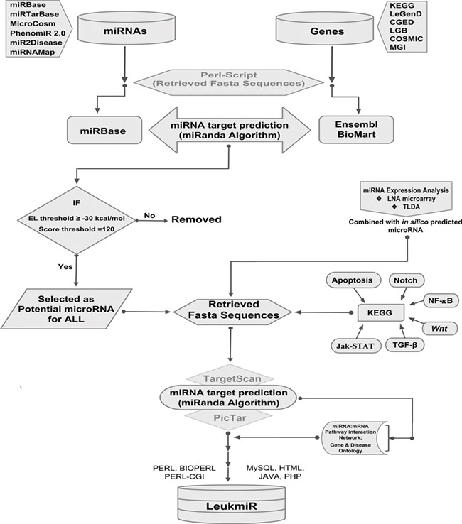
Figure 1 Schematic representation of database structure and construction. The work flow represents the mining of ...
Notes:
Figure 1 Schematic representation of database structure and construction. The work flow represents the mining of miRNAs and their target genes using Perl script and further incorporation into the database using mysql, perl-cgi, java, php and html.
Unless provided in the caption above, the following copyright applies to the content of this slide: © The Author(s) 2020. Published by Oxford University Press.This is an Open Access article distributed under the terms of the Creative Commons Attribution License (http://creativecommons.org/licenses/by/4.0/), which permits unrestricted reuse, distribution, and reproduction in any medium, provided the original work is properly cited.

Slide 2
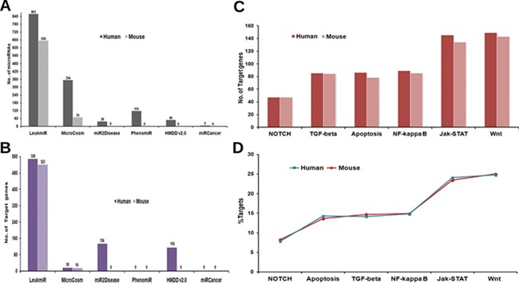
Figure 2 Contents of ‘LeukmiR’. Total number of (A) ALL miRNAs and (B) target genes for both human and mouse in ...
Notes:
Figure 2 Contents of ‘LeukmiR’. Total number of (A) ALL miRNAs and (B) target genes for both human and mouse in LeukmiR compared to MirCosm, miR2Disease, PhenomiR, HMDD v2.0 and miRCancer databases. (C) Total number of microRNA targets with respect to different pathways. (D) Percentage of the same available in different signaling pathways.
Unless provided in the caption above, the following copyright applies to the content of this slide: © The Author(s) 2020. Published by Oxford University Press.This is an Open Access article distributed under the terms of the Creative Commons Attribution License (http://creativecommons.org/licenses/by/4.0/), which permits unrestricted reuse, distribution, and reproduction in any medium, provided the original work is properly cited.

Slide 3
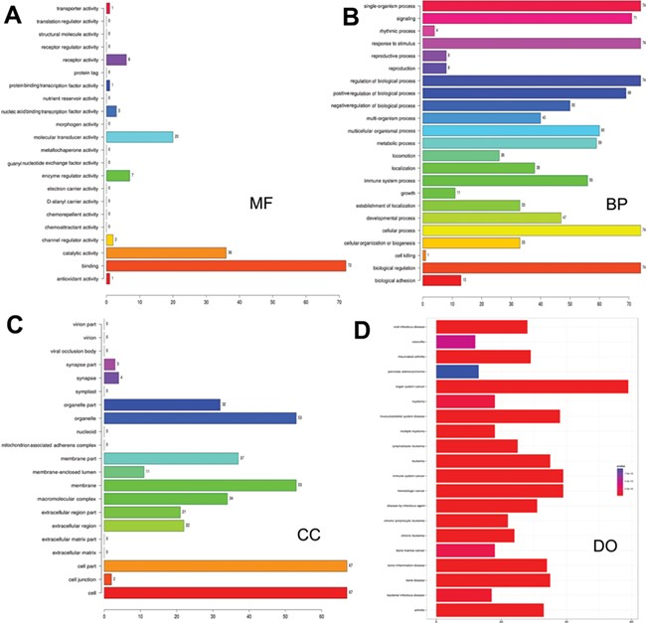
Figure 3 Gene ontology and disease ontology of miRNA targets in various signaling pathways. The gene ontology of ...
Notes:
Figure 3 Gene ontology and disease ontology of miRNA targets in various signaling pathways. The gene ontology of targets represented in terms of their associated (A) molecular function (MF), (B) biological process (BP), (C) cellular component (CC) and (D) disease ontology of target genes.
Unless provided in the caption above, the following copyright applies to the content of this slide: © The Author(s) 2020. Published by Oxford University Press.This is an Open Access article distributed under the terms of the Creative Commons Attribution License (http://creativecommons.org/licenses/by/4.0/), which permits unrestricted reuse, distribution, and reproduction in any medium, provided the original work is properly cited.

