Slide 1
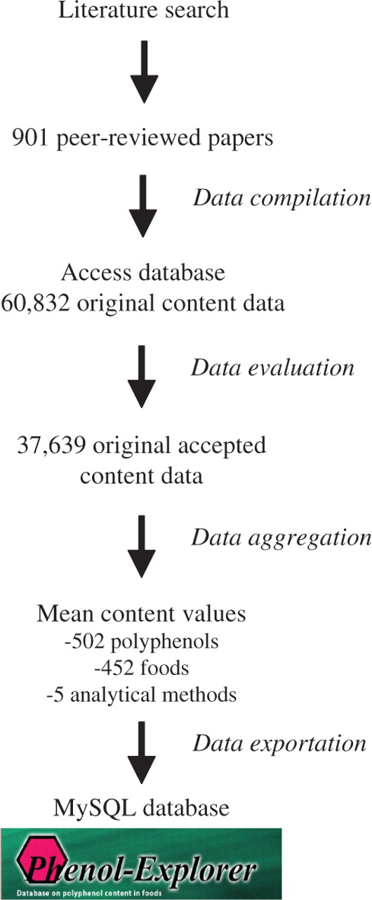
Figure 1. Schema of the development of the Phenol-Explorer database.
Notes:
Figure 1. Schema of the development of the Phenol-Explorer database.
Unless provided in the caption above, the following copyright applies to the content of this slide: © The Author(s) 2010. Published by Oxford University Press.This is Open Access article distributed under the terms of the Creative Commons Attribution Non-Commercial License (http://creativecommons.org/licenses/by-nc/2.5), which permits unrestricted non-commercial use, distribution, and reproduction in any medium, provided the original work is properly cited.

Slide 2
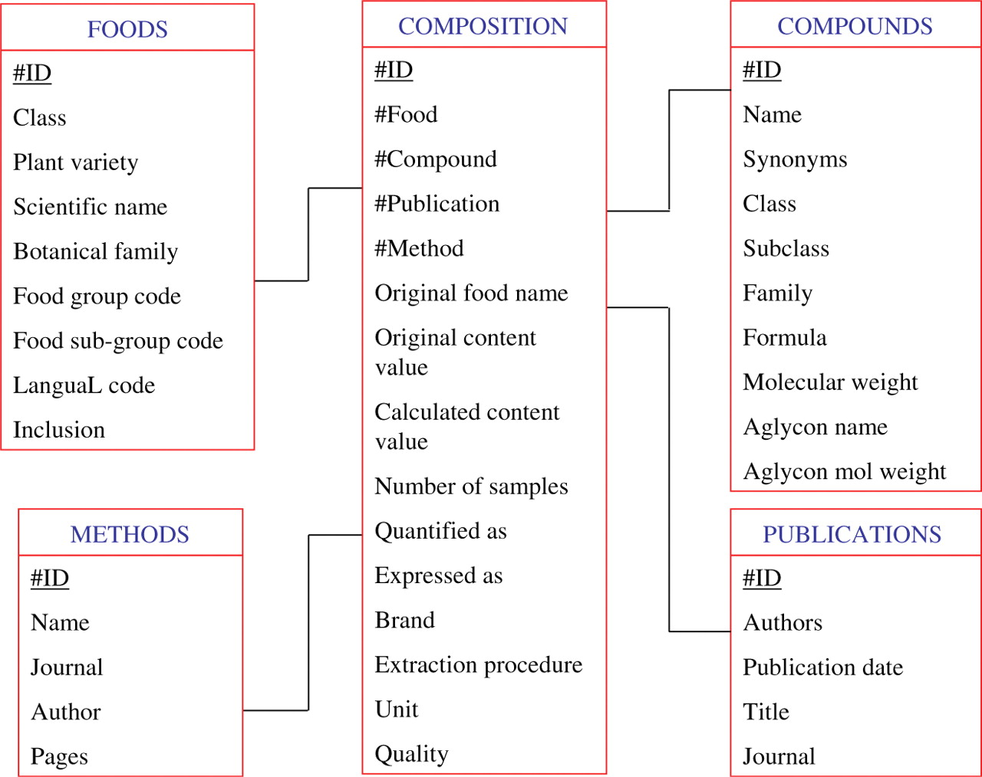
Figure 2. The different tables and their relationships in the Phenol-Explorer database.
Notes:
Figure 2. The different tables and their relationships in the Phenol-Explorer database.
Unless provided in the caption above, the following copyright applies to the content of this slide: © The Author(s) 2010. Published by Oxford University Press.This is Open Access article distributed under the terms of the Creative Commons Attribution Non-Commercial License (http://creativecommons.org/licenses/by-nc/2.5), which permits unrestricted non-commercial use, distribution, and reproduction in any medium, provided the original work is properly cited.

Slide 3
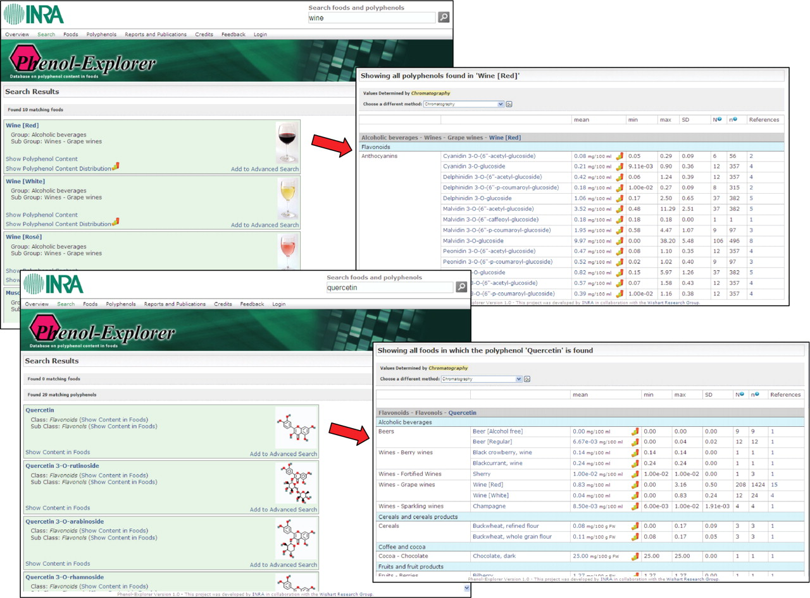
Figure 3. Phenol-Explorer: screenshot of simple searches for a food and the polyphenols it contains, or for a ...
Notes:
Figure 3. Phenol-Explorer: screenshot of simple searches for a food and the polyphenols it contains, or for a polyphenol and the foods containing it.
Unless provided in the caption above, the following copyright applies to the content of this slide: © The Author(s) 2010. Published by Oxford University Press.This is Open Access article distributed under the terms of the Creative Commons Attribution Non-Commercial License (http://creativecommons.org/licenses/by-nc/2.5), which permits unrestricted non-commercial use, distribution, and reproduction in any medium, provided the original work is properly cited.

Slide 4
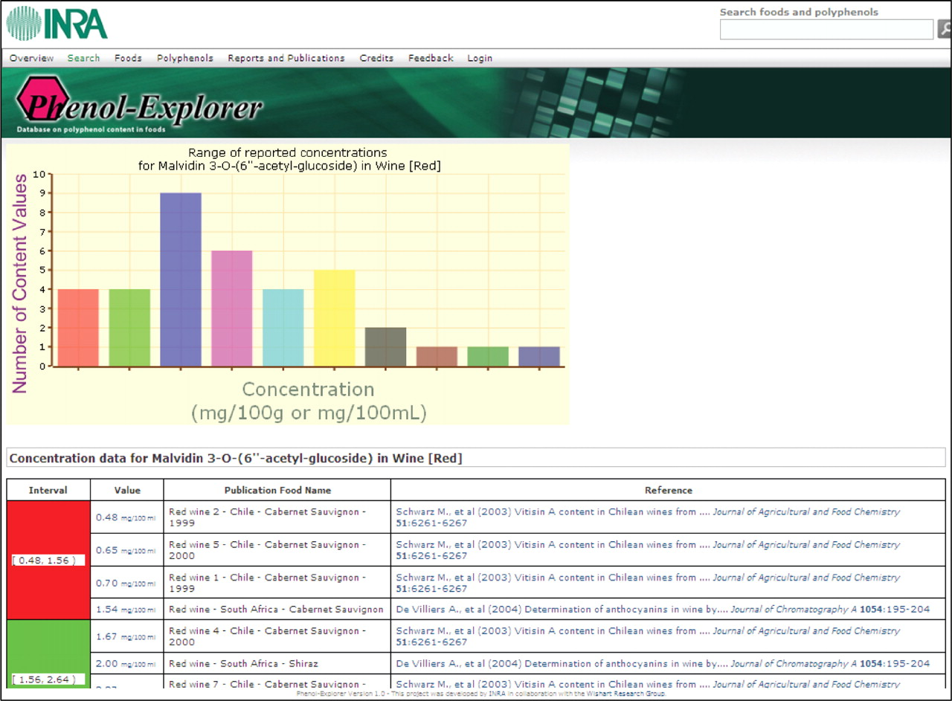
Figure 4. Phenol-Explorer: screenshot of the distribution of the different original content values and their ...
Notes:
Figure 4. Phenol-Explorer: screenshot of the distribution of the different original content values and their corresponding literature references, used to calculate a mean content value of a given polyphenol in a given food.
Unless provided in the caption above, the following copyright applies to the content of this slide: © The Author(s) 2010. Published by Oxford University Press.This is Open Access article distributed under the terms of the Creative Commons Attribution Non-Commercial License (http://creativecommons.org/licenses/by-nc/2.5), which permits unrestricted non-commercial use, distribution, and reproduction in any medium, provided the original work is properly cited.

Slide 5
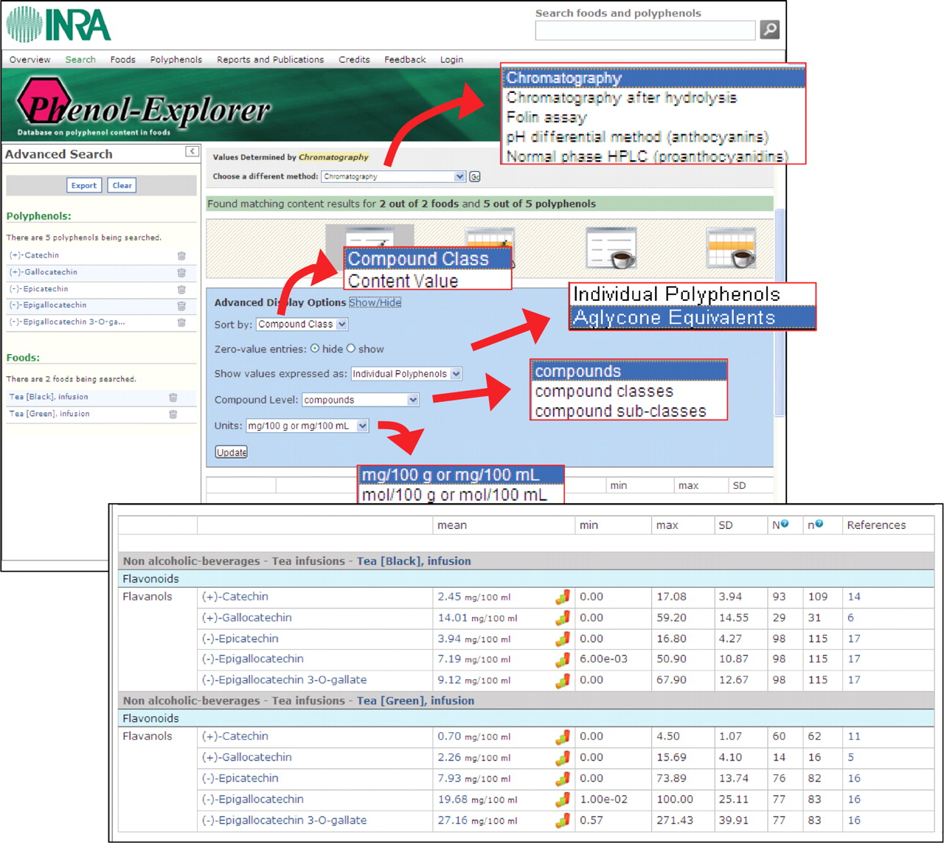
Figure 5. Phenol-Explorer: screenshot of an advanced search showing the different display options.
Notes:
Figure 5. Phenol-Explorer: screenshot of an advanced search showing the different display options.
Unless provided in the caption above, the following copyright applies to the content of this slide: © The Author(s) 2010. Published by Oxford University Press.This is Open Access article distributed under the terms of the Creative Commons Attribution Non-Commercial License (http://creativecommons.org/licenses/by-nc/2.5), which permits unrestricted non-commercial use, distribution, and reproduction in any medium, provided the original work is properly cited.

Slide 6
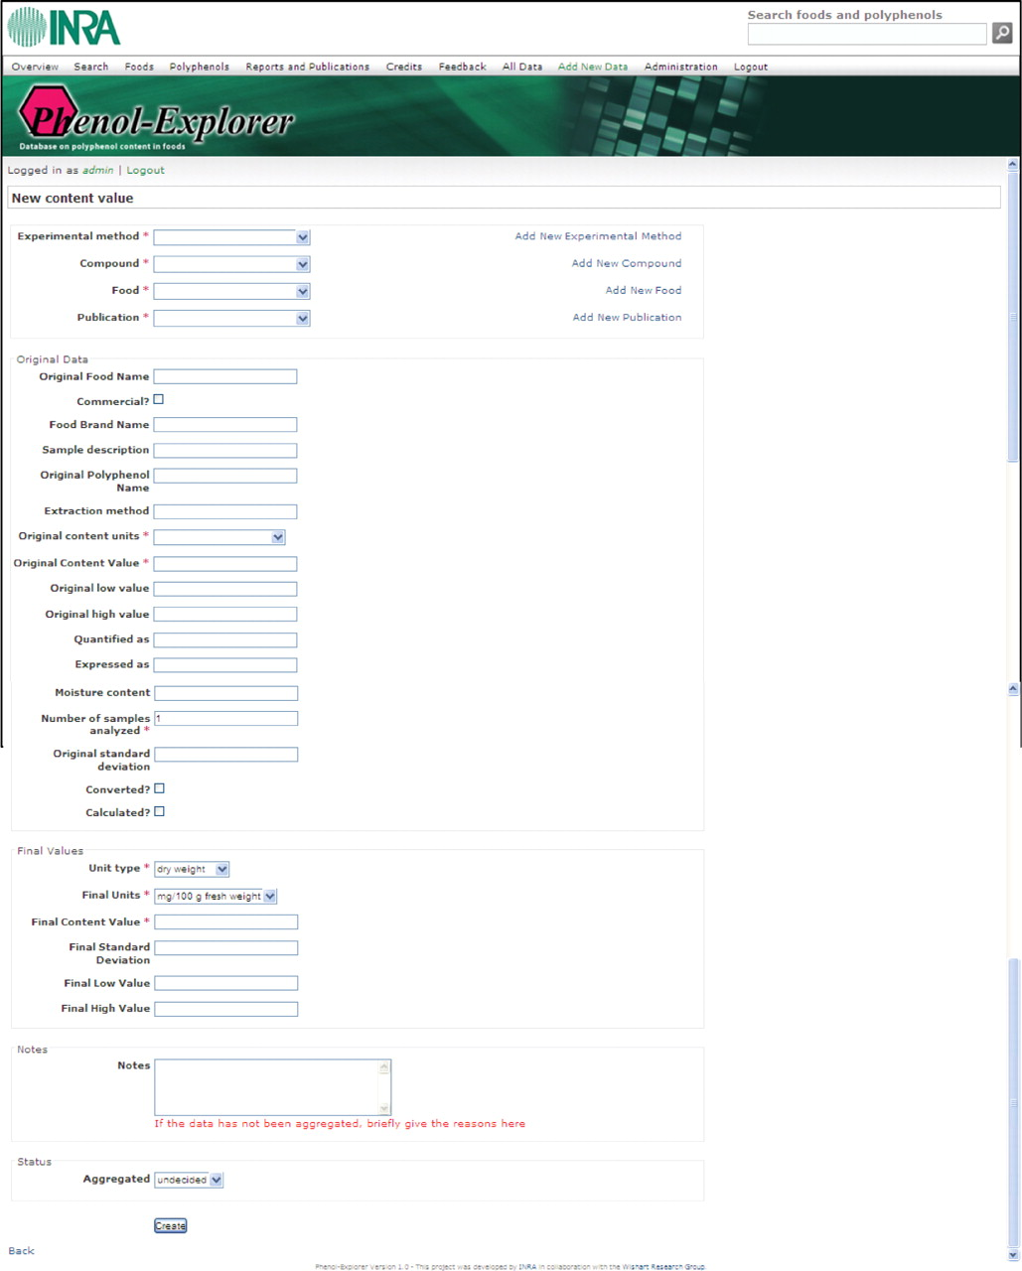
Figure 6. Phenol-Explorer: screenshot of the webpage from which new data can be added by an authorized compiler.
Notes:
Figure 6. Phenol-Explorer: screenshot of the webpage from which new data can be added by an authorized compiler.
Unless provided in the caption above, the following copyright applies to the content of this slide: © The Author(s) 2010. Published by Oxford University Press.This is Open Access article distributed under the terms of the Creative Commons Attribution Non-Commercial License (http://creativecommons.org/licenses/by-nc/2.5), which permits unrestricted non-commercial use, distribution, and reproduction in any medium, provided the original work is properly cited.

