Slide 1
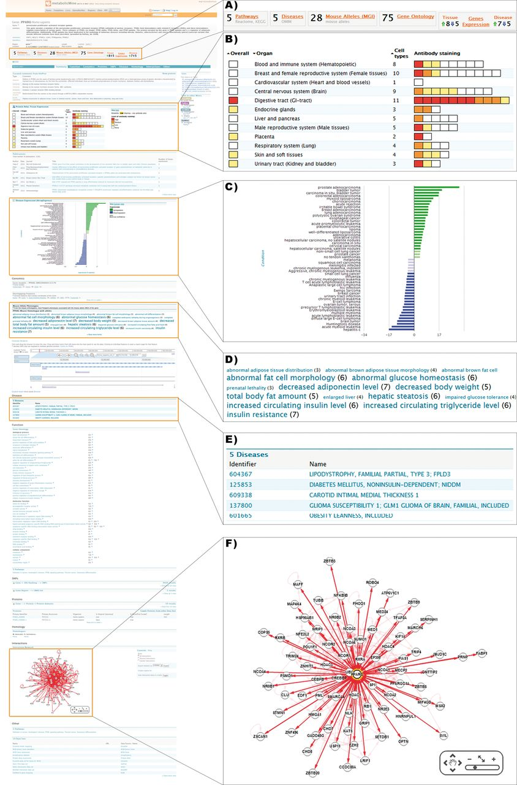
Figure 2. Detailed view of a metabolicMine gene report page, focusing on the gene PPARG. Report pages collate ...
Notes:
Figure 2. Detailed view of a metabolicMine gene report page, focusing on the gene PPARG. Report pages collate information from a range of data sets and include visualization tools and further links. (A) Previews provide summary counts for key data sets, helping the user identify relevant information. (B) Heatmaps are used to indicate PPARG protein levels in different tissues based on staining results in Protein Atlas. (C) Disease expression data from ArrayExpress is visualized, enabling exploration of links with different diseases. (D) The phenotype Tag Cloud is associated with the available alleles of the mouse PPARG homologue, enabling researchers to find interesting mouse strains for further experiments. Phenotypes with more alleles are displayed more prominently. (E) Human disease associations are summarized in tabular form and hyperlinked to the relevant report pages. (F) An interactive graphical tool enables exploration of PPARG's interactions with other genes, generated using data from IntAct and BioGRID.
Unless provided in the caption above, the following copyright applies to the content of this slide: © Crown copyright 2013.

