Slide 1
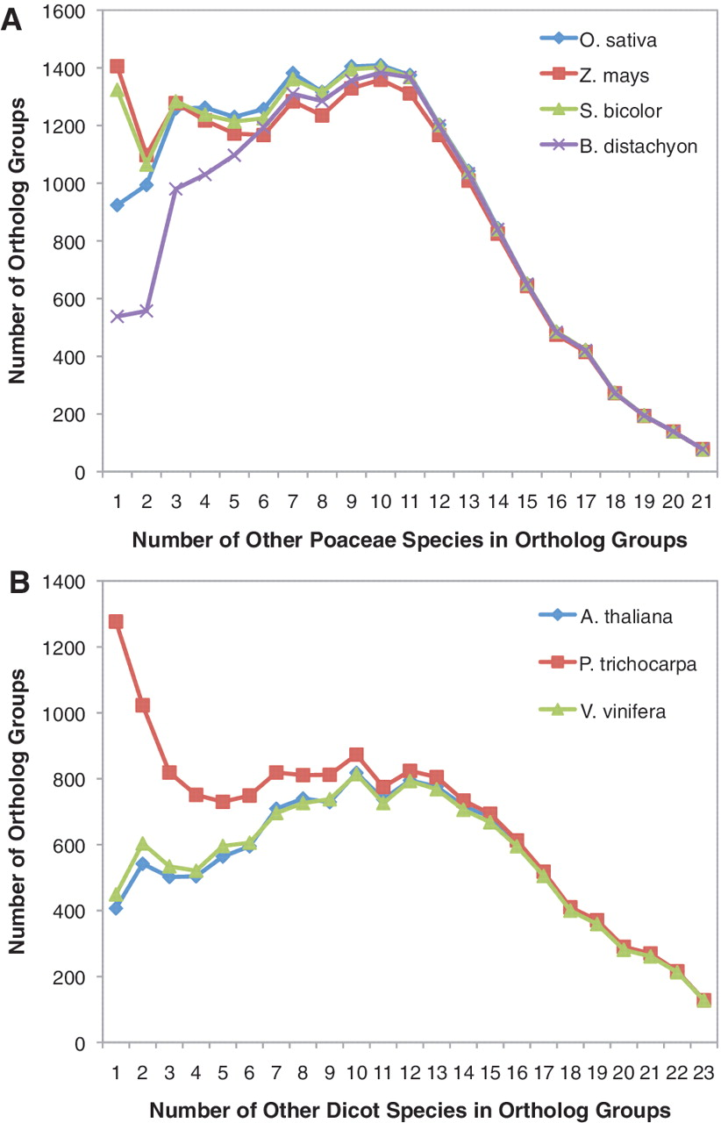
Figure 2. Number of additional species in orthologous groups with B. distachyon, O. sativa, S. bicolor and Z. mays. (A) ...
Notes:
Figure 2. Number of additional species in orthologous groups with B. distachyon, O. sativa, S. bicolor and Z. mays. (A) For each orthologous group, the number of other Poaceae species present within the orthologous group was quantified. Counts were determined separately for orthologous groups containing B. distachyon, O. sativa, S. bicolor and Z. mays sequences. Proteins from A. thaliana, P. trichocarpa and V. vinifera were not included in these species counts. (B) For each orthologous group, the number of other dicot species present within the orthologous group was quantified. Counts were determined separately for orthologous groups containing A. thaliana, P. trichocarpa and V. vinifera sequences. Proteins from B. distachyon, O. sativa, S. bicolor and Z. mays were not included in these species counts.
Unless provided in the caption above, the following copyright applies to the content of this slide: © The Author(s) 2012. Published by Oxford University Press.This is an Open Access article distributed under the terms of the Creative Commons Attribution Non-Commercial License (http://creativecommons.org/licenses/by-nc/3.0), which permits unrestricted non-commercial use, distribution, and reproduction in any medium, provided the original work is properly cited.

