Slide 1
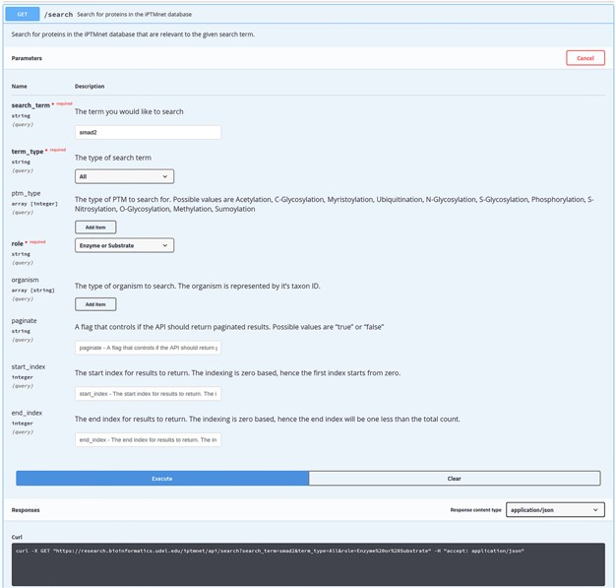
Figure 2 Performing a search with API using Swagger UI. iPTMnet API documentation for the ‘/search’ endpoint. The ...
Notes:
Figure 2 Performing a search with API using Swagger UI. iPTMnet API documentation for the ‘/search’ endpoint. The Swagger UI provides a webpage for users to explore the API in an interactive manner. Users can enter various query parameters and execute the query to obtain the results. The webpage also generates a cURL command (illustrated) that can be executed in a command-line shell to query the API and obtain the results.
Unless provided in the caption above, the following copyright applies to the content of this slide: © The Author(s) 2020. Published by Oxford University Press.This is an Open Access article distributed under the terms of the Creative Commons Attribution License (http://creativecommons.org/licenses/by/4.0/), which permits unrestricted reuse, distribution, and reproduction in any medium, provided the original work is properly cited.

