Slide 1
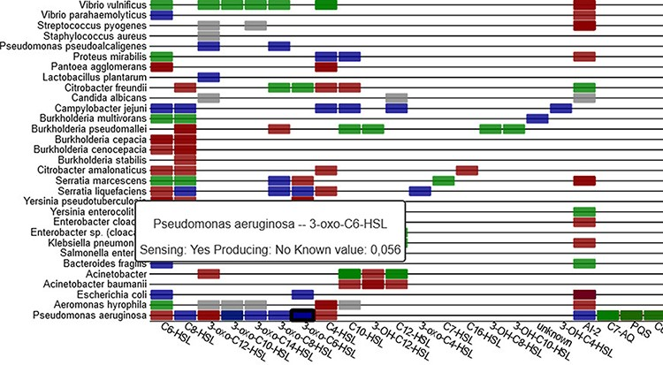
Figure 6. Sensing information between organisms and signal molecules is depicted in a heat-map (part shown), with ...
Notes:
Figure 6. Sensing information between organisms and signal molecules is depicted in a heat-map (part shown), with colour coding representing the different classes of mechanisms (sensing, producing, inhibiting and unclear).
Unless provided in the caption above, the following copyright applies to the content of this slide: © The Author(s) 2021. Published by Oxford University Press.This is an Open Access article distributed under the terms of the Creative Commons Attribution License (https://creativecommons.org/licenses/by/4.0/), which permits unrestricted reuse, distribution, and reproduction in any medium, provided the original work is properly cited.

