Slide 1
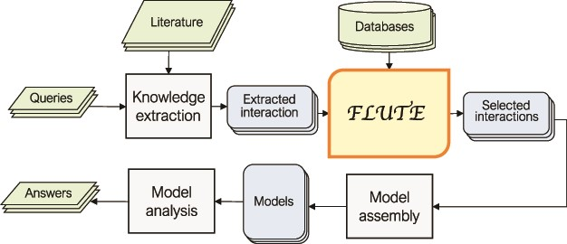
Figure 1 An outline of the role of FLUTE in the automated information extraction and the model assembly and analysis ...
Notes:
Figure 1 An outline of the role of FLUTE in the automated information extraction and the model assembly and analysis flow: FLUTE uses available databases to filter extracted interactions obtained as output of knowledge extraction process from available literature, which is usually initiated by user queries. The selected interactions from FLUTE are inputs to model assembly that creates models, which are then explored with model analysis in order to provide answers to user questions.
Unless provided in the caption above, the following copyright applies to the content of this slide: © The Author(s) 2020. Published by Oxford University Press.This is an Open Access article distributed under the terms of the Creative Commons Attribution License (http://creativecommons.org/licenses/by/4.0/), which permits unrestricted reuse, distribution, and reproduction in any medium, provided the original work is properly cited.

Slide 2
Figure 2 From sentences to scored interactions: (a) example sentence and the corresponding machine reading output; (b) ...
Notes:
Figure 2 From sentences to scored interactions: (a) example sentence and the corresponding machine reading output; (b) graphical representation of interactions; (c) interactions found between ERK1, ERK2 and RAGE by STRING.
Unless provided in the caption above, the following copyright applies to the content of this slide: © The Author(s) 2020. Published by Oxford University Press.This is an Open Access article distributed under the terms of the Creative Commons Attribution License (http://creativecommons.org/licenses/by/4.0/), which permits unrestricted reuse, distribution, and reproduction in any medium, provided the original work is properly cited.

Slide 3
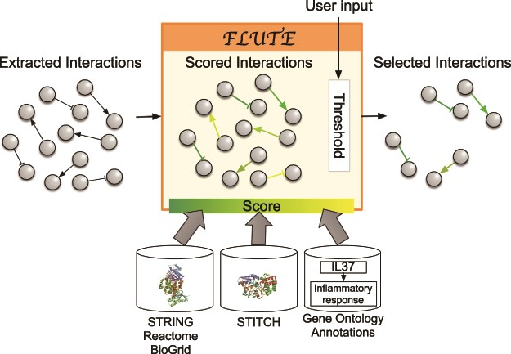
Figure 3 Filtration process with FLUTE: inputs to FLUTE include extracted interactions, scores of these interactions ...
Notes:
Figure 3 Filtration process with FLUTE: inputs to FLUTE include extracted interactions, scores of these interactions that are found in databases, and the user’s selection of thresholds for the scores. Outputs from FLUTE include selected interactions determined by their scores and thresholds.
Unless provided in the caption above, the following copyright applies to the content of this slide: © The Author(s) 2020. Published by Oxford University Press.This is an Open Access article distributed under the terms of the Creative Commons Attribution License (http://creativecommons.org/licenses/by/4.0/), which permits unrestricted reuse, distribution, and reproduction in any medium, provided the original work is properly cited.

Slide 4
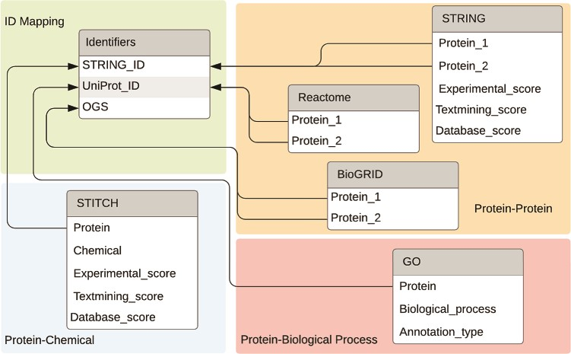
Figure 4 Databases and the connections between databases used by FLUTE.
Notes:
Figure 4 Databases and the connections between databases used by FLUTE.
Unless provided in the caption above, the following copyright applies to the content of this slide: © The Author(s) 2020. Published by Oxford University Press.This is an Open Access article distributed under the terms of the Creative Commons Attribution License (http://creativecommons.org/licenses/by/4.0/), which permits unrestricted reuse, distribution, and reproduction in any medium, provided the original work is properly cited.

Slide 5
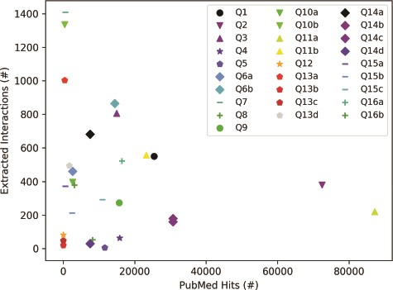
Figure 5 Influence of query category and term choice (the legend corresponds to query numbers in Table 3) on the ...
Notes:
Figure 5 Influence of query category and term choice (the legend corresponds to query numbers in Table 3) on the number of papers found in PubMed and on the number of interactions extracted from the top 200 papers (except Q12, Q13b and Q13c, where PubMed returned less than 200 hits). Results obtained for the same query topic category, but different term aliases, or different example terms, are grouped together with the same marker shape and similar color.
Unless provided in the caption above, the following copyright applies to the content of this slide: © The Author(s) 2020. Published by Oxford University Press.This is an Open Access article distributed under the terms of the Creative Commons Attribution License (http://creativecommons.org/licenses/by/4.0/), which permits unrestricted reuse, distribution, and reproduction in any medium, provided the original work is properly cited.

Slide 6
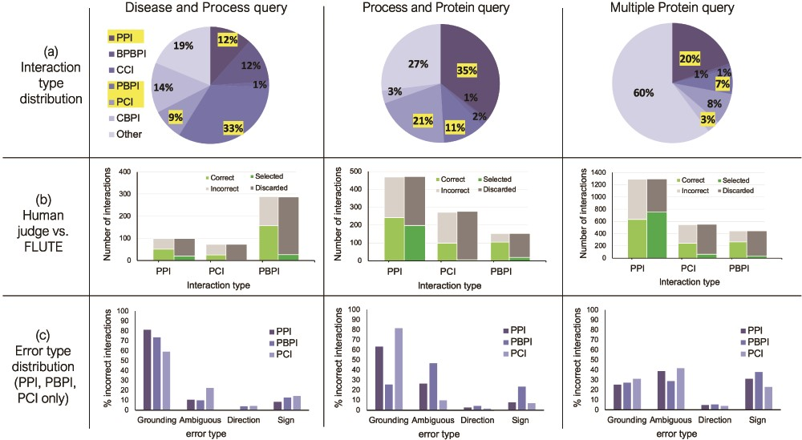
Figure 6 The influence of interaction type and machine reading errors on the number of selected interactions. (a) ...
Notes:
Figure 6 The influence of interaction type and machine reading errors on the number of selected interactions. (a) Overall distribution of interaction types for the three different queries, disease and biological process query, biological process and protein query and multiple protein query. (b) The comparison between FLUTE and manual selection; human judge decides whether interaction is correct given literature evidence, and FLUTE selects the interactions that are supported by databases. (c) The distribution of errors types in machine extraction of PPIs, PBPIs and PCIs for the three different queries.
Unless provided in the caption above, the following copyright applies to the content of this slide: © The Author(s) 2020. Published by Oxford University Press.This is an Open Access article distributed under the terms of the Creative Commons Attribution License (http://creativecommons.org/licenses/by/4.0/), which permits unrestricted reuse, distribution, and reproduction in any medium, provided the original work is properly cited.

Slide 7
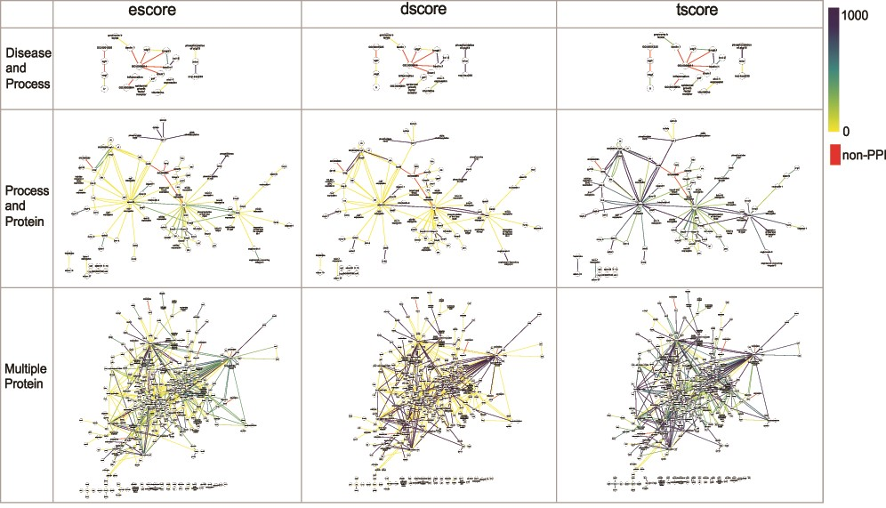
Figure 7 The networks of selected PPI interactions for the Disease and Process set (top row), Process and Protein set ...
Notes:
Figure 7 The networks of selected PPI interactions for the Disease and Process set (top row), Process and Protein set (middle row), and Multiple Protein set (bottom row), where each edge color represents a value of escore (left), dscore (middle) or tscore (right). Each PPI edge is colored by the indicated score type, from the minimum (0) to the maximum score (1000). A red edge indicates a non-PPI.
Unless provided in the caption above, the following copyright applies to the content of this slide: © The Author(s) 2020. Published by Oxford University Press.This is an Open Access article distributed under the terms of the Creative Commons Attribution License (http://creativecommons.org/licenses/by/4.0/), which permits unrestricted reuse, distribution, and reproduction in any medium, provided the original work is properly cited.

Slide 8
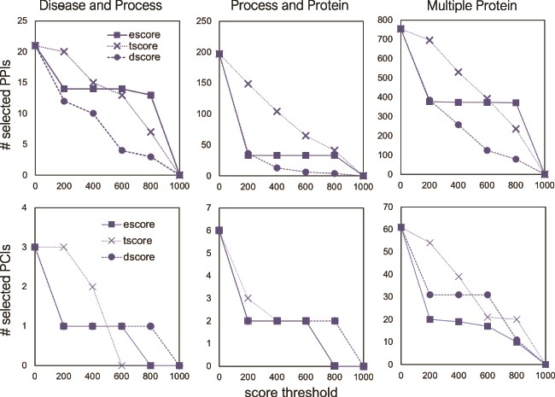
Figure 8 The number of selected interactions, PPIs (top) and PCIs (bottom) as a function of a score threshold for each ...
Notes:
Figure 8 The number of selected interactions, PPIs (top) and PCIs (bottom) as a function of a score threshold for each score type, for the three different queries.
Unless provided in the caption above, the following copyright applies to the content of this slide: © The Author(s) 2020. Published by Oxford University Press.This is an Open Access article distributed under the terms of the Creative Commons Attribution License (http://creativecommons.org/licenses/by/4.0/), which permits unrestricted reuse, distribution, and reproduction in any medium, provided the original work is properly cited.

Slide 9
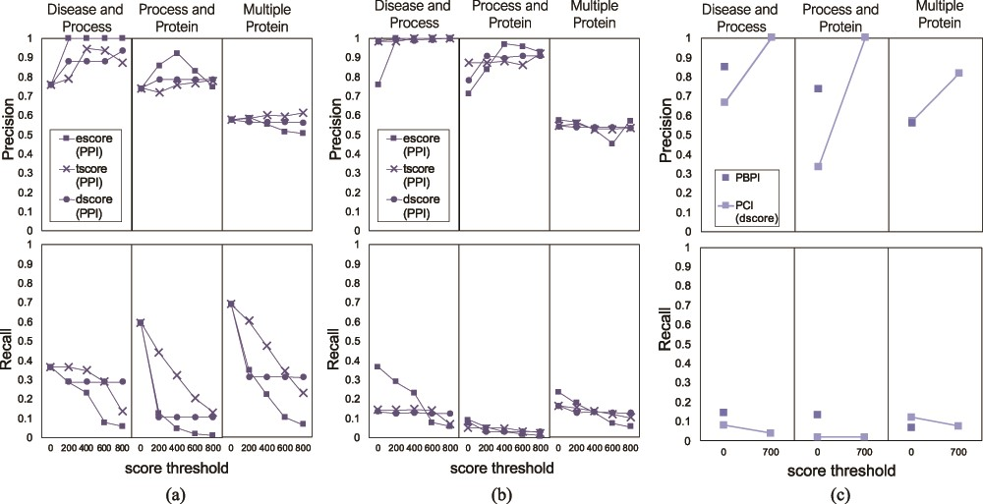
Figure 9 Precision and recall of FLUTE, compared to human judging, and the sensitivity of precision and recall to the ...
Notes:
Figure 9 Precision and recall of FLUTE, compared to human judging, and the sensitivity of precision and recall to the scores, for the three different queries: (a) precision and recall when filtering PPIs with only one subscore at a time, (b) average precision and recall when filtering PPIs for all possible subscore combinations and (c) precision and recall when filtering PBPI and PCIs.
Unless provided in the caption above, the following copyright applies to the content of this slide: © The Author(s) 2020. Published by Oxford University Press.This is an Open Access article distributed under the terms of the Creative Commons Attribution License (http://creativecommons.org/licenses/by/4.0/), which permits unrestricted reuse, distribution, and reproduction in any medium, provided the original work is properly cited.

Slide 10
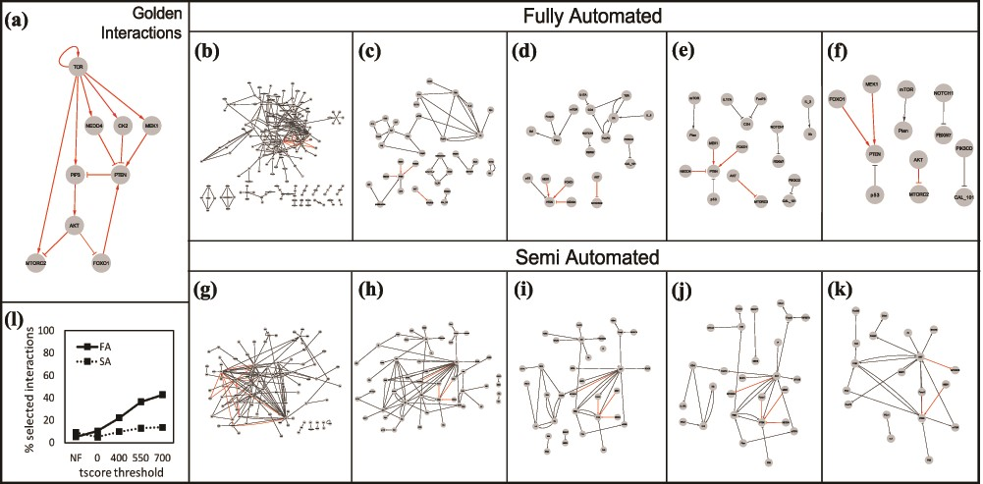
Figure 10 (a) The golden set of interactions from (27). The gray box in the right-hand corner shows the number of ...
Notes:
Figure 10 (a) The golden set of interactions from (27). The gray box in the right-hand corner shows the number of golden interactions present in each set in red. Interactions obtained using the Fully Automated (FA) approach: (b) unfiltered, (c) filtered without thresholds, (d) tscore > 400, (e) tscore > 550, (f) tscore > 700. Interactions obtained using the Semi Automated (SA) approach: (g) unfiltered, (h) filtered, no thresholds, (i) tscore > 400, (j) tscore > 550, (k) tscore > 700. (l) Comparison of the two approaches: % of selected interactions in each approach as a function of a tscore threshold.
Unless provided in the caption above, the following copyright applies to the content of this slide: © The Author(s) 2020. Published by Oxford University Press.This is an Open Access article distributed under the terms of the Creative Commons Attribution License (http://creativecommons.org/licenses/by/4.0/), which permits unrestricted reuse, distribution, and reproduction in any medium, provided the original work is properly cited.

Slide 11
Figure 11 Results of STRING search for the T-cell case study: (a) Interactions between the STRING search terms (PTEN, ...
Notes:
Figure 11 Results of STRING search for the T-cell case study: (a) Interactions between the STRING search terms (PTEN, AKT1 and FOXO1) illustrated as a graph. (b) Expanded network with 50 additional nodes, threshold of 0.65. (c) Expanded network with 50 additional nodes, threshold of 0.95. (NOTE: Unlike the STRING database, the STRING web application uses score values within the [0,1] interval, where 0 is low-confidence, and 1 is high confidence. Interactions from the list of golden interactions illustrated in Figure 10a are in red.)
Unless provided in the caption above, the following copyright applies to the content of this slide: © The Author(s) 2020. Published by Oxford University Press.This is an Open Access article distributed under the terms of the Creative Commons Attribution License (http://creativecommons.org/licenses/by/4.0/), which permits unrestricted reuse, distribution, and reproduction in any medium, provided the original work is properly cited.

