Slide 1
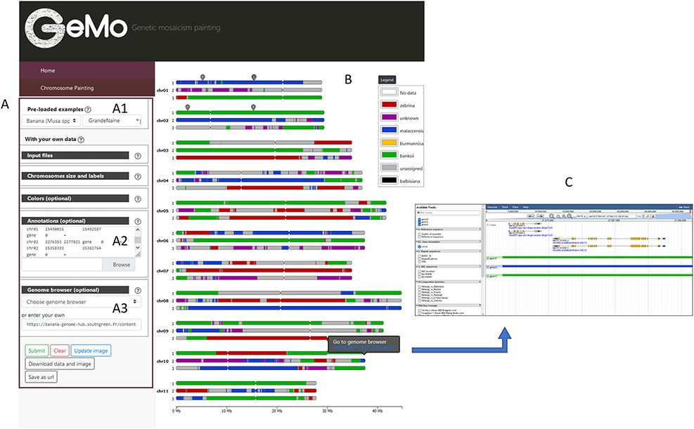
Figure 1. Overview of the GeMo visualization interface representing the genome ancestry mosaics of the triploid ...
Notes:
Figure 1. Overview of the GeMo visualization interface representing the genome ancestry mosaics of the triploid cultivated banana ‘Grande Naine’ (13). (A) Menu panel allowing the user to load their own data or to visualize preloaded data (A1). (B) Predicted mosaic structure for the 3 × 11 chromosomes as proposed in (13). Each color on the chromosomes represents a genetic group, except dark gray for undefined genomic block. Symbols on chr01 and chr02 indicate genomic features (such as gene of interest, QTLs, etc.) entered by users based on genomic coordinates of the reference genome used to draw the genome ancestry mosaics in the menu entitled ‘Annotations’ in A2. (C) Automatically exported dataset from GeMo by clicking on a block and imported as a track to the JBrowse configured in the Genome Browser menu in A3.
Unless provided in the caption above, the following copyright applies to the content of this slide: © The Author(s) 2022. Published by Oxford University Press.This is an Open Access article distributed under the terms of the Creative Commons Attribution-NonCommercial License (https://creativecommons.org/licenses/by-nc/4.0/), which permits non-commercial re-use, distribution, and reproduction in any medium, provided the original work is properly cited. For commercial re-use, please contact journals.permissions@oup.com

