Slide 1
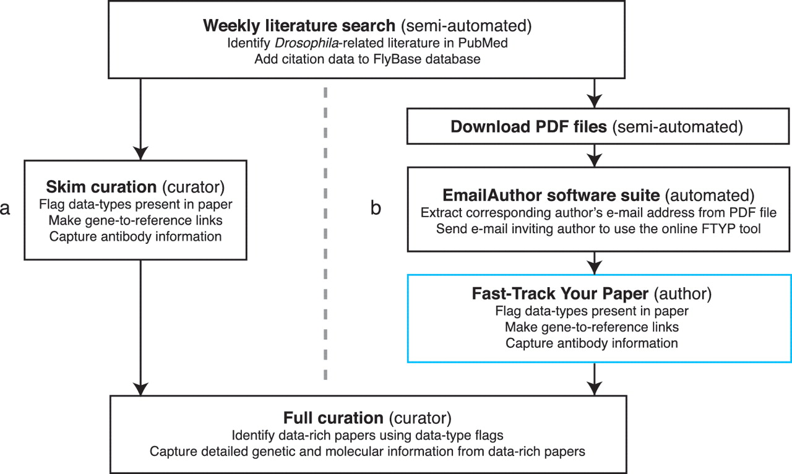
Figure 1. Literature curation pipeline before (a) and after (b) integrating community curation. A weekly search of the ...
Notes:
Figure 1. Literature curation pipeline before (a) and after (b) integrating community curation. A weekly search of the PubMed database identifies recent Drosophila-related publications. Newly identified papers subsequently undergo skim curation, which assigns data type flags and captures a limited subset of curated information (genes studied and antibodies generated). The data type flags are used to identify data-rich papers which are prioritized for full curation. The skim curation step previously carried out by FlyBase curators (a), has been replaced by community curation (b) by adapting the pipeline. First, we now download the PDF file of each new publication (currently possible for 89% of new papers). Secondly, we developed the EmailAuthor software suite, which is used to automatically e-mail the corresponding author of new papers. Finally, authors who have been e-mailed use the FTYP tool to skim curate their paper.
Unless provided in the caption above, the following copyright applies to the content of this slide: © The Author(s) 2012. Published by Oxford University Press.This is an Open Access article distributed under the terms of the Creative Commons Attribution Non-Commercial License (http://creativecommons.org/licenses/by-nc/3.0), which permits unrestricted non-commercial use, distribution, and reproduction in any medium, provided the original work is properly cited.

Slide 2
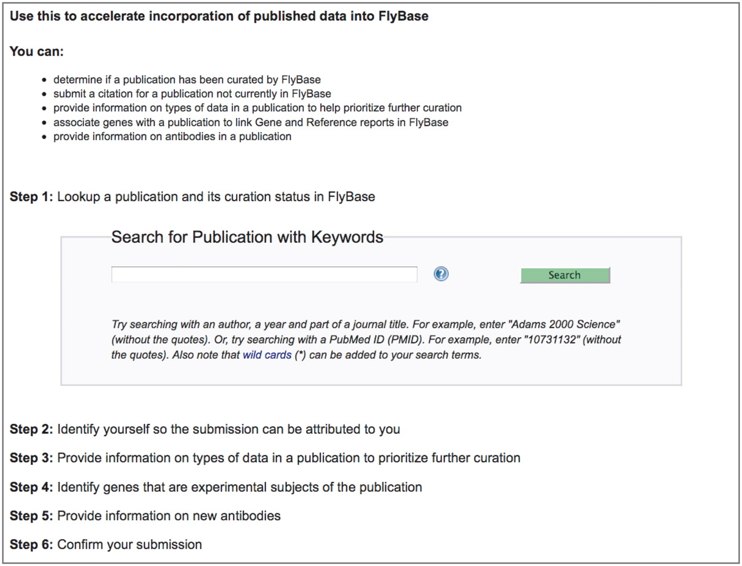
Figure 2. The Fast-Track Your Paper tool. The first page of the FTYP tool, listing the six steps that guide the user ...
Notes:
Figure 2. The Fast-Track Your Paper tool. The first page of the FTYP tool, listing the six steps that guide the user through the complete community curation process.
Unless provided in the caption above, the following copyright applies to the content of this slide: © The Author(s) 2012. Published by Oxford University Press.This is an Open Access article distributed under the terms of the Creative Commons Attribution Non-Commercial License (http://creativecommons.org/licenses/by-nc/3.0), which permits unrestricted non-commercial use, distribution, and reproduction in any medium, provided the original work is properly cited.

Slide 3
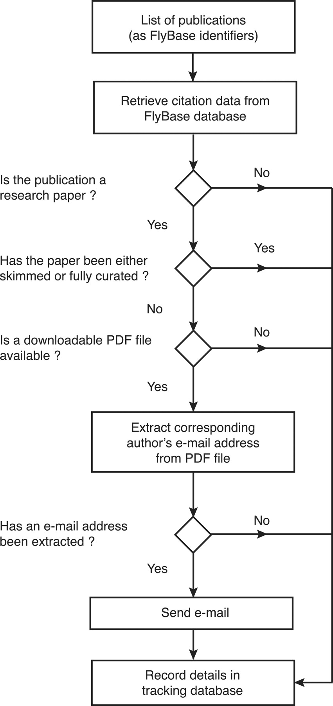
Figure 3. Workflow of the EmailAuthor software suite. For each publication, the software first checks its type and ...
Notes:
Figure 3. Workflow of the EmailAuthor software suite. For each publication, the software first checks its type and curation status using information stored in the FlyBase database. If it is a research paper that has not yet been triaged and a PDF file corresponding to the paper is available, the software attempts to extract the corresponding author’s e-mail address from the PDF file. If this is successful (97% of cases), an e-mail is sent to the extracted e-mail address. At each decision point, the information is stored in a tracking database.
Unless provided in the caption above, the following copyright applies to the content of this slide: © The Author(s) 2012. Published by Oxford University Press.This is an Open Access article distributed under the terms of the Creative Commons Attribution Non-Commercial License (http://creativecommons.org/licenses/by-nc/3.0), which permits unrestricted non-commercial use, distribution, and reproduction in any medium, provided the original work is properly cited.

Slide 4
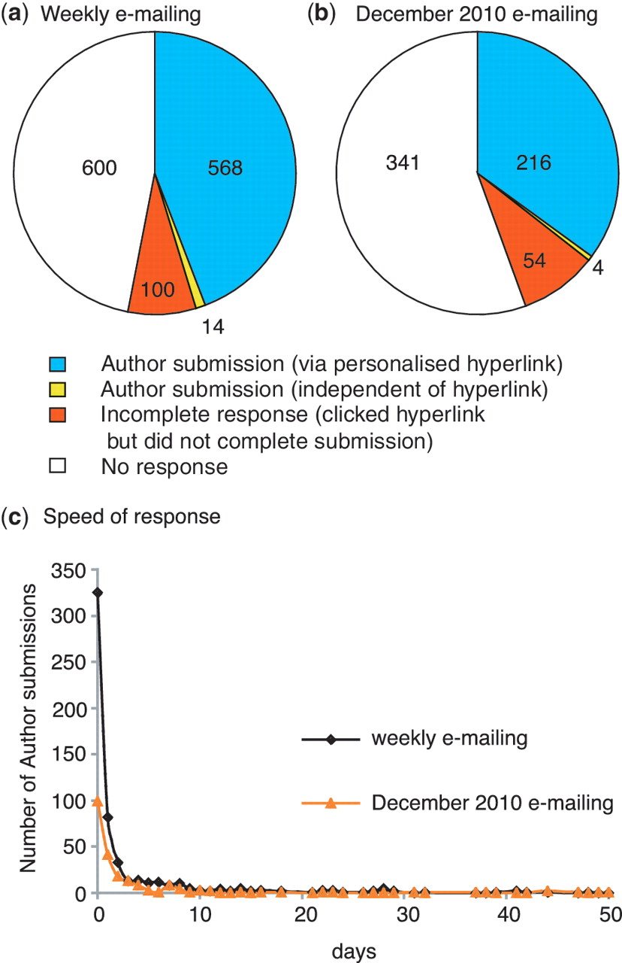
Figure 4. Author response to direct e-mailing. Overall response to (a) weekly e-mailing (corresponding author e-mailed ...
Notes:
Figure 4. Author response to direct e-mailing. Overall response to (a) weekly e-mailing (corresponding author e-mailed <2 weeks after the entry for the published paper appeared in PubMed) and (b) single e-mailing to authors of untriaged papers carried out in December 2010 (in this case a PubMed entry for the published paper had existed for 2–13 months prior to e-mailing the corresponding author). The number of papers in each category is shown. (c) Speed of author response: number of days between author being sent e-mail and completing the author submission.
Unless provided in the caption above, the following copyright applies to the content of this slide: © The Author(s) 2012. Published by Oxford University Press.This is an Open Access article distributed under the terms of the Creative Commons Attribution Non-Commercial License (http://creativecommons.org/licenses/by-nc/3.0), which permits unrestricted non-commercial use, distribution, and reproduction in any medium, provided the original work is properly cited.

Slide 5
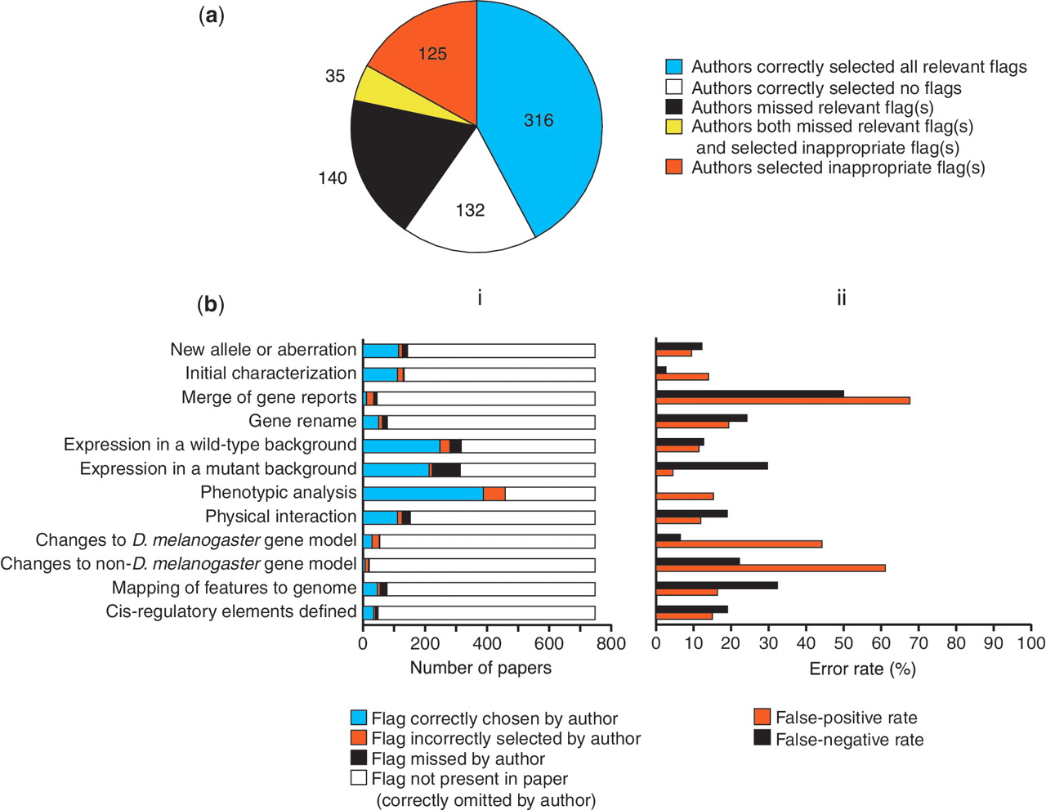
Figure 5. Accuracy of author-submitted data type flags. (a) Accuracy at the level of the whole paper. The number of ...
Notes:
Figure 5. Accuracy of author-submitted data type flags. (a) Accuracy at the level of the whole paper. The number of papers in each category is shown. (b) Accuracy on a flag-by-flag basis. (i) Frequency of occurrence and accuracy of selection of each data type flag. (ii) Error rates for selection of each data type flag.
Unless provided in the caption above, the following copyright applies to the content of this slide: © The Author(s) 2012. Published by Oxford University Press.This is an Open Access article distributed under the terms of the Creative Commons Attribution Non-Commercial License (http://creativecommons.org/licenses/by-nc/3.0), which permits unrestricted non-commercial use, distribution, and reproduction in any medium, provided the original work is properly cited.

Slide 6
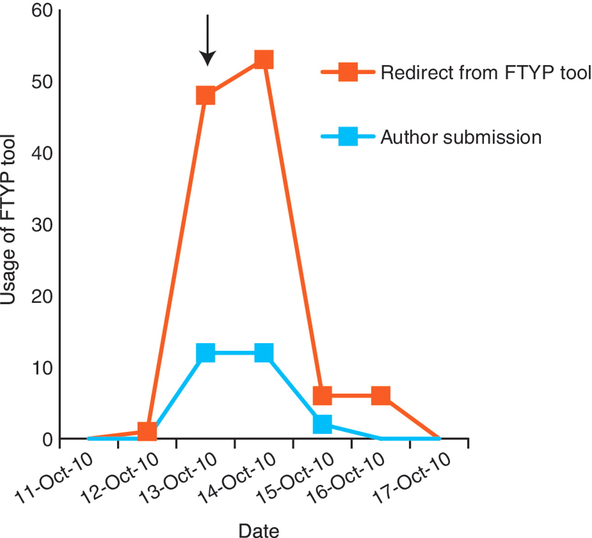
Figure 6. Community curation is most productive when authors are directed to a particular publication. A general e-mail ...
Notes:
Figure 6. Community curation is most productive when authors are directed to a particular publication. A general e-mail was sent to the Drosophila research community on 13 October 2010 (arrow), alerting them that we would be starting the weekly direct e-mailing the following week. This resulted in a small increase in successful author submissions, but resulted in a larger increase in unproductive redirects from the FTYP tool, where authors attempted to curate a paper that had already been skimmed or fully curated and were redirected to a page thanking them for their effort.
Unless provided in the caption above, the following copyright applies to the content of this slide: © The Author(s) 2012. Published by Oxford University Press.This is an Open Access article distributed under the terms of the Creative Commons Attribution Non-Commercial License (http://creativecommons.org/licenses/by-nc/3.0), which permits unrestricted non-commercial use, distribution, and reproduction in any medium, provided the original work is properly cited.

