Slide 1
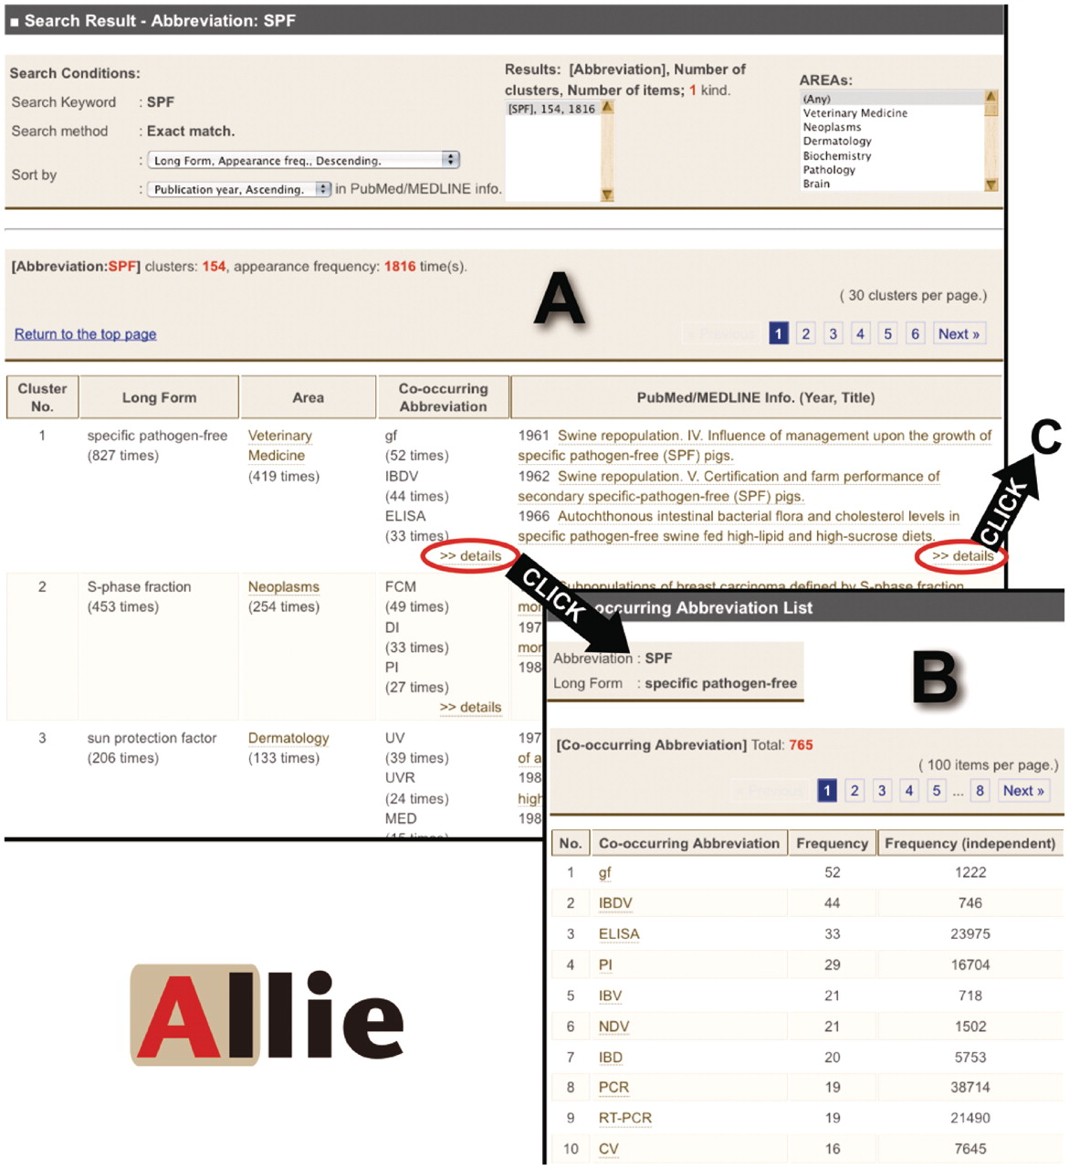
Figure 2. Images of Allie’s outputs. (A) Hit cluster-list page for the abbreviation ‘SPF’. By clicking links in the ...
Notes:
Figure 2. Images of Allie’s outputs. (A) Hit cluster-list page for the abbreviation ‘SPF’. By clicking links in the ‘Co-occurring Abbreviation’ or the ‘PubMed/MEDLINE Info.’ cells, the user can access these corresponding pages (A to B or A to C, respectively). (B) Co-occurring abbreviation page. Here, the user is provided with all the co-occurring abbreviations, and by clicking one of the listed abbreviations, one can access the hit cluster-list page. (C) PubMed/MEDLINE Information page. Here, the user is provided with all publication years, titles, and co-occurring abbreviations that appear in the titles or abstracts with the pair. Each title is anchor text that links to the corresponding PubMed page. By clicking one of the co-occurring abbreviations, the user can access the hit cluster-list page (C to D). (D) Hit cluster-list page for the abbreviation ‘BVD’.
Unless provided in the caption above, the following copyright applies to the content of this slide: © The Author(s) 2011. Published by Oxford University Press.This is Open Access article distributed under the terms of the Creative Commons Attribution Non-Commercial License (http://creativecommons.org/licenses/by-nc/2.5), which permits unrestricted non-commercial use, distribution, and reproduction in any medium, provided the original work is properly cited.

