Slide 1
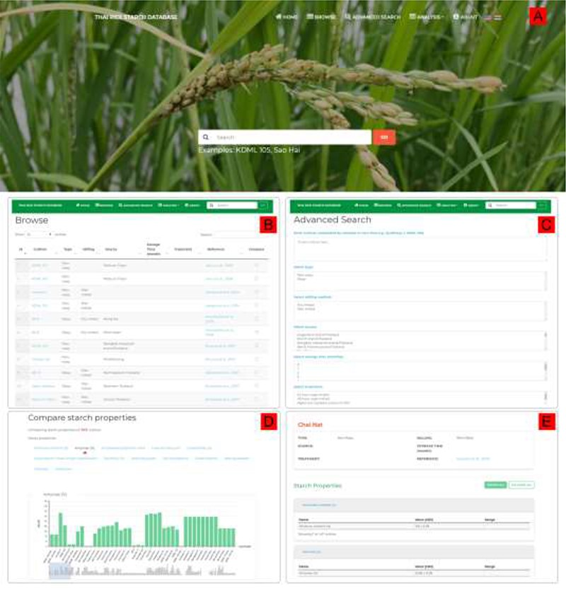
Figure 2. ThRSDB web interface. (A) Homepage with the top navigation menu and the Search form. The flag icons are for ...
Notes:
Figure 2. ThRSDB web interface. (A) Homepage with the top navigation menu and the Search form. The flag icons are for switching between English and Thai version. (B) Browse page. The Search box is provided on the top menu of every page except the homepage. (C) Advanced Search page. (D) A bar chart comparing the percentage amylose between cultivars. Other starch properties are listed, which can be selected to display the corresponding chart. (E) The page presenting detailed information on a selected cultivar.
Unless provided in the caption above, the following copyright applies to the content of this slide: © The Author(s) 2020. Published by Oxford University Press.This is an Open Access article distributed under the terms of the Creative Commons Attribution License (http://creativecommons.org/licenses/by/4.0/), which permits unrestricted reuse, distribution, and reproduction in any medium, provided the original work is properly cited.

