Slide 1
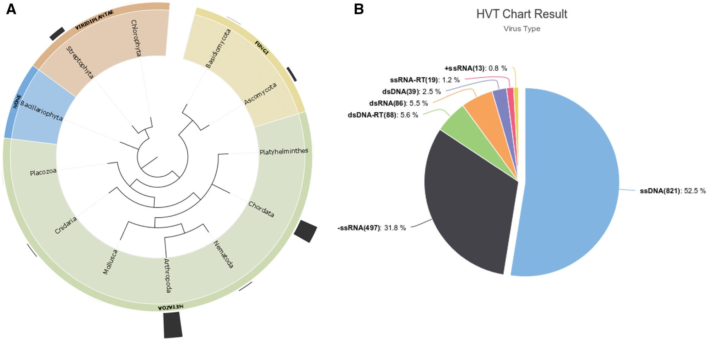
Figure 1. (A) Distribution of HVT events (endogenization) across different Phylum, outermost bars represent the number ...
Notes:
Figure 1. (A) Distribution of HVT events (endogenization) across different Phylum, outermost bars represent the number of HVT cases in the taxa shown. (B) HVT chart result from database search including all cases reported in the database, ssDNAs >50% of all known HVT events.
Unless provided in the caption above, the following copyright applies to the content of this slide: © The Author(s) 2018. Published by Oxford University Press.This is an Open Access article distributed under the terms of the Creative Commons Attribution License (http://creativecommons.org/licenses/by/4.0/), which permits unrestricted reuse, distribution, and reproduction in any medium, provided the original work is properly cited.

