Slide 1
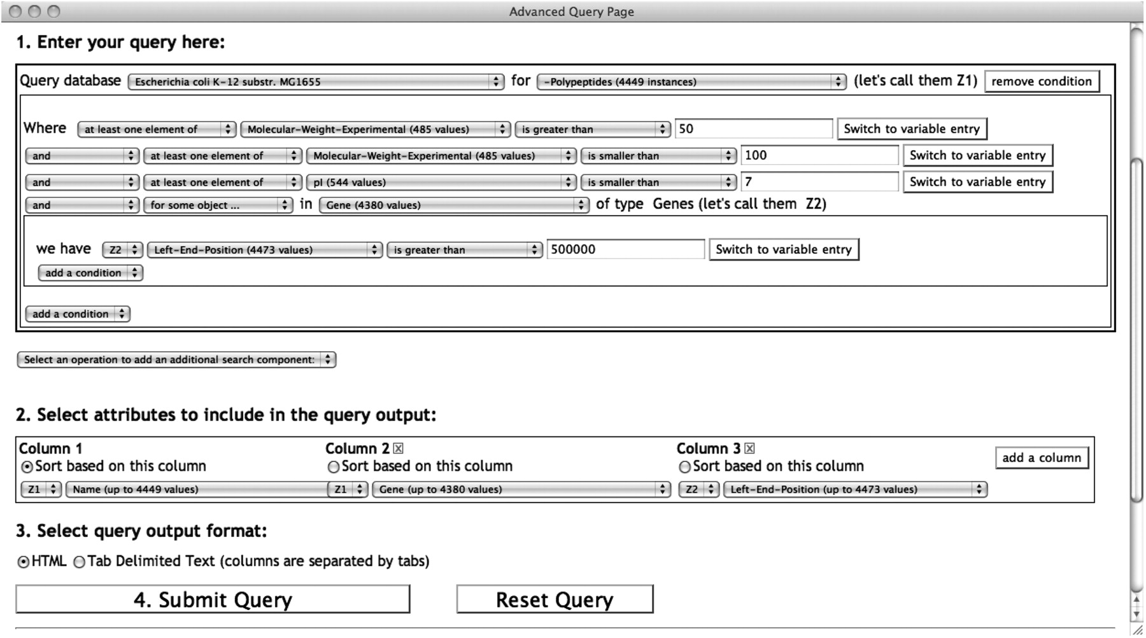
Figure 2. A SAQP query searching for EcoCyc (Escherichia coli) polypeptides constrained by experimentally determined ...
Notes:
Figure 2. A SAQP query searching for EcoCyc (Escherichia coli) polypeptides constrained by experimentally determined molecular weight, isoelectric point and their genes. A three-column output table is specified containing the polypeptide name, gene name producing this polypeptide and the left-end-position of the gene on the genome. The atomic condition with a quantifier ‘for some object…’ retrieves only the polypeptides that are produced by genes located after the first 500 kb of the genome. Notice the use of two variables Z1 and Z2 in the query and in the output specification. The Z2 variable comes from the quantifier applied to the genes, whereas the Z1 variable comes from the search component main search objects, the polypeptides.
Unless provided in the caption above, the following copyright applies to the content of this slide: © The Author(s) 2010. Published by Oxford University Press.This is Open Access article distributed under the terms of the Creative Commons Attribution Non-Commercial License (http://creativecommons.org/licenses/by-nc/2.5), which permits unrestricted non-commercial use, distribution, and reproduction in any medium, provided the original work is properly cited.

