Slide 1
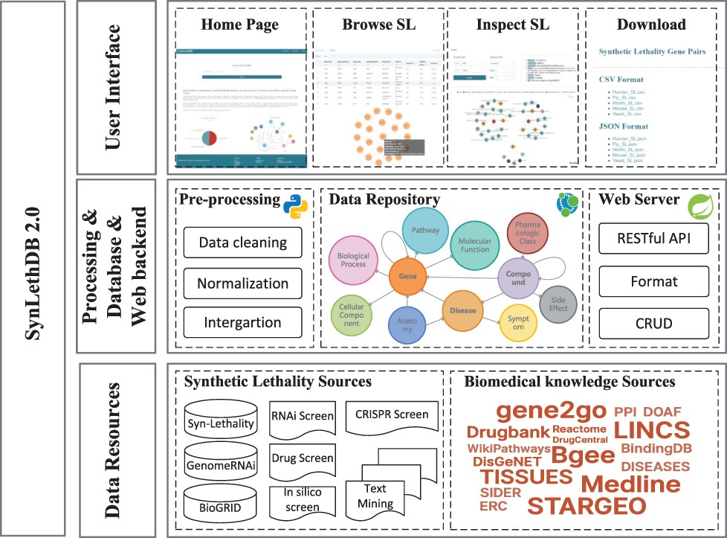
Figure 1. Architecture of SynLethDB 2.0. The bottom layer shows the data sources of SLs and other biomedical knowledge. ...
Notes:
Figure 1. Architecture of SynLethDB 2.0. The bottom layer shows the data sources of SLs and other biomedical knowledge. The middle layer shows the data preprocessing steps, database storage and web server. The top layer shows the main functional modules of the user interface.
Unless provided in the caption above, the following copyright applies to the content of this slide: © The Author(s) 2022. Published by Oxford University Press.This is an Open Access article distributed under the terms of the Creative Commons Attribution-NonCommercial License (https://creativecommons.org/licenses/by-nc/4.0/), which permits non-commercial re-use, distribution, and reproduction in any medium, provided the original work is properly cited. For commercial re-use, please contact journals.permissions@oup.com

