Slide 1
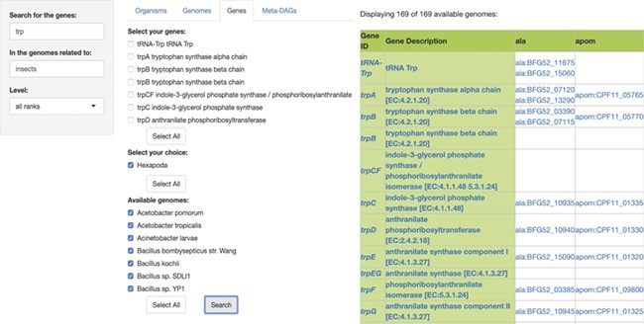
Figure 3 SymGen’s gene module. For this example, we searched for all the genes containing the letters ‘trp’ in the ...
Notes:
Figure 3 SymGen’s gene module. For this example, we searched for all the genes containing the letters ‘trp’ in the genomes of symbionts of insects. We selected all of the 169 available genomes. The resulting table is a list in a presence/absence format, where all the present genes are shown with their KEGG id and a link to their KEGG gene web page. The ‘Gene ID’ and the ‘Gene Description’ features are both linked to their KEGG orthology web page.
Unless provided in the caption above, the following copyright applies to the content of this slide: © The Author(s) 2020. Published by Oxford University Press.This is an Open Access article distributed under the terms of the Creative Commons Attribution License (http://creativecommons.org/licenses/by/4.0/), which permits unrestricted reuse, distribution, and reproduction in any medium, provided the original work is properly cited.

