Slide 1
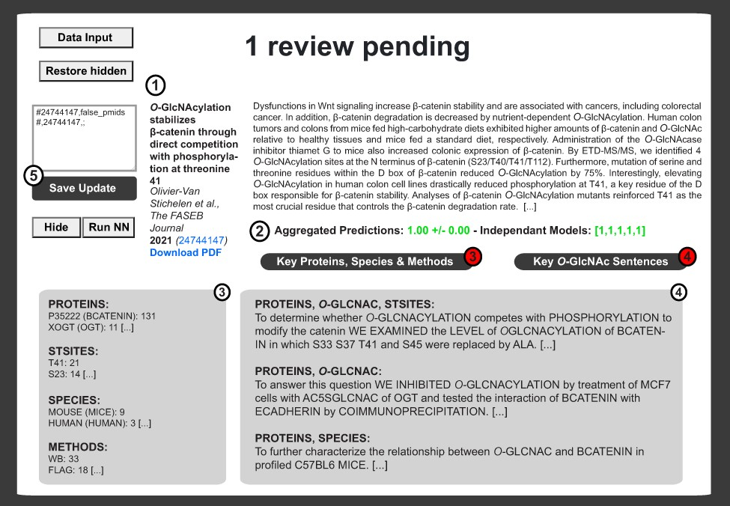
Figure 5. Example of literature report upon logistic binary classifier and automatization routines. The private ...
Notes:
Figure 5. Example of literature report upon logistic binary classifier and automatization routines. The private interface contains the literature item metadata (Authors, Title, Year, Journal, Volume, Issue, Abstract, PMID and PubMed Link) (1) as well as the prediction score from the neural network (2). Neural network decisions are presented for each model ((2) right brackets). Decisions are then average and binomial confidence interval is calculated ((2) left). In (3), extracted proteins, sites, species and methods are shown next to the number of iteration for each item. This information is complemented by sentences associated with combinations of tags relevant to O-GlcNAcylated proteins (4). An update window is available for rapid update of the master update file upon inspection of each publication (5).
Unless provided in the caption above, the following copyright applies to the content of this slide: © The Author(s) 2021. Published by Oxford University Press.This is an Open Access article distributed under the terms of the Creative Commons Attribution License (http://creativecommons.org/licenses/by/4.0/), which permits unrestricted reuse, distribution, and reproduction in any medium, provided the original work is properly cited.

