Slide 1
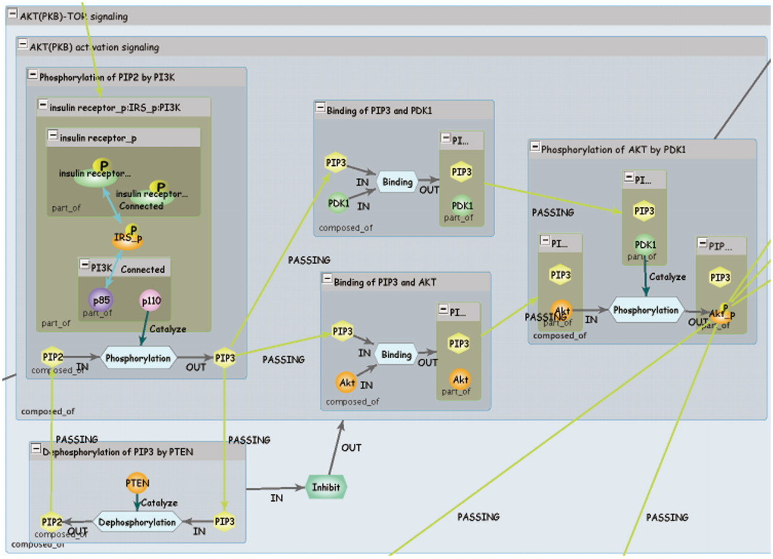
Figure 2. INOH pathway. Each blue window represents event of different granularity, and green window represents ...
Notes:
Figure 2. INOH pathway. Each blue window represents event of different granularity, and green window represents molecular complex. Light blue hexagons are Process nodes that show molecular interactions, and green hexagon is EventRelation node that shows positive/negative indirect relation between events.
Unless provided in the caption above, the following copyright applies to the content of this slide: © The Author(s) 2011. Published by Oxford University Press.This is an Open Access article distributed under the terms of the Creative Commons Attribution Non-Commercial License (http://creativecommons.org/licenses/by-nc/3.0), which permits unrestricted non-commercial use, distribution, and reproduction in any medium, provided the original work is properly cited.

