Slide 1
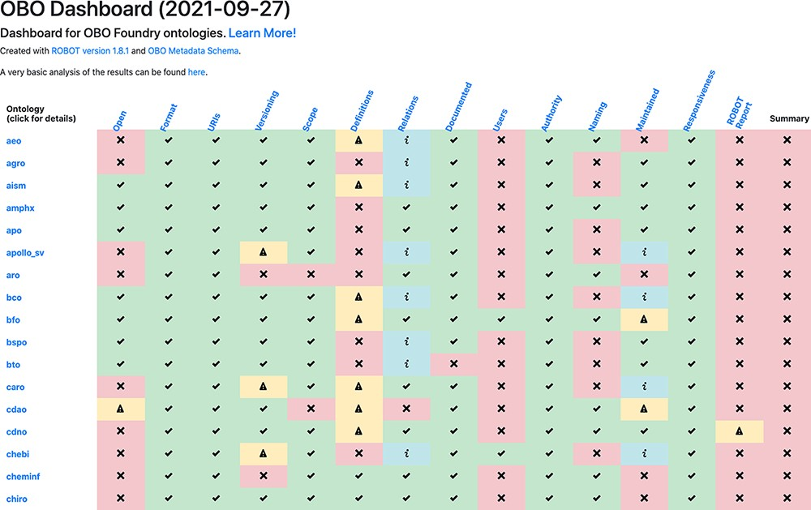
Figure 2. The OBO dashboard (truncated). The rows represent OBO ontologies (of which the first 15 in alphabetical order ...
Notes:
Figure 2. The OBO dashboard (truncated). The rows represent OBO ontologies (of which the first 15 in alphabetical order are shown here) and the columns are the OBO principles. The final column, ‘Summary’, shows whether the ontology passed all of the tests. Clicking on the ontology ID in the far left column directs to a detailed report page.
Unless provided in the caption above, the following copyright applies to the content of this slide: © The Author(s) 2021. Published by Oxford University Press.This is an Open Access article distributed under the terms of the Creative Commons Attribution License (https://creativecommons.org/licenses/by/4.0/), which permits unrestricted reuse, distribution, and reproduction in any medium, provided the original work is properly cited.

