Slide 1
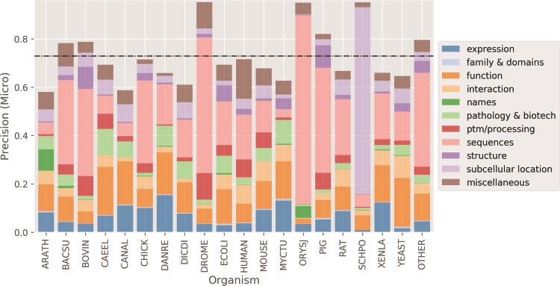
Figure 7 Micro average precision performance per organism. Higher precision for organisms happens when there is a ...
Notes:
Figure 7 Micro average precision performance per organism. Higher precision for organisms happens when there is a concentration of categories. Black dashed horizontal line: mean organism precision.
Unless provided in the caption above, the following copyright applies to the content of this slide: © The Author(s) 2020. Published by Oxford University Press.This is an Open Access article distributed under the terms of the Creative Commons Attribution License (http://creativecommons.org/licenses/by/4.0/), which permits unrestricted reuse, distribution, and reproduction in any medium, provided the original work is properly cited.

