Slide 1
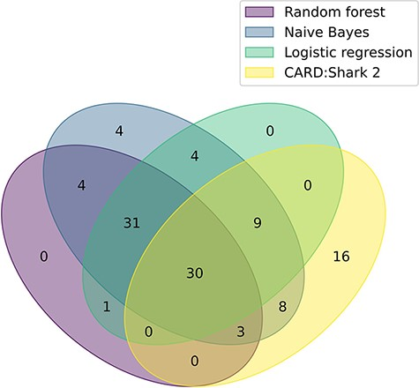
Figure 2. A Venn diagram illustrating the overlap of each model’s positive paper predictions that were ultimately ...
Notes:
Figure 2. A Venn diagram illustrating the overlap of each model’s positive paper predictions that were ultimately curated into CARD. The plot based on data from Table 3. For CARD*Shark 2, both high- and low-level predictions are included.
Unless provided in the caption above, the following copyright applies to the content of this slide: © The Author(s) 2023. Published by Oxford University Press.This is an Open Access article distributed under the terms of the Creative Commons Attribution License (https://creativecommons.org/licenses/by/4.0/), which permits unrestricted reuse, distribution, and reproduction in any medium, provided the original work is properly cited.

