Slide 1
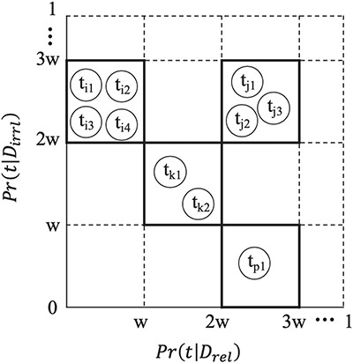
Figure 2 Feature Binning. To bin a set of terms, we first partition the continuous probability interval [0,1] into ...
Notes:
Figure 2 Feature Binning. To bin a set of terms, we first partition the continuous probability interval [0,1] into equal-spaced sub-intervals, each of width w. Two terms ${\mathrm{t}}_{\mathrm{p}}$ and ${\mathrm{t}}_{\mathrm{q}}$ are grouped into one bin if and only if the probability $Pr ({\mathrm{t}}_{\mathrm{p}}|{\mathrm{D}}_{r\mathrm{el}})$ falls into the same probability sub-interval as $P\mathrm{r}({t}_q|{D}_{r\mathrm{el}})$, and $P\mathrm{r}({t}_p|{D}_{i\mathrm{rrl}})$falls into the same probability sub-interval as $P\mathrm{r}({t}_q|{D}_{i\mathrm{rrl}})$.
Unless provided in the caption above, the following copyright applies to the content of this slide: © The Author(s) 2019. Published by Oxford University Press.This is an Open Access article distributed under the terms of the Creative Commons Attribution License (http://creativecommons.org/licenses/by/4.0/), which permits unrestricted reuse, distribution, and reproduction in any medium, provided the original work is properly cited.

