Slide 1
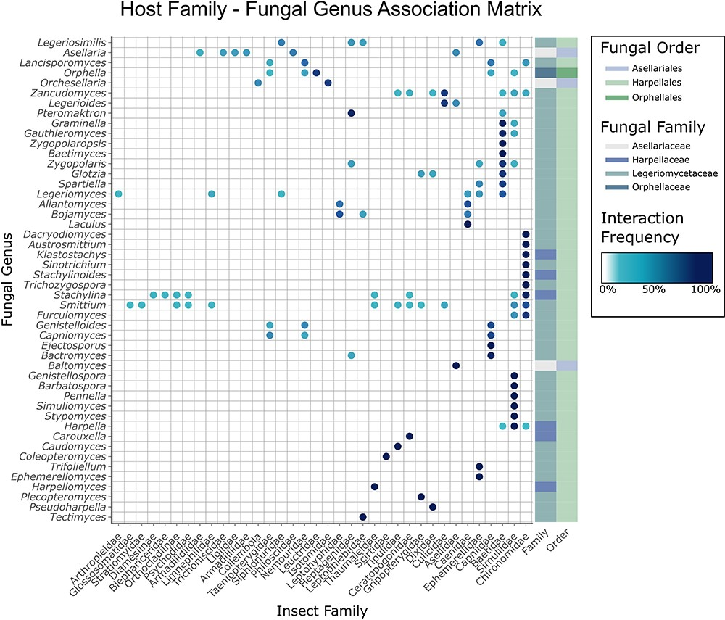
Figure 5. Matrix of trichomycetes–insect interactions generated using the CIGAF web application. Insect hosts at the ...
Notes:
Figure 5. Matrix of trichomycetes–insect interactions generated using the CIGAF web application. Insect hosts at the family level are shown along the x-axis, and fungal genera are shown along the y-axis. The darker the dot at any row–column intersection, the higher the prevalence (number of records containing the indicated trichomycetes–insect interaction). Fungal genera (rows) are clustered by interaction pattern similarity such that genera with similar interaction patterns are next to each other. Insect hosts are ordered alphabetically. The rectangle array at the end of each row indicates the fungal family and fungal order to which the corresponding fungal genus belongs.
Unless provided in the caption above, the following copyright applies to the content of this slide: © The Author(s) 2023. Published by Oxford University Press.This is an Open Access article distributed under the terms of the Creative Commons Attribution License (https://creativecommons.org/licenses/by/4.0/), which permits unrestricted reuse, distribution, and reproduction in any medium, provided the original work is properly cited.

