Slide 1
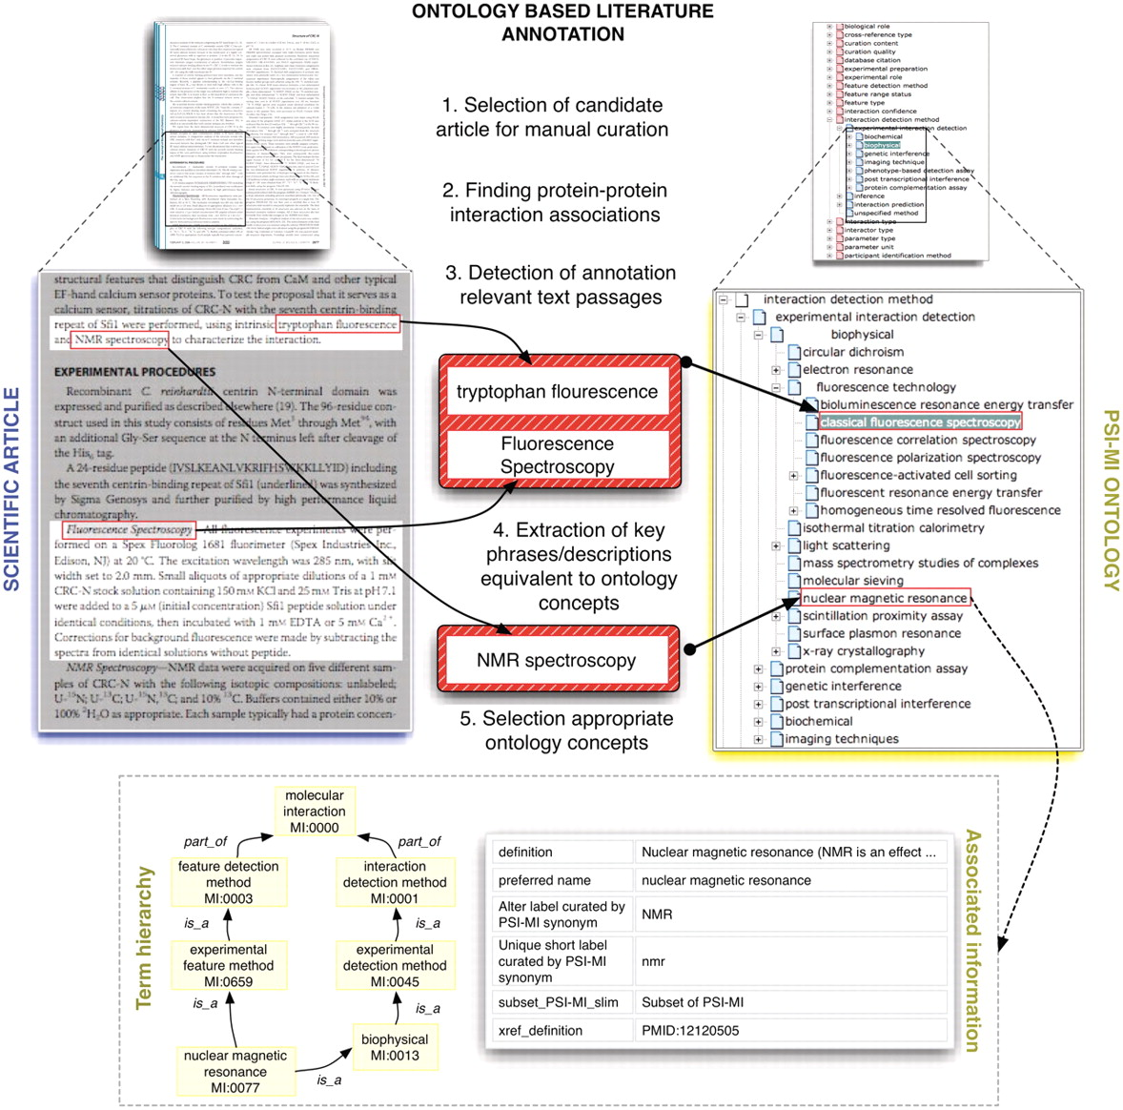
Figure 1. This figure shows schematically how protein interaction data is annotated and/or marked up using ontologies. ...
Notes:
Figure 1. This figure shows schematically how protein interaction data is annotated and/or marked up using ontologies. Systems such as MyMiner (myminer.armi.monash.edu.au/links.php), have been used for text labeling and highlighting purposes in the context of the BioCreative competition. The main steps illustrated in this figure have been addressed in the BioCreative challenges. Finding associations between textual expressions referring to experimental techniques used to characterize protein interactions and their equivalent concepts in the MI ontology is cumbersome in some cases when deep domain inference is required. Experienced curators are able to quickly navigate the term hierarchy to find the appropriate terms while novice annotators often need to search the ontology using method keywords as queries and consult associated descriptive information for potential candidate terms.
Unless provided in the caption above, the following copyright applies to the content of this slide: © The Author(s) 2012. Published by Oxford University Press.This is an Open Access article distributed under the terms of the Creative Commons Attribution Non-Commercial License (http://creativecommons.org/licenses/by-nc/3.0), which permits unrestricted non-commercial use, distribution, and reproduction in any medium, provided the original work is properly cited.

Slide 2
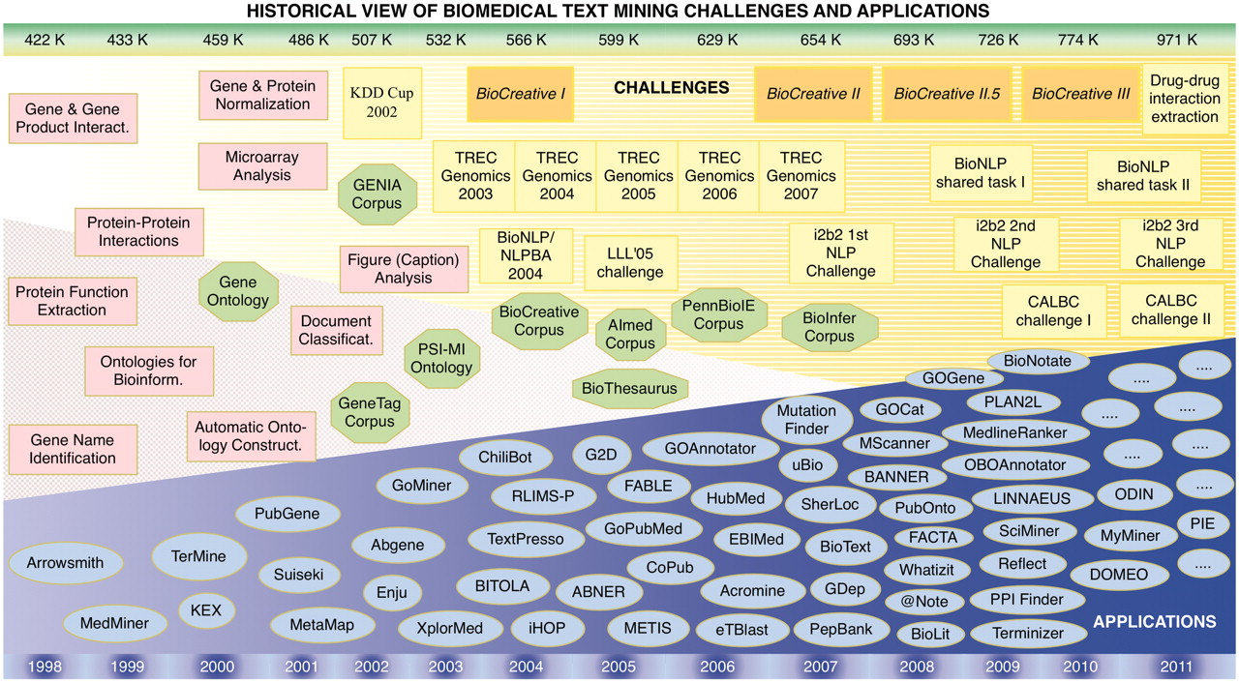
Figure 2. Historical view and timeline of the BioCreative challenges in the context of other community efforts, textual ...
Notes:
Figure 2. Historical view and timeline of the BioCreative challenges in the context of other community efforts, textual resources (corpora) and applications developed in the area of biomedical text mining. The upper bar shows the number of new records added to PubMed each year, expressed in thousands (K). The lower bar refers to the corresponding year timeline. Pink squares, appearance of biomedical text mining methods; green octagons, relevant ontologies, lexical resources and corpora; yellow boxes, community challenges; blue ovals, biomedical text mining applications.
Unless provided in the caption above, the following copyright applies to the content of this slide: © The Author(s) 2012. Published by Oxford University Press.This is an Open Access article distributed under the terms of the Creative Commons Attribution Non-Commercial License (http://creativecommons.org/licenses/by-nc/3.0), which permits unrestricted non-commercial use, distribution, and reproduction in any medium, provided the original work is properly cited.

Slide 3
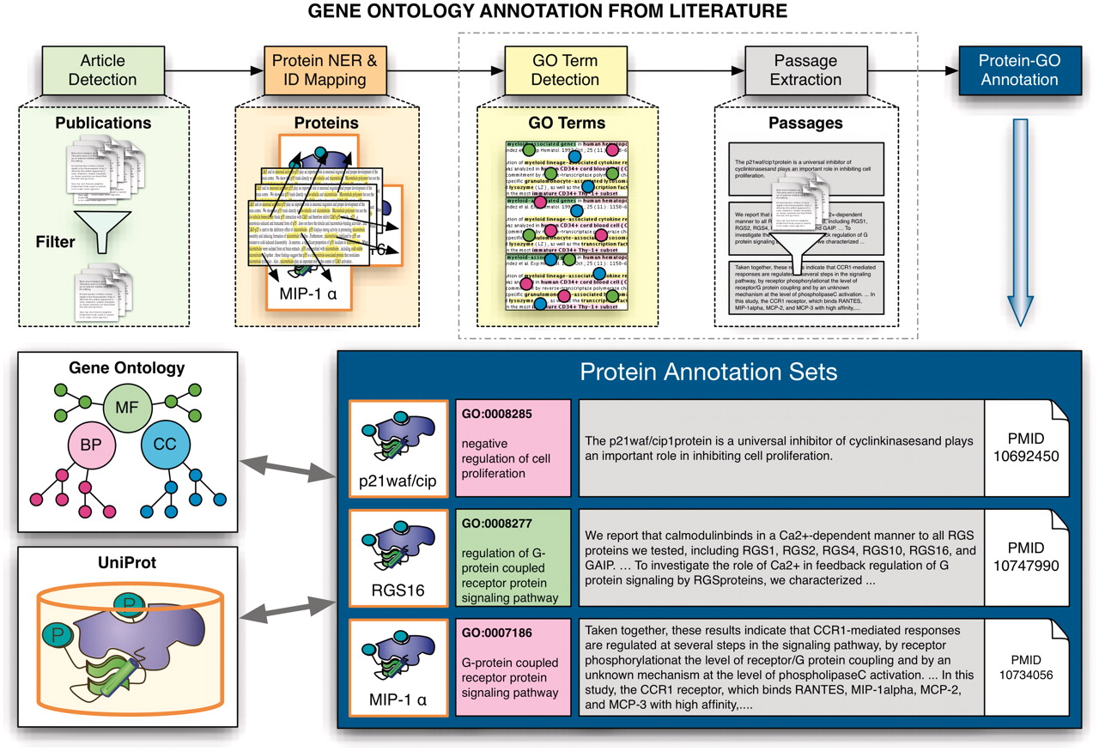
Figure 3. Schematic overview of the extraction of GO annotations from the literature. The process illustrates the ...
Notes:
Figure 3. Schematic overview of the extraction of GO annotations from the literature. The process illustrates the individual steps of the annotation process, covering the initial selection of relevant documents for GO annotation of proteins, identification of proteins and their corresponding database identifiers followed by the extraction of associations to GO terms and the retrieval of evidence sentences/passages. The participating teams had to provide the evidence passages for a given document–protein–GO term triplet for one subtask, and to actually detect GO–protein associations (together with evidence passages) for the other subtask.
Unless provided in the caption above, the following copyright applies to the content of this slide: © The Author(s) 2012. Published by Oxford University Press.This is an Open Access article distributed under the terms of the Creative Commons Attribution Non-Commercial License (http://creativecommons.org/licenses/by-nc/3.0), which permits unrestricted non-commercial use, distribution, and reproduction in any medium, provided the original work is properly cited.

Slide 4
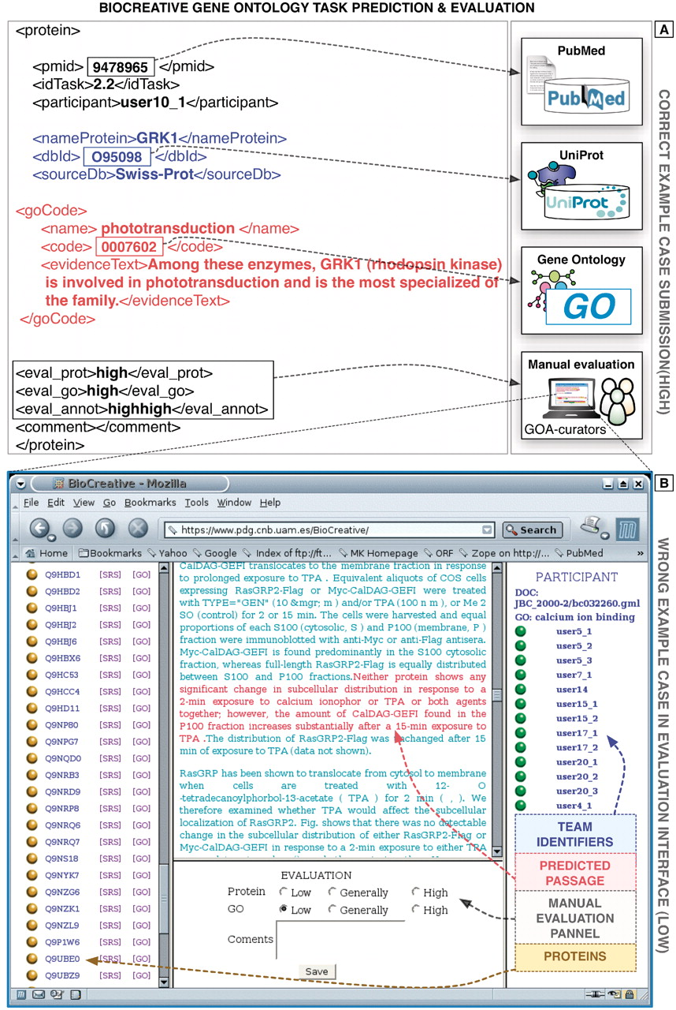
Figure 4. Example predictions of the GO task of BioCreative I. (A) Here a correct prediction is shown, containing the ...
Notes:
Figure 4. Example predictions of the GO task of BioCreative I. (A) Here a correct prediction is shown, containing the information on the corresponding document, protein and GO term as well as the supporting evidence text passages extracted automatically from the full-text article. (B) Example prediction (wrong) showing a screen shot of the original evaluation interface developed at the time for this task (based on Apache/PHP). The original evaluation application is not functional anymore and was implemented specifically for this task. Proteins and GO terms were defined unambiguously through corresponding standard identifiers. The database curators manually evaluated both the correctness of the protein as well as the GO terms.
Unless provided in the caption above, the following copyright applies to the content of this slide: © The Author(s) 2012. Published by Oxford University Press.This is an Open Access article distributed under the terms of the Creative Commons Attribution Non-Commercial License (http://creativecommons.org/licenses/by-nc/3.0), which permits unrestricted non-commercial use, distribution, and reproduction in any medium, provided the original work is properly cited.

Slide 5
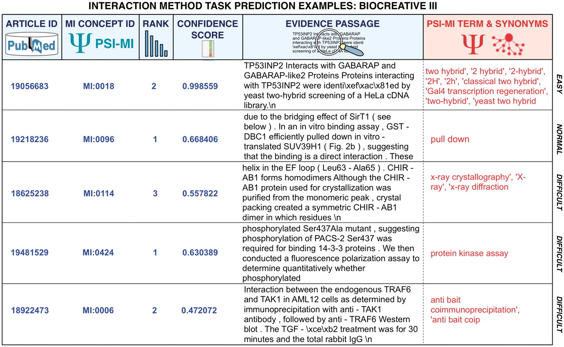
Figure 5. Representative predictions submitted for the MI task of BioCreative III of diverse degrees of difficulty for ...
Notes:
Figure 5. Representative predictions submitted for the MI task of BioCreative III of diverse degrees of difficulty for automated systems. The examples correspond to submissions from various teams. Participating teams had to return the article identifier, the concept identifier for the interaction detection method according to the MI ontology, a rank, a confidence score as well as a supporting text evidence passages extracted from the full-text article. Submissions were plain text files where each field was separated using a tabulator. This figure provides colored highlights of original predictions to better grasp the output. In red, the original term from the MI ontology and its synonyms have been added to facilitate the interpretation of the results. As can be seen some cases are rather straightforward, and could be detected by direct term lookup, while others require generating lexical variants or even more sophisticated machine learning and statistical word analysis.
Unless provided in the caption above, the following copyright applies to the content of this slide: © The Author(s) 2012. Published by Oxford University Press.This is an Open Access article distributed under the terms of the Creative Commons Attribution Non-Commercial License (http://creativecommons.org/licenses/by-nc/3.0), which permits unrestricted non-commercial use, distribution, and reproduction in any medium, provided the original work is properly cited.

